Slide 1


Online Safety
A Guide for Parents
Danny Nicholson
CEOP Ambassador
Think Bank Education and Training
www.think-bank.com/parents

Slide 2
















What does your child love doing online? What apps/games/sites and devices do they use?
The online world can be exciting. It has lots of opportunities to offer young people. However it’s important to manage and minimise the associated risks

Slide 3
What is Online safety?
Conduct: online behaviour
Content: access to inappropriate or unreliable content
Contact: interaction with unsuitable, unpleasant or dangerous people
Commercialism: use of platforms with hidden costs. In app purchases, in-game items etc.
Notes:
Being aware of possible threats that online activity can bring, and how to deal with them.
Conduct: children’s behaviour may put them at risk
Content: access to inappropriate or unreliable content may put children at risk
Contact: interaction with unsuitable, unpleasant or dangerous people may put children at risk
Commercialism: children’s use of platforms with hidden costs may put them at risk. In app purchases, in-game items etc.

Slide 4



Social Media
Notes:
Websites and apps that allow the creation or sharing of social information
Promote creation and sharing of content
Join people up into social networks
Keep in touch with friends, connect with new people, share photos and videos
Over 13’s

Slide 5

Social Media Risks
Notes:
Potential risks include
Seeing inappropriate or harmful content
Sharing private or personal information
Misinformation
Inappropriate contact with other young people or adults
The promotion of harmful or illegal behaviour or conduct
Extreme views – extreme right wing / conspirary theories
Sharing location information
Digital footprint

Slide 6
Notes:
Image collectors – no longer have to hang around near bus stops with cameras
Can sit at home, browse social media and download pictures of young teens
These are then shared on private servers to other pedophiles
Easy for young girls to get 1000 followers if they promise to go live – one paedophile will share to friends, many followers quickly

Slide 7

Instagram and Body Image
Notes:
Facebook’s own research shows that they are aware Instagram is harming teenagers.
Makes body image issues worse for 1 in 3 teen girls.
1 in 5 teens says that Instagram makes them feel worse about themselves.
Of teens with suicidal thoughts, 13% said the desire came from Instagram
The “explore” page algorithm pushes more of the same images you’ve been looking at, so you’re encouraged to spend longer on the platform
Start looking at “weight loss” images and you’ll be bombarded with many more of the same image
Can push teens toward eating disorders, an unhealthy sense of their own bodies and depression
https://www.cnbc.com/2021/09/14/facebook-documents-show-how-toxic-instagram-is-for-teens-wsj.html
https://archive.is/egPlc

Slide 8
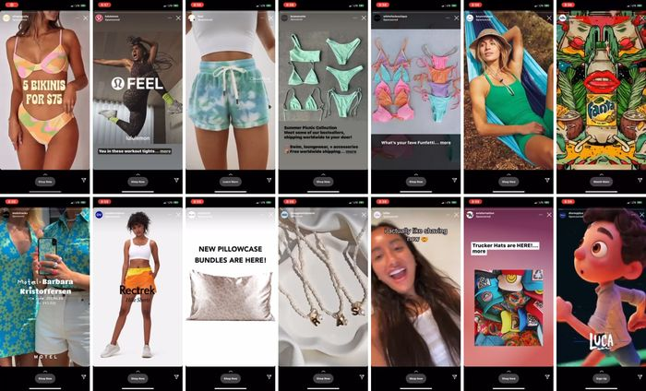
“Lindsay Dubin found that in two minutes of watching Instagram stories, she saw 33 stories of accounts she follows as well as these 14 ads, many of which were focused on physical appearances.” (Wall St Journal)
Notes:
https://www.wsj.com/articles/facebook-knows-instagram-is-toxic-for-teen-girls-company-documents-show-11631620739

Slide 9
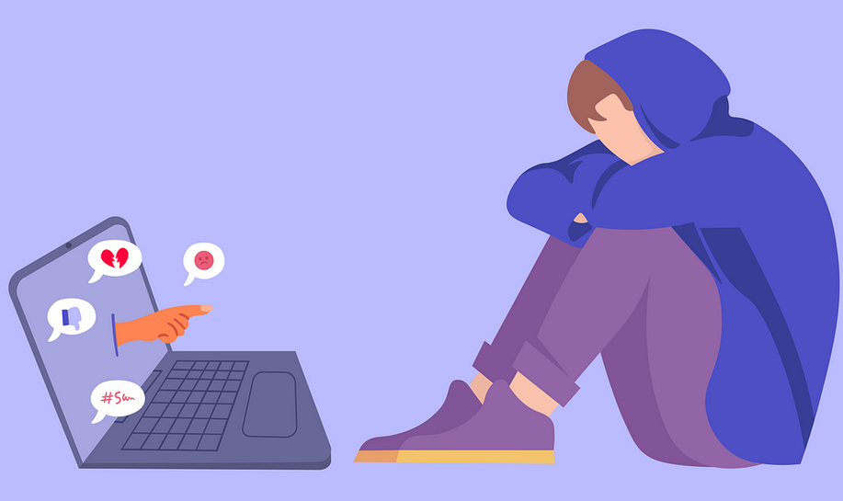
Online Bullying
Notes:
Bullying can take place online or using technology. It is important that children know what to do if they or their friends are victims of online bullying.
Online bullying can happen in many different ways including unkind messages or comments, the sharing of embarrassing photos or exclusion from group chats
Children need to understand that their online actions can be just as hurtful as offline actions and that seeking to deliberately hurt or upset someone is always unacceptable.

Slide 10
Advice on Bullying
Discuss bullying with your child. Teach importance of online respect. Make them know they can talk to you.
If they are a victim of bullying
  Save the evidence
  Report to the school (or the police)
  Use online tools to report and block the perpetrator
  Don’t deny them access to a device or site. They may feel punished when they’re already the victim
  Don’t retaliate

Slide 11

Grooming
Notes:
An offender will build up a relationship with a child online
Can take place over minutes, or years
Offender may pretend to be another child (or multiple children)
Offender may be able to make use of personal information the child or their friends has shared online – school/clubs/interests etc.
May reward them with in-game items: Robucks /V-bucks / Skins
Aim is to exploit children in two ways
Online sexual abuse – tricked or coerced into sexual activity over chat, video or photos
Physical meeting in order to abuse them

Slide 12

Notes:
Group Messaging / Chat /Voip App
Predator will aim to move a child out of a game/social media site and onto a private Discord server.
Unfiltered/unmoderated
Often goal is to get the child to send them an image. Any image from your phone is geotagged, and very easy to get location from.
Discord itself is not a banned site – but it’s full of lots of different servers – with different levels of security and moderation

Slide 13



Live Streaming/Chat
The risks
Exposure to age inappropriate content, including sexual or violent content, nudity
Negative or inappropriate comments
Acting on impulse, and saying or doing something they’d be less likely to do offline
Inappropriate contact
Notes:
What are the risks?
•Content. Children could be exposed to age inappropriate content, including sexual or violent content.
•Offensive comments. If the live stream is public, viewers may be able to leave negative or inappropriate comments.
•Live streaming is ‘in the moment’. This increases the risk of children and young people acting on impulse, and saying or doing something they’d be less likely to do offline.
•Inappropriate contact. People seeking to harm children may attempt to trick them into engaging in sexual activity, flatter them with positive comments or gifts, or make threats to try to force them to do things they don’t want to do.

Slide 14
Live Streaming
What can you do?
Talk to them – have an ongoing conversation as part of your family life.
Use devices in communal spaces.
Go through privacy, filtering and safety settings.
Be wary of requests to chat in private.
Know where to get support and how to report and block.
www.thinkuknow.co.uk/parents/articles/what-is-live-streaming
Notes:
Talk to them. The best way you can protect your child is to talk with them about online life. And not just once: make this an ongoing conversation as part of your family life.
Use devices in public spaces. Younger children should be closely supervised by an adult and live streaming should not take place in a private space, like the bedroom or bathroom.
Privacy and safety settings. Go through the privacy and safety settings together with your child. Make sure only trusted friends and family they know offline can view their online profiles and videos.
Be wary of requests to chat in private. Remind your child to be wary of people they meet online who want to chat to them in private, away from other people.
Support and Reporting. It’s really important that your child knows how to get support. Remind them that they can always speak to you or another adult they trust if they have any worries. Talk to them about how to report to social media platforms or CEOP if they're concerned about contact from an adult.
(Note – a specific Live Streaming presentation for parents/carers can be downloaded from www.thinkuknow.co.uk/professionals/resources/live-streaming)

Slide 15
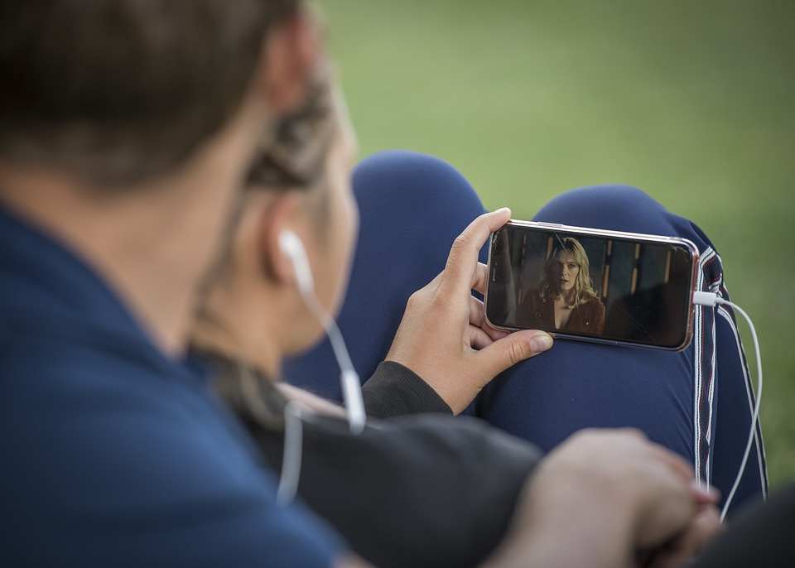
Online videos.
Notes:
The risks
Inappropriate content. They may, see something not intended for them – extreme animal cruelty, suicide, sexual content
They can be exposed to unsuitable videos through a link they’ve found or been sent, or an app they’ve downloaded
They are curious and they may go looking for content
Imitating the things they see. Dangerous stunts etc.
Some are intended to get children to show their bodies off (headstand challenge)
The risks mainly focus on viewing inappropriate content.
What is inappropriate video content? An inappropriate video is anything that worries, scares or upsets your child. It could be aimed at adults and include sexual images or show violent behaviour. Or it might encourage crime, terrorism, eating disorders or suicide and self harm.
How could your child see inappropriate content?
If your child is watching videos online, whether it’s on a streaming service, YouTube or through another platform, they may, accidently, see something not intended for them.
Sometimes, children can be exposed to unsuitable videos through a link they’ve found or been sent, or an app they’ve downloaded.
Sometimes children are curious and they may go looking for content.

Slide 16
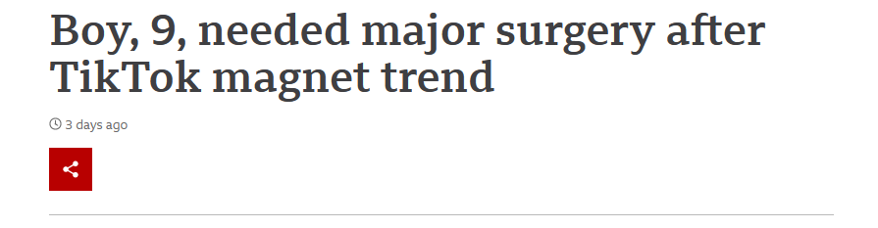
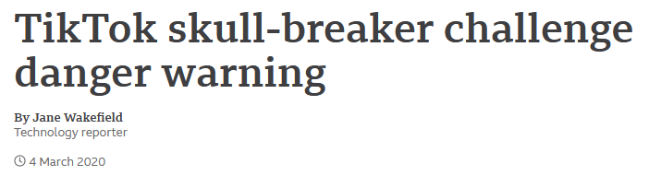
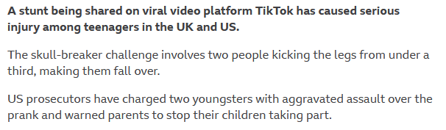



Notes:
https://www.bbc.co.uk/news/uk-scotland-tayside-central-58565720
https://www.bbc.co.uk/news/technology-51742854
https://www.independent.co.uk/life-style/doctors-warning-milk-crate-challenge-injury-b1909030.html
https://www.newsweek.com/teen-girl-severely-burned-after-trying-tiktok-challenge-faces-months-hospital-1596162

Slide 17
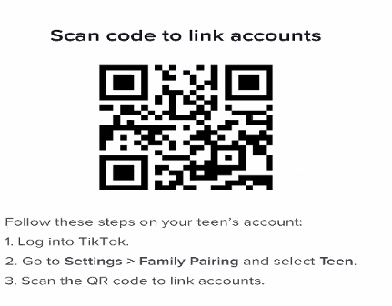
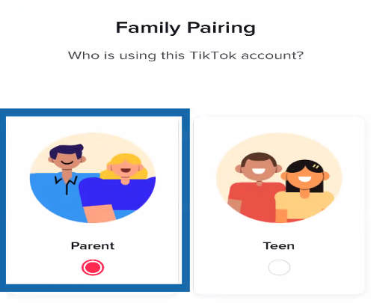
TikTok Advice
Use Family Pairing
TikTok on parents phone linked to TikTok on teen’s phone
Set time limits
Can see their viewing history
Discuss boundaries and expectations

Slide 18


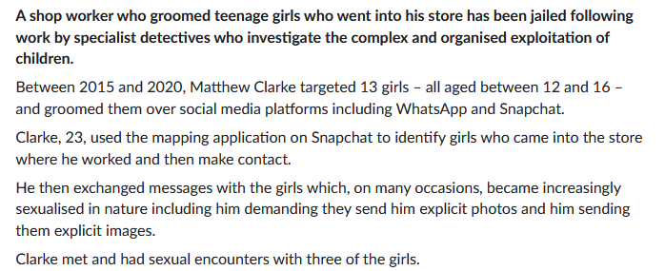
“used the mapping application on Snapchat to identify girls who came into the store where he worked and then make contact.”
Notes:
A shop worker who groomed teenage girls who went into his store has been jailed following work by specialist detectives who investigate the complex and organised exploitation of children.
Between 2015 and 2020, Matthew Clarke targeted 13 girls – all aged between 12 and 16 – and groomed them over social media platforms including WhatsApp and Snapchat.
Clarke, 23, from #Colchester, used the mapping application on Snapchat to identify girls who came into the store where he worked and then make contact.
He then exchanged messages with the girls which, on many occasions, became increasingly sexualised in nature including him demanding they send him explicit photos and him sending them explicit images.
Clarke met and had sexual encounters with three of the girls.
https://www.essex.police.uk/news/essex/news/brought-to-justice/2021/september/colchester-shop-working-who-groomed-girls-jailed/

Slide 19
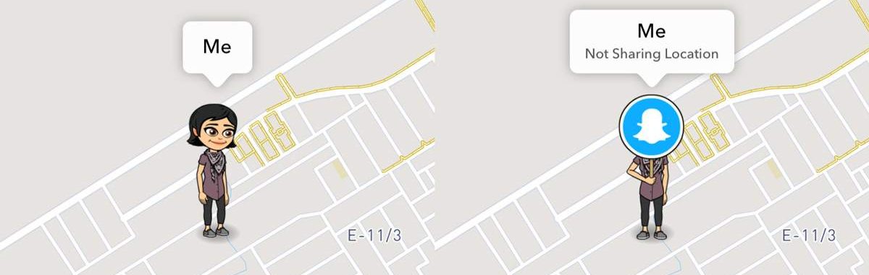
Snapchat
Make sure it’s used in Ghost Mode
Settings -> Turn on Ghost Mode -> Duration: Until turned off
Notes:
Make sure it’s used in Ghost Mode
Stops real-time sharing of their location
Settings -> Turn on Ghost Mode -> Duration: Until turned off
Install on your phone and add them as a friend.
If you can see their location, they’re not in Ghost Mode….

Slide 20
“Self-generated” imagery
1 in 8 secondary school children had been sent a naked or semi-naked image by another young person
1 teen in 20 had been sent a naked or semi-naked image online by an adult
Children can be coerced into sending images to a close friend, unaware of where that image may end up.
44% of child sex abuse content is self-generated where children have been coerced into sending images of themselves.
Source : NSPCC/LGFL Digisafe/IWF
Notes:
https://www.nspcc.org.uk/globalassets/documents/online-safety/children-sending-receiving-sexual-messages.pdf
https://www.iwf.org.uk/news/%E2%80%98disturbing%E2%80%99-rise-videos-of-children-who-have-been-groomed-into-filming-their-own-abuse

Slide 21
What to do if your child has been sending inappropriate self-generated images.
Try not to shout at them, or blame them
Reassure them and offer support
Inform the school (if child agrees)
Contact CEOP
Use the Childline Report Remove tool
Make a report on the social media platform used.
Can also report to Internet Watch Foundation https://report.iwf.org.uk/en

Slide 22

Childline Report/Remove Tool
Report a nude or sexual image to Childline.
They’ll help get it removed from public sites
Won’t remove it from phones or computers
https://www.childline.org.uk/info-advice/bullying-abuse-safety/online-mobile-safety/remove-nude-image-shared-online/
Notes:
https://www.nspcc.org.uk/about-us/news-opinion/2021/childline-tool-remove-nude-images-online/

Slide 23
Top Tips from ParentZone
Building a child’s digital resilience is better than blocking
  Encourage online interests, discuss boundaries, be available for support
Don’t limit talk to just “the online safety chat”
  Be interested in what they’re doing, ongoing discussions, be open to talk
Balance taking an interest with giving them space to be independent
  Give them space to internalise safety messages and self-regulate
Don’t be afraid to set boundaries
  Set expectations of behaviour, rules for sharing images of themselves and others, consent
Concentrate on how they’re using it, rather than how long
  Not all screen time is the same
https://parentinfo.org/article/the-5-digital-parenting-rules-that-really-matter
Notes:
https://parentinfo.org/article/the-5-digital-parenting-rules-that-really-matter

Slide 24

Parental Controls
Your child’s phone will have parental controls
Broadband and Phone provider will have parental settings too
Explore their features
Can restrict screen time, purchases, app installs and more.
Won’t solve problems on their own. Talk to your kids!
https://www.commonsensemedia.org/blog/parents-ultimate-guide-to-parental-controls

Slide 25
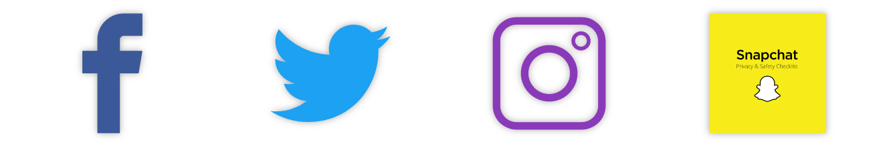
Social Media Checklists
SWGFL have checklists to secure your child’s profile for popular social media sites
https://swgfl.org.uk/resources/checklists/

Slide 26

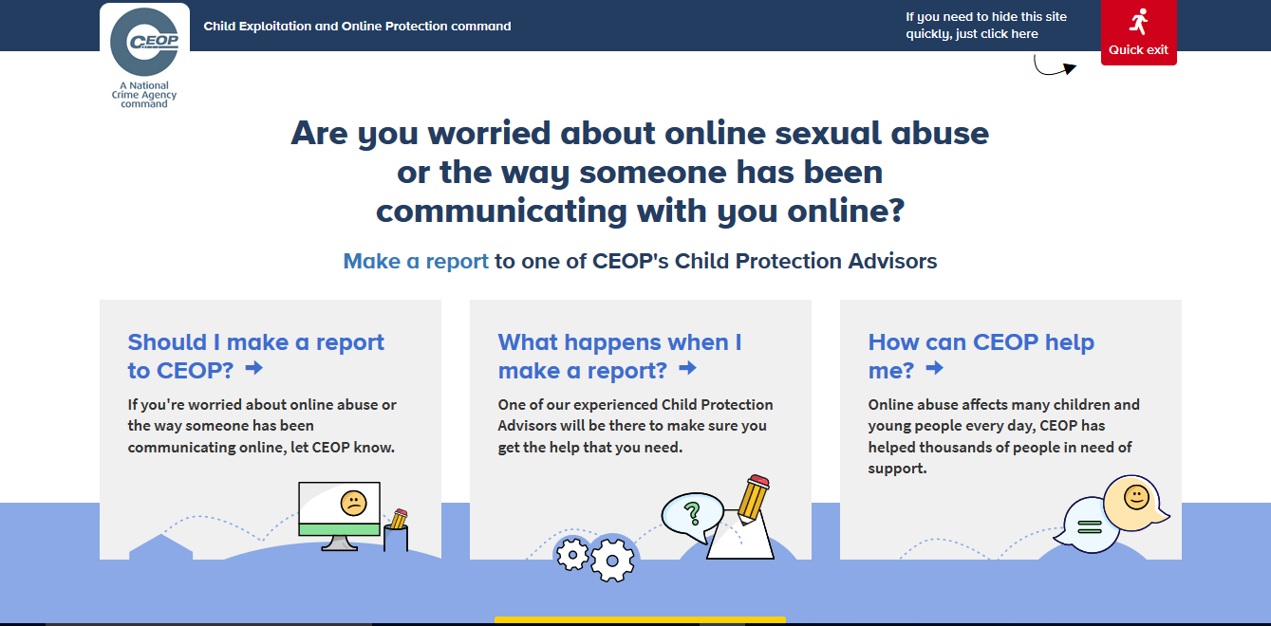
Reporting to NCA-CEOP – www.ceop.police.uk

Slide 27
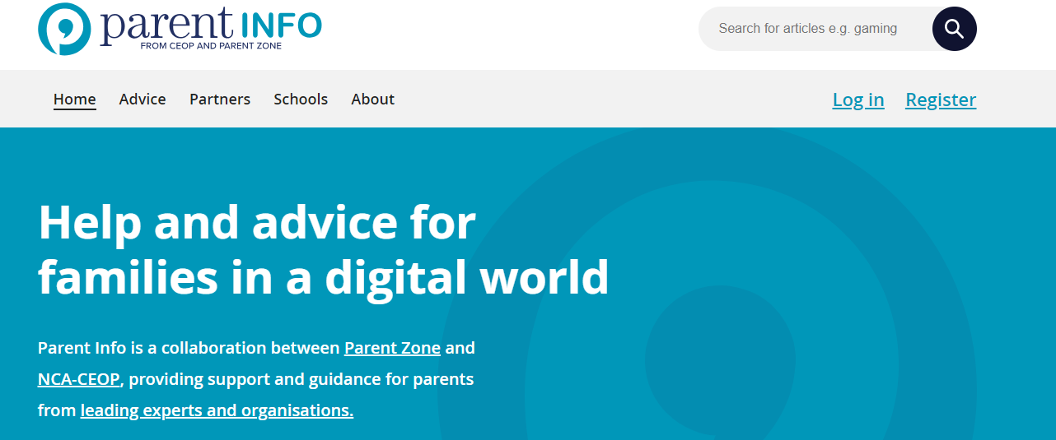
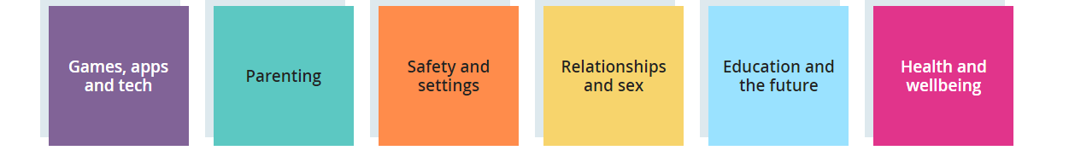
www.parentinfo.org

Slide 28
Useful Sites
UK Safer Internet Centre: https://www.saferinternet.org.uk
Internet Matters: https://www.internetmatters.org
Parent Zone: https://parentzone.org.uk/
Report abuse or grooming to CEOP: https://www.ceop.police.uk/
Report Harmful Content: https://reportharmfulcontent.com/

Slide 29
Thank you for your time
All the links in one place!
Danny Nicholson
www.think-bank.com/parents
https://wke.lt/w/s/sxPpNv

