Slide 1
MY FAIR LADY
1987

Slide 2
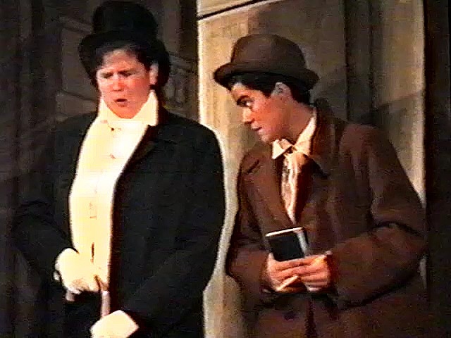
Pickering meets Higgins in Covent Garden

Slide 3
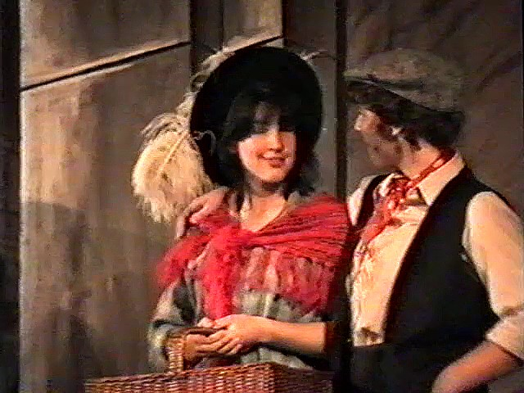
Eliza & Friend in Covent Garden

Slide 4
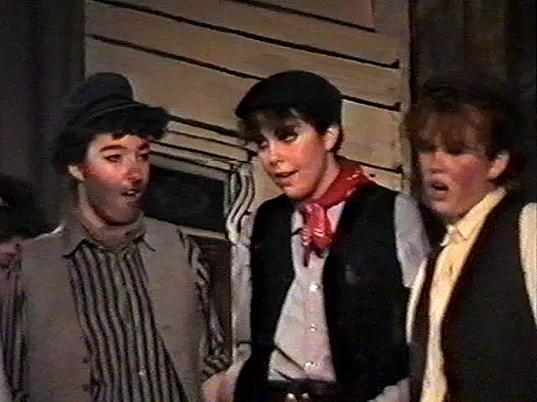
Cockneys in Covent Garden

Slide 5
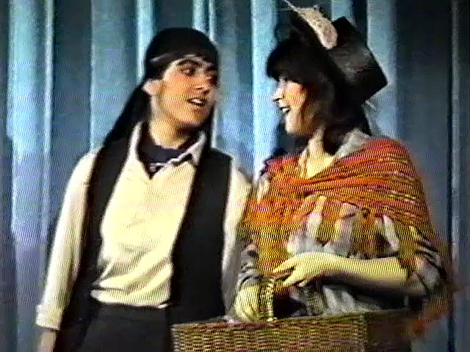
Alfred Doolitle speaks to his daughter, Eliza

Slide 6
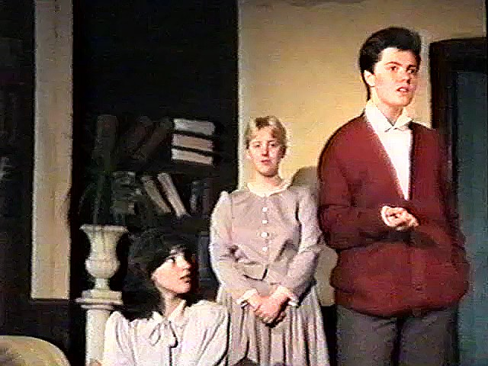
Eliza & Mrs Pearce listen to Higgins, in his study

Slide 7
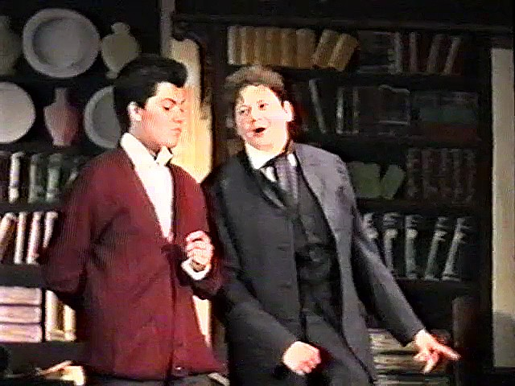
Higgins considers Pickering’s bet

Slide 8
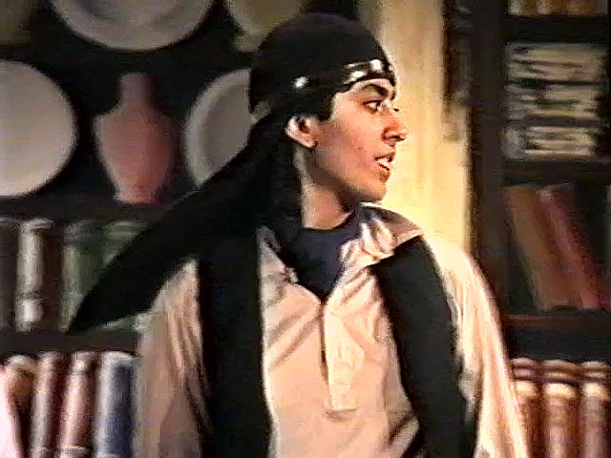
Alfred Doolitle visits Higgins at home

Slide 9
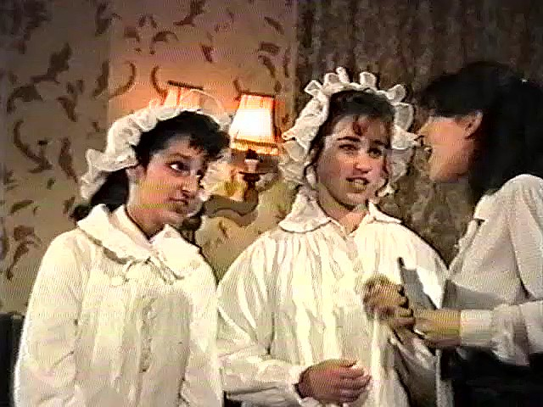
The maids are kept awake by late-night lessons

Slide 10
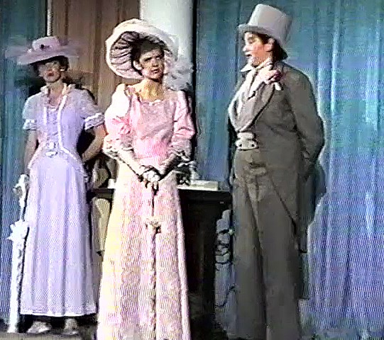
Pickering tells Higgin’s mother about Eliza & the bet while Mrs Eynesford-Hill looks on, at Ascot

Slide 11
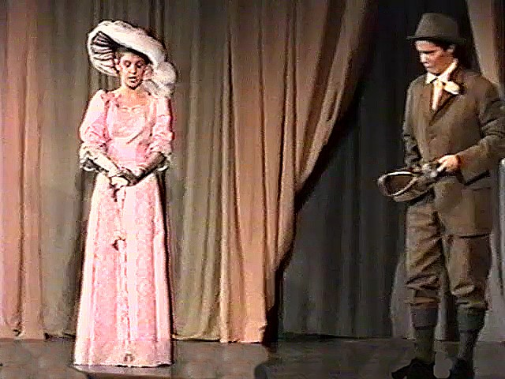
Higgins, at Ascot, explains to his mother about Eliza’s conversation topics

Slide 12
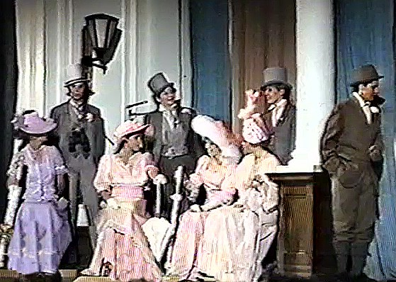
Mrs Higgins with her guests, in her box at Ascot

Slide 13
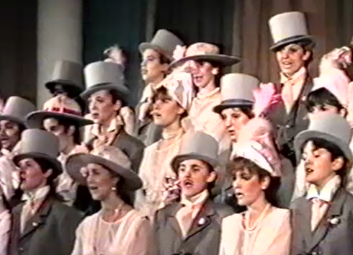
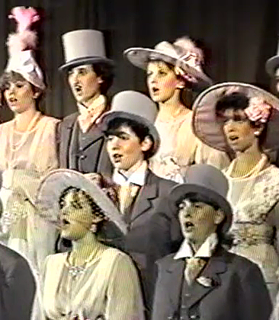
The Ascot Chorus

Slide 14
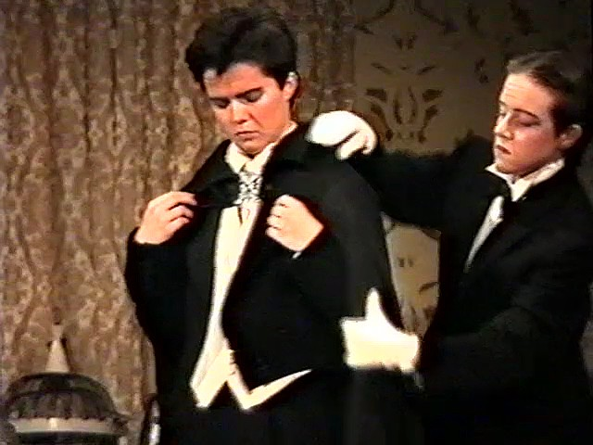
Higgins prepares to leave for the Embassy Ball with the help of his butler

Slide 15
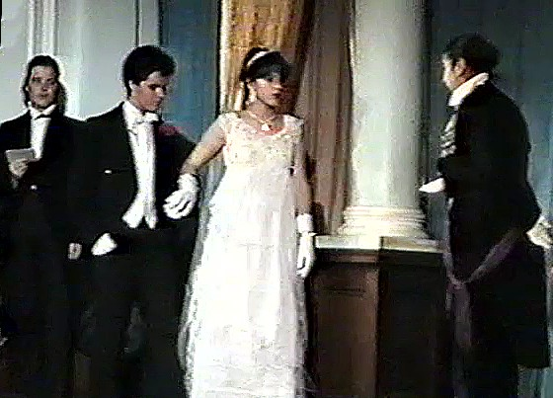
Higgins & Eliza arrive at the Embassy Ball

Slide 16
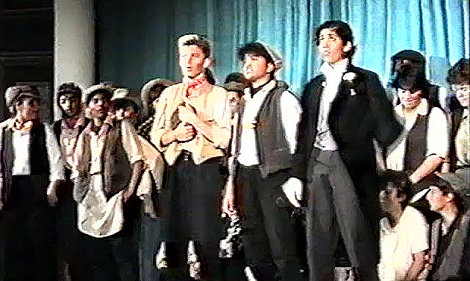
Alfred Doolittle is getting married in the morning

Slide 17
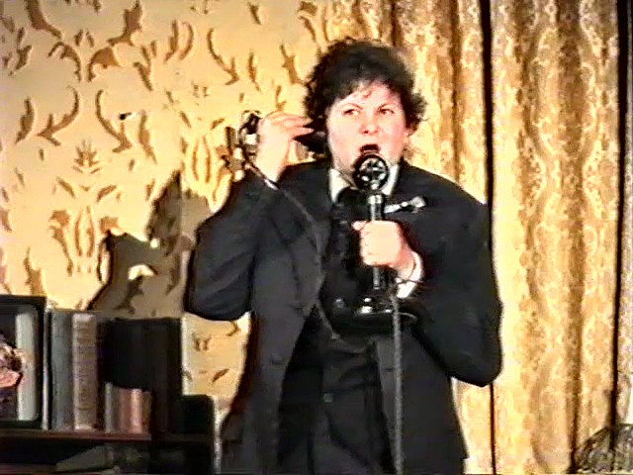
Eliza is missing. Pickering calls the police.

Slide 18
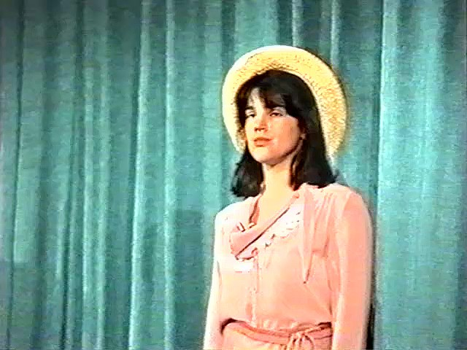
The ‘new’ Eliza – but where does she belong?

Slide 19
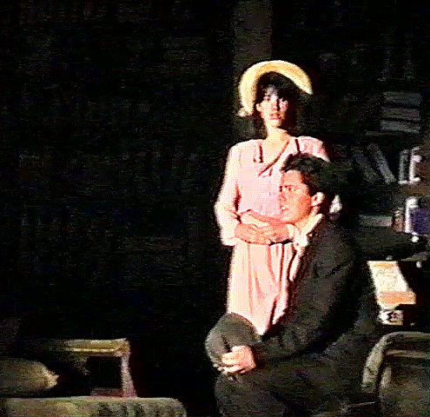
Eliza & Higgins – do they have a future together?

Slide 20
MY FAIR LADY
1995

Slide 21
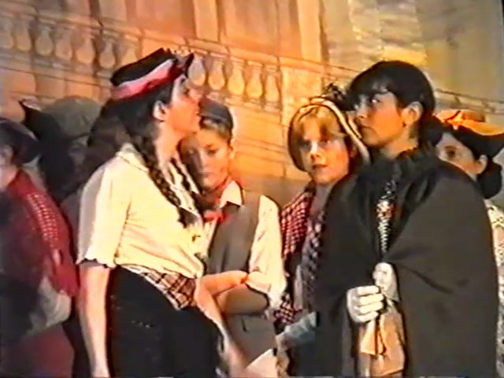
Eliza has a set-to with a ‘lady’ in Covent Garden

Slide 22
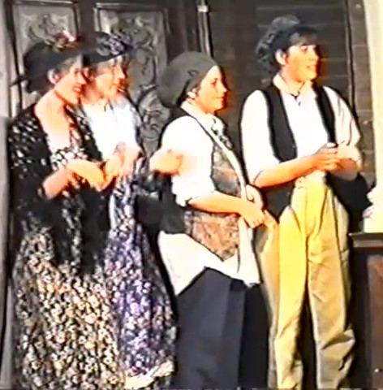
The
Cockneys
in
Covent
Garden

Slide 23
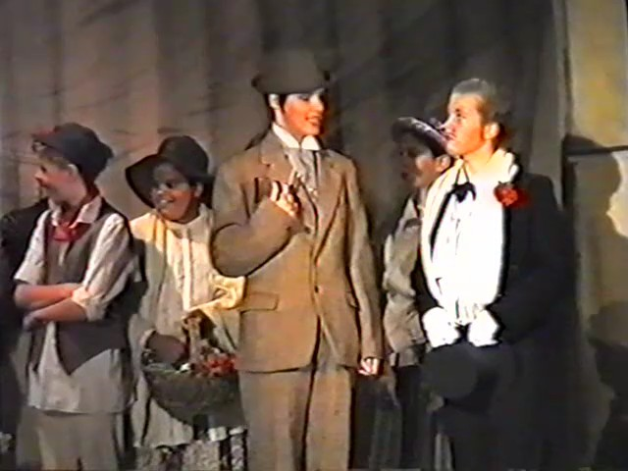
Higgins explains his linguistic skills to Pickering

Slide 24
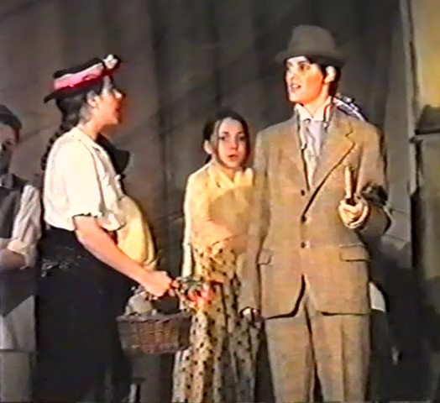
Higgins says he can teach Eliza to talk like a ‘lady’

Slide 25
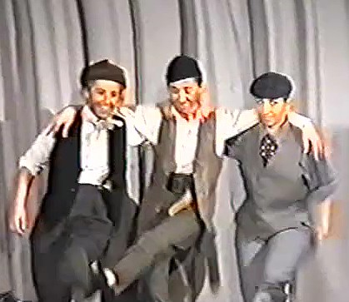
Alfred Doolittle leaves the pub with his mates

Slide 26
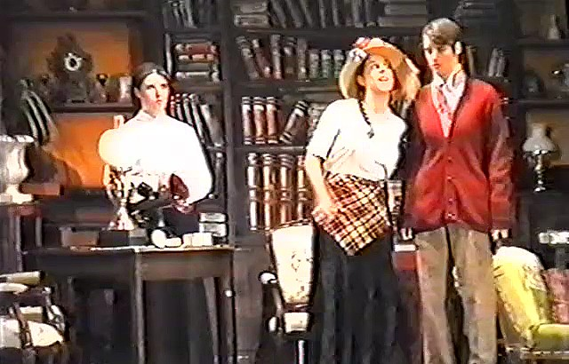
Mrs Pearce, the housekeeper looks on as Eliza negotiates speaking lessons with Higgins

Slide 27
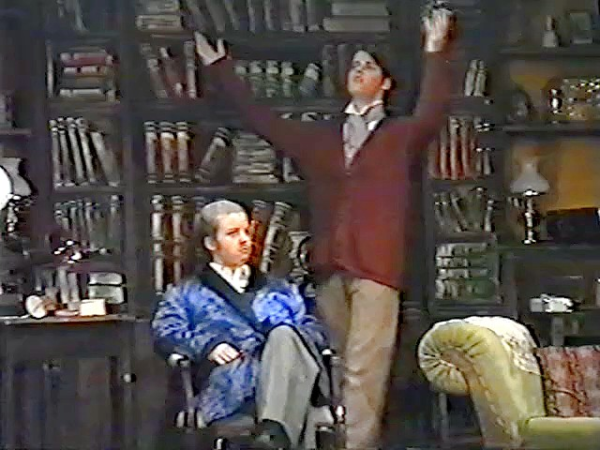
Higgins shares his thoughts with Pickering

Slide 28
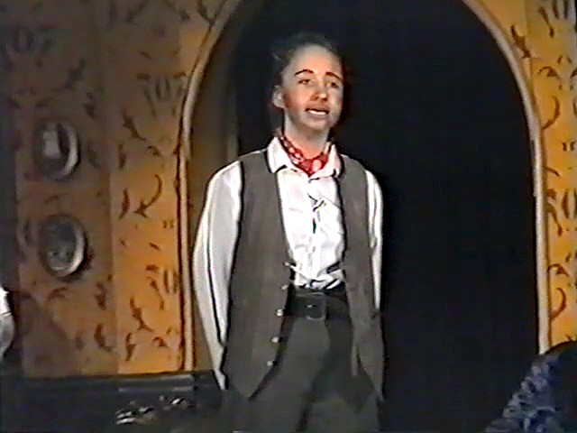
Alfred Doolittle has come looking for Eliza hoping some money will come his way

Slide 29
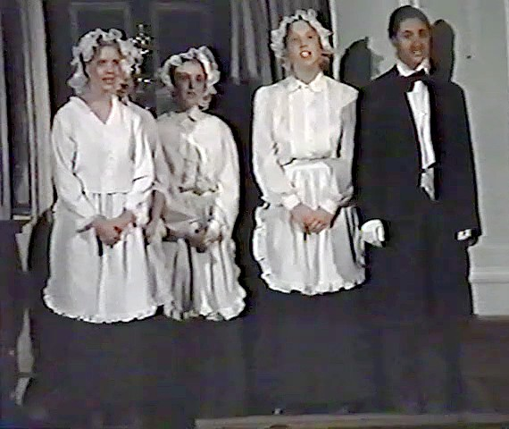
The maids and butler sing at the front door

Slide 30
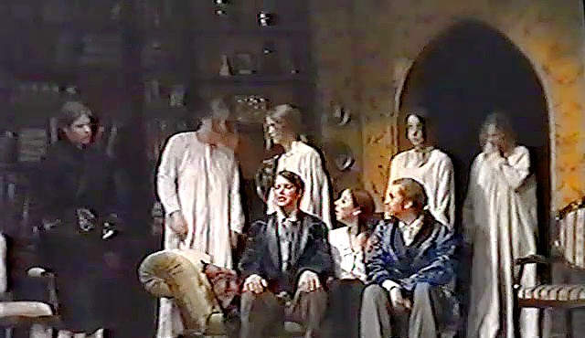
The servants have been woken by the noise
from the study

Slide 31
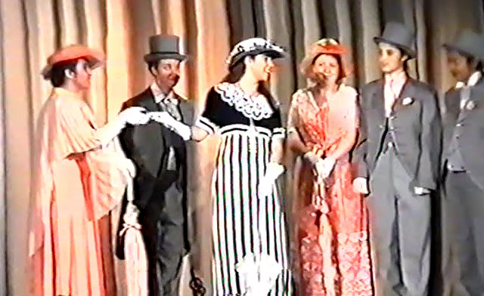
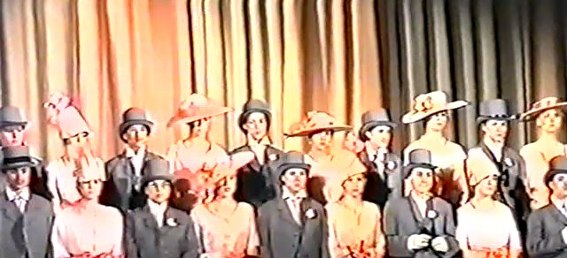
Eliza at Ascot
with Mrs Higgins
and guests
The
Ascot Chorus

Slide 32
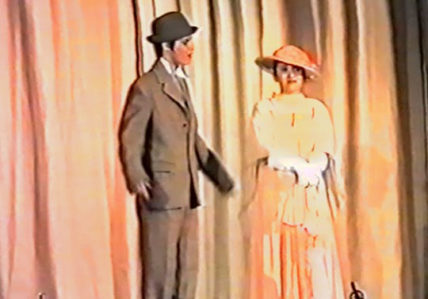
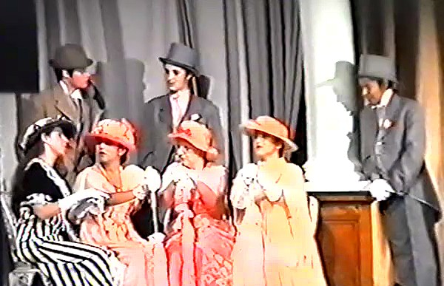
Higgins reassures his mother about Eliza
Mrs Higgins with her guests in her box at Ascot

Slide 33
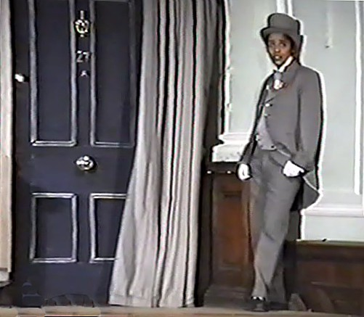
Freddy Eynesford-Hill waits on the street where ‘she’ lives

Slide 34
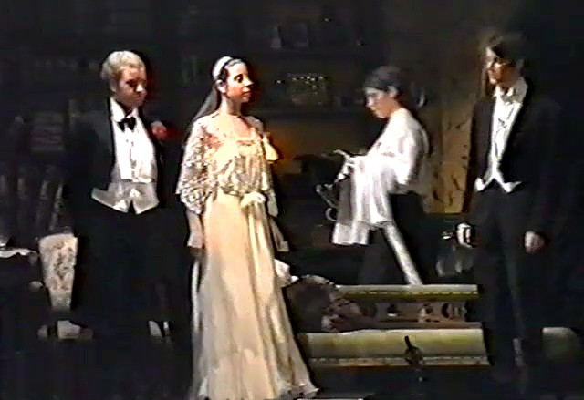
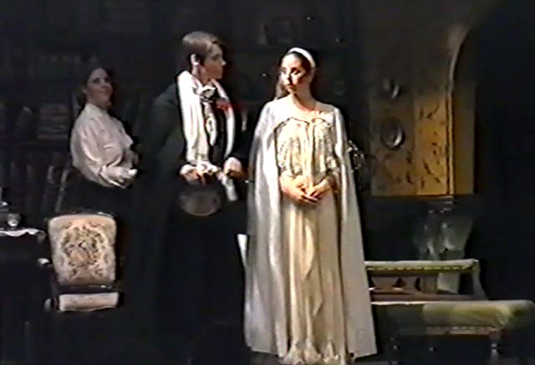
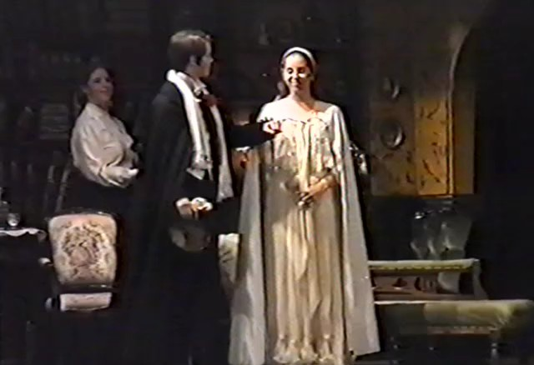
Departure
for the
Embassy Ball

Slide 35
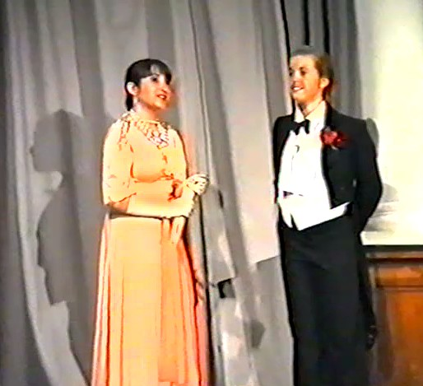
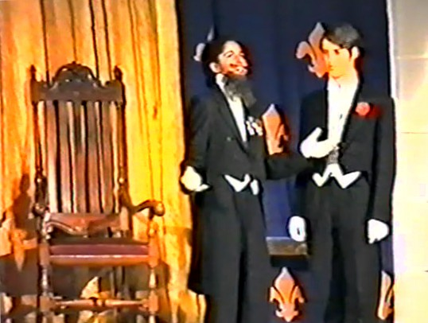
At the Embassy Ball
Mrs Higgins & Pickering
Zoltan Karpathy
& Higgins

Slide 36
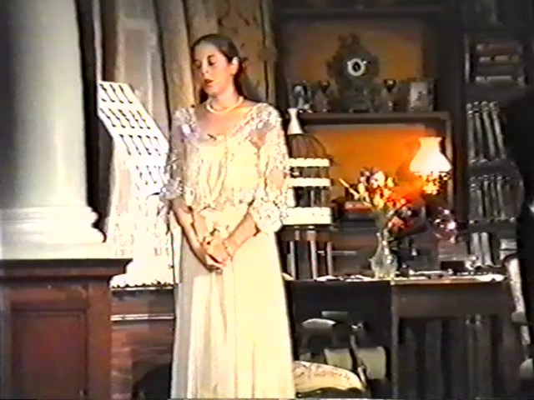
The Embassy Ball is over

Slide 37
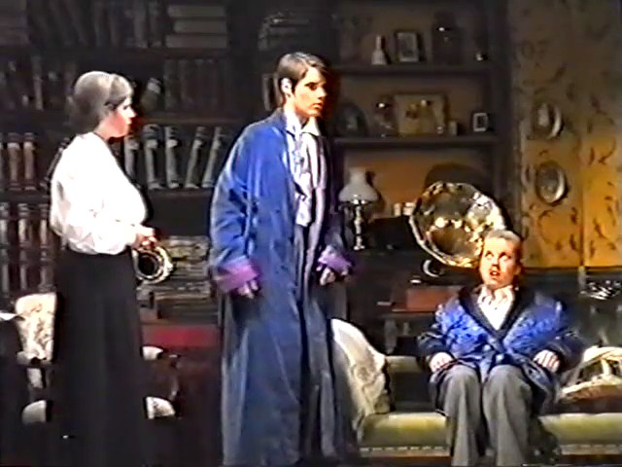
The household is in confusion – Eliza has gone

Slide 38
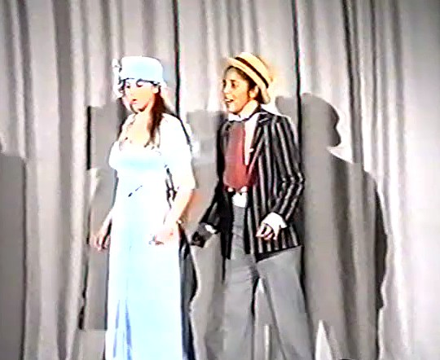
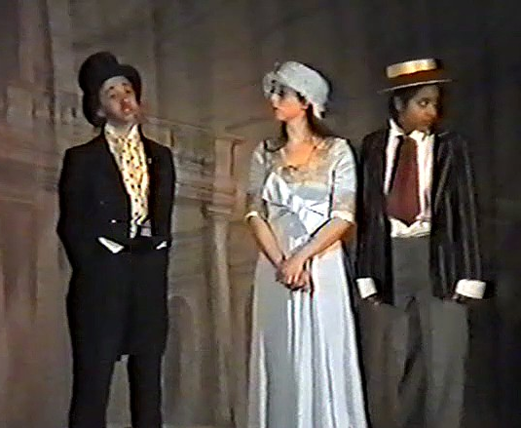
Eliza re-visits
Covent Garden
with Freddy
Alfred Doolittle
is getting married

Slide 39
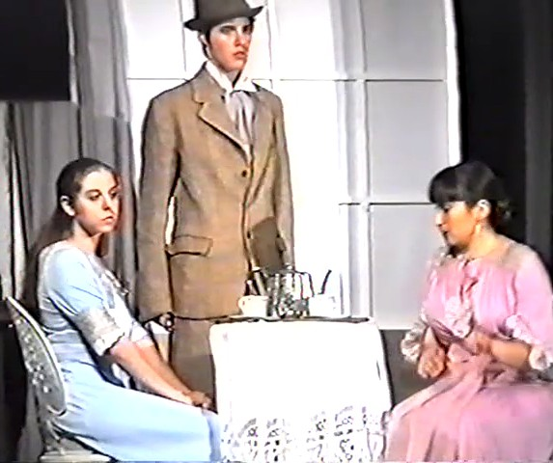
Higgins finds Eliza with his mother

Slide 40
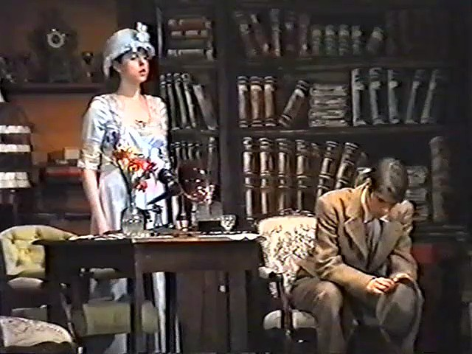
Eliza returns – but will she stay?

Slide 41
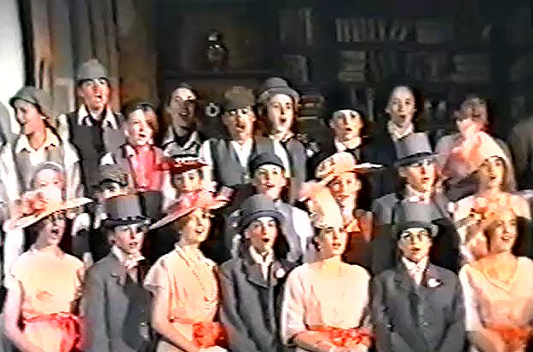
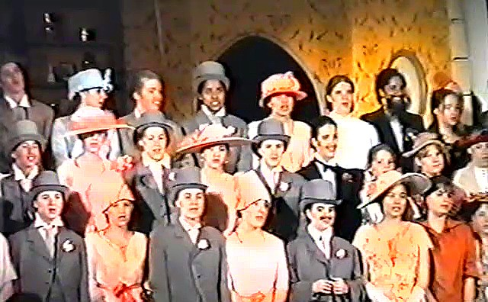
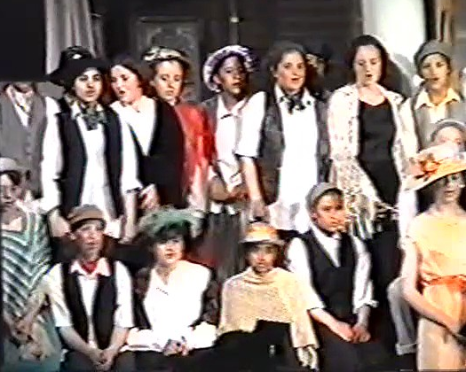
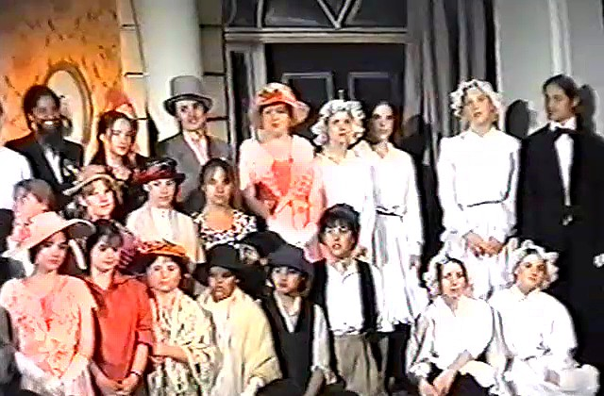
Curtain Call

Slide 42
MY FAIR LADY
2005

Slide 43
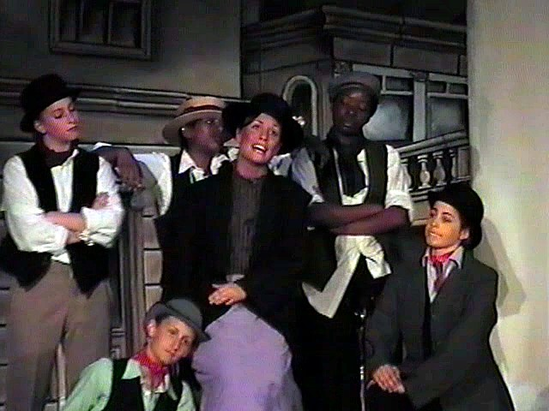
‘Wouldn’t It Be Loverly?’

Slide 44



Alfred Doolittle
&
Friends

Slide 45

Eliza visits 27a Wimpole Street

Slide 46

Eliza makes herself at home

Slide 47



Pickering is thoughtful
Higgins gives instructions
Mrs Pearce, the housekeeper, offers her opinion

Slide 48


Alfred Doolittle arrives to find Eliza and compensation

Slide 49



The lessons begin
Progress is slow and tiring
The dance of success

Slide 50

The servants sing ‘Poor Professor Higgins

Slide 51


Ascot
Pickering tells Mrs Higgins about Eliza.
Higgins reassures his mother

Slide 52






Eliza makes polite conversation with
Mrs Eynsford-Hill
& Mrs Higgins
The Ascot Chorus

Slide 53

Freddy Eynsford-Hill is in love

Slide 54



Ready for the Embassy Ball

Slide 55


Eliza departs from Wimpole Street
Alfred Doolittle is getting married in the morning

Slide 56

Eliza is missing. Where is she?

Slide 57


Mrs Higgins is looking after Eliza
Higgins finds Eliza, but will she return to Wimpole Street?

Slide 58


Professor Higgins waits
Eliza
returns

Slide 59



Curtain
Call

Slide 60


