Slide 1
HMS PINAFORE
1989

Slide 2
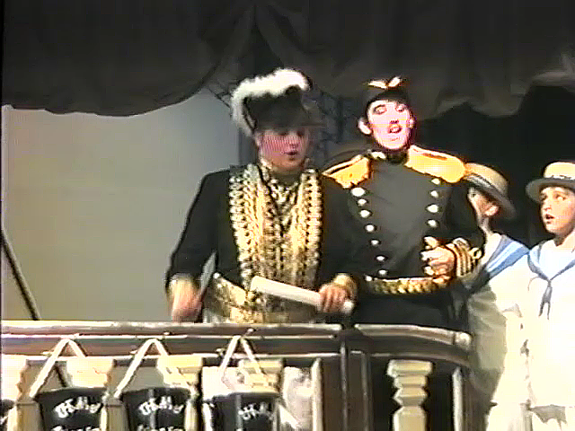
Sir Joseph
&
Captain
Corcoran

Slide 3
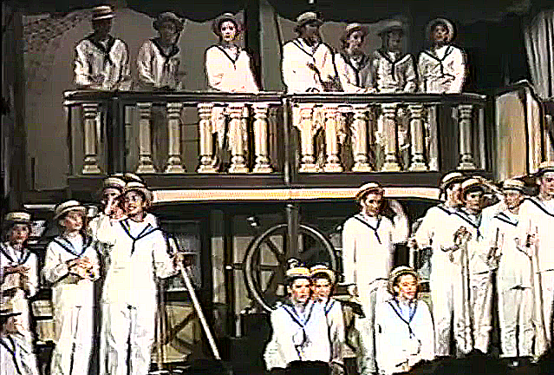
The Crew

Slide 4
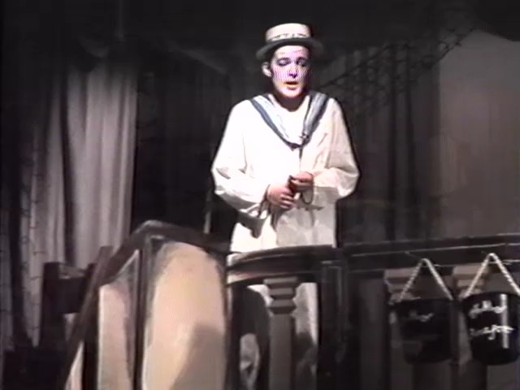
Ralph
Rackstraw

Slide 5
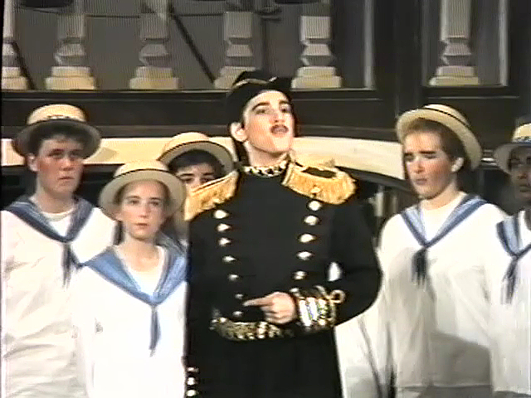
Captain Corcoran
&
Crew

Slide 6
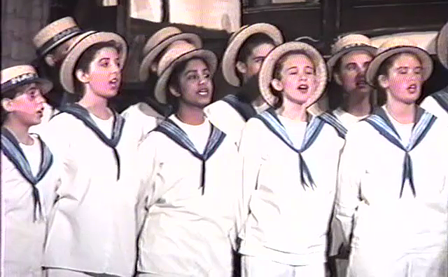
The Sailors

Slide 7
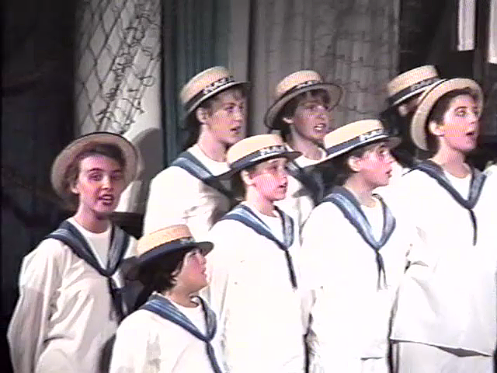
More Sailors

Slide 8
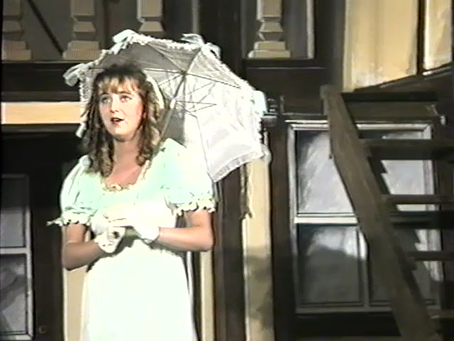
Josephine Corcoran

Slide 9
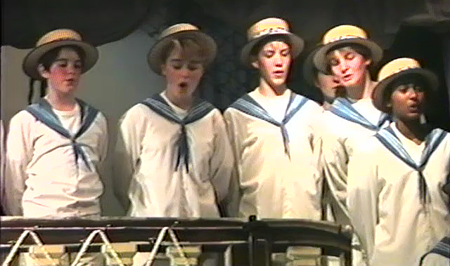
More Sailors

Slide 10
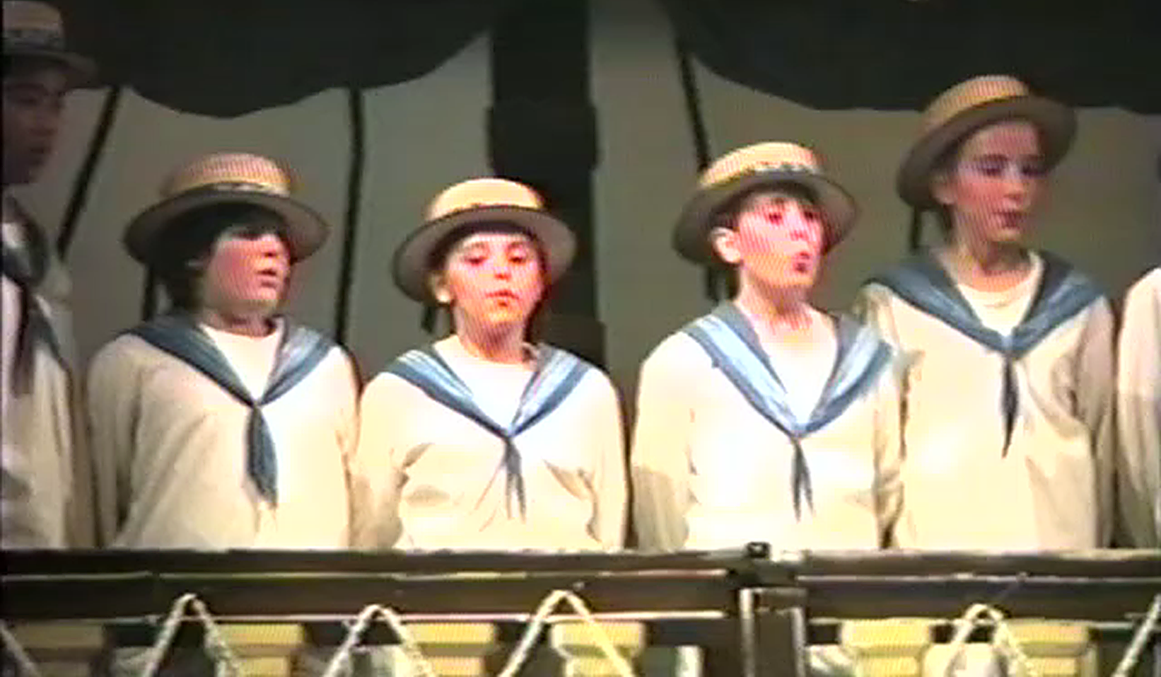
And more Sailors

Slide 11
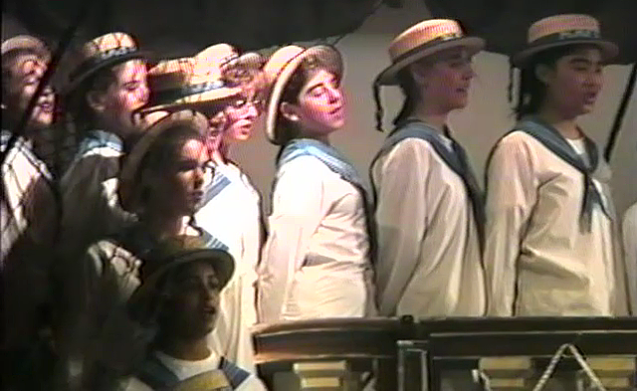
And yet more Sailors

Slide 12
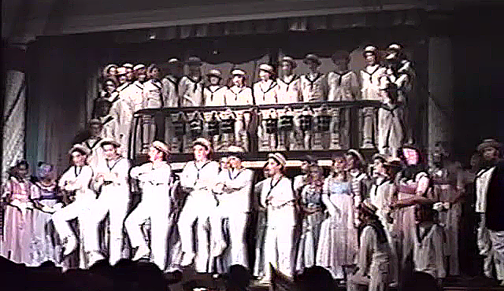
The Crew

Slide 13
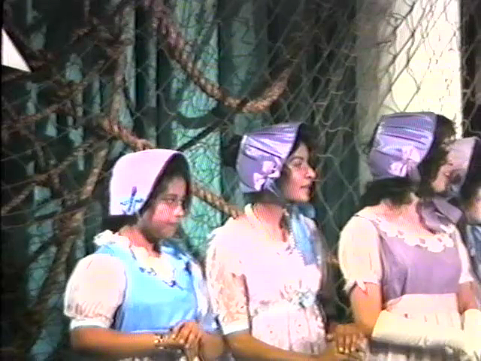
Sisters,
Cousins
&
Aunts

Slide 14
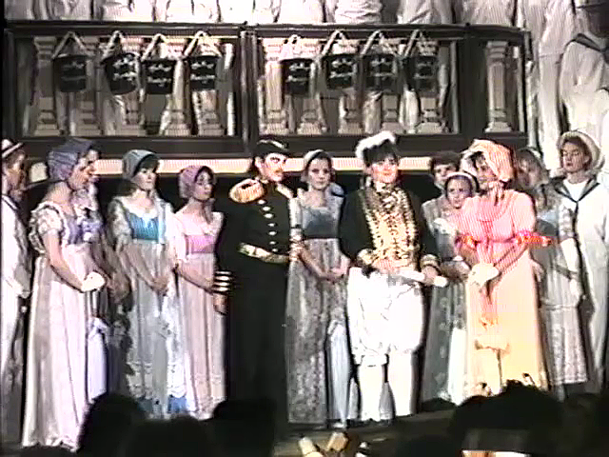
Captain
Corcoran
&
Sir Joseph
Porter with the
Cousins
&
Aunts

Slide 15
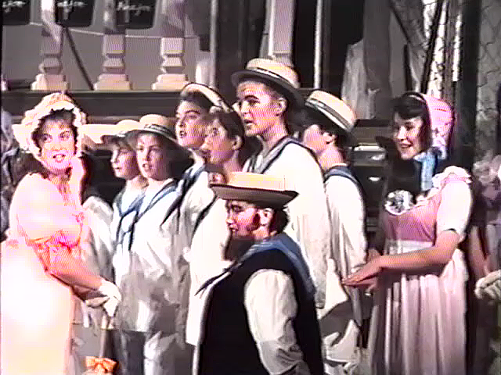
Hebe, with
Ralph,
Boatswain
&
Crew

Slide 16
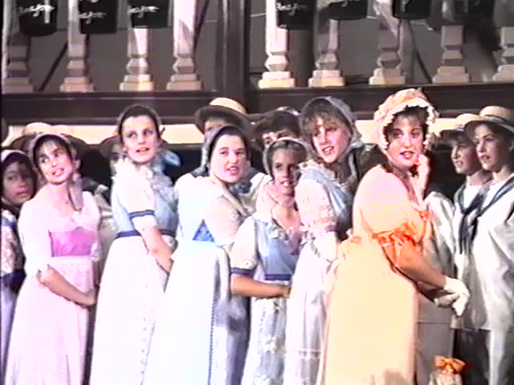
Sisters,
Cousins
&
Aunts

Slide 17
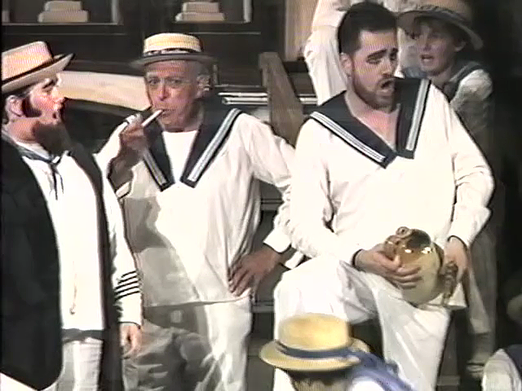
Boatswain
&
Guest
Crew

Slide 18
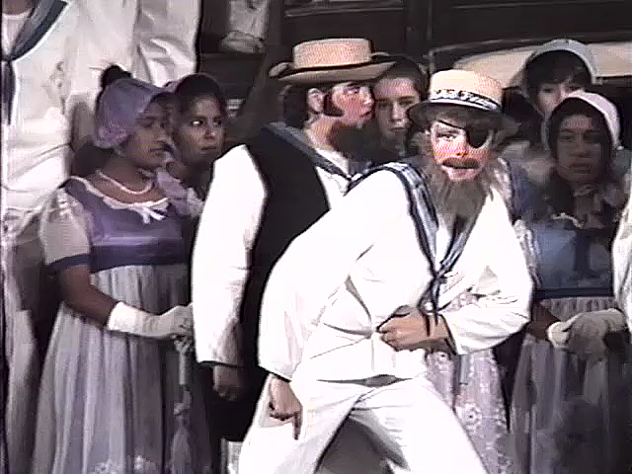
Deadeye Dick

Slide 19
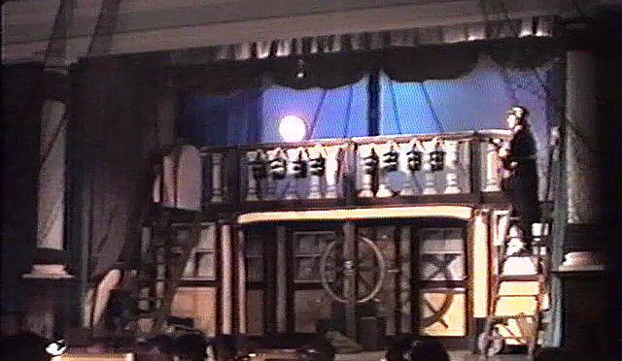
HMS Pinafore at night

Slide 20
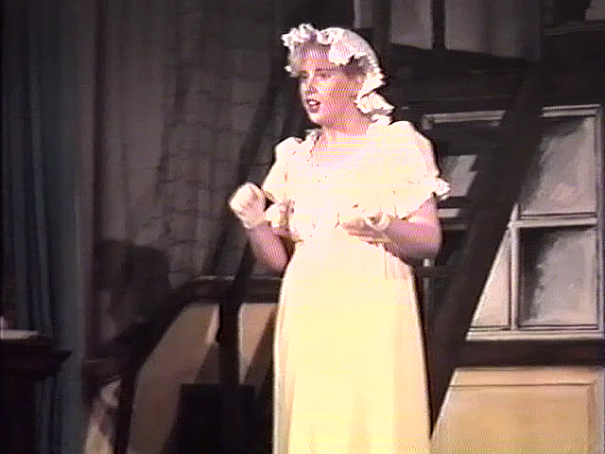
Little Buttercup

Slide 21
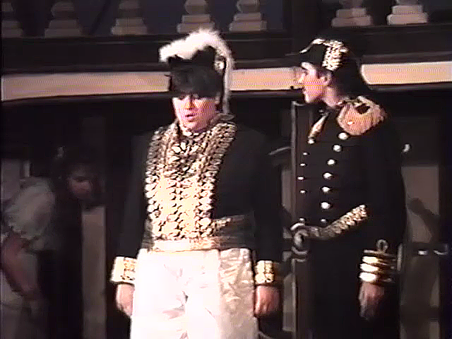
Sir Joseph
&
Captain
Corcoran again

Slide 22
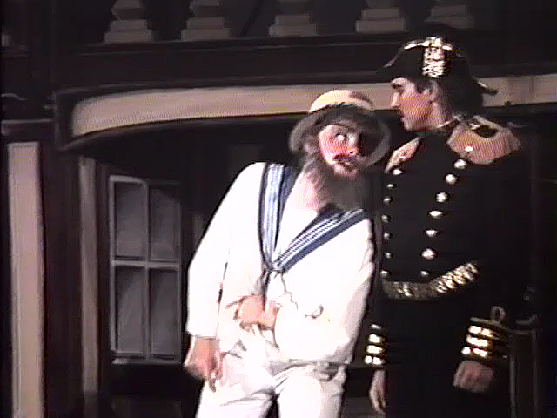
Deadeye Dick
&
Captain
Corcoran

Slide 23
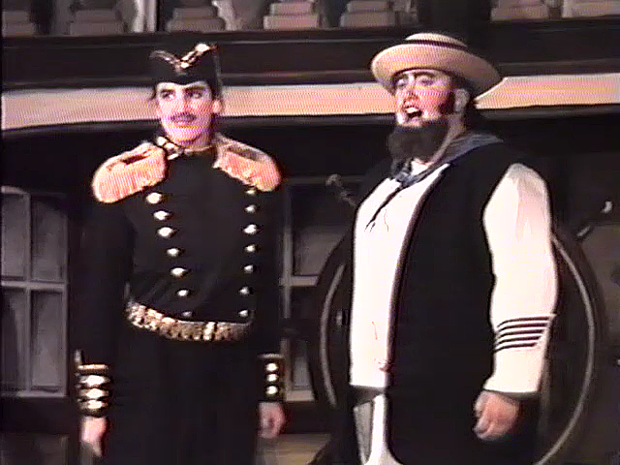
Captain
Corcoran
& Boatswain

Slide 24
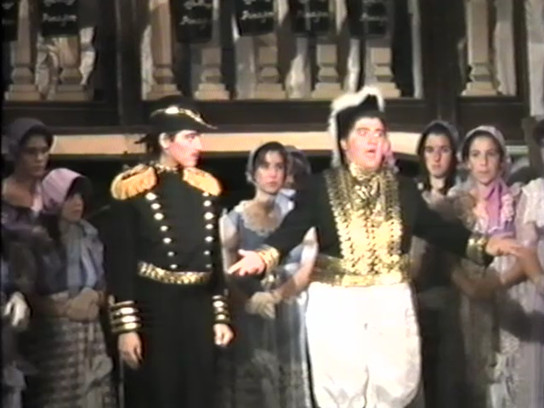
Sir Joseph has a lot to say

Slide 25
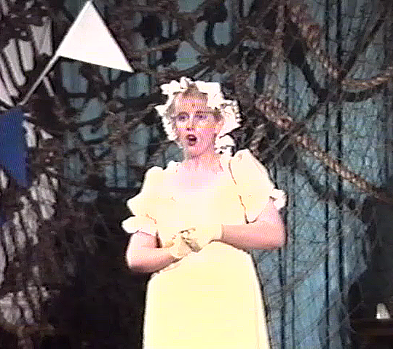
Little Buttercup again

Slide 26
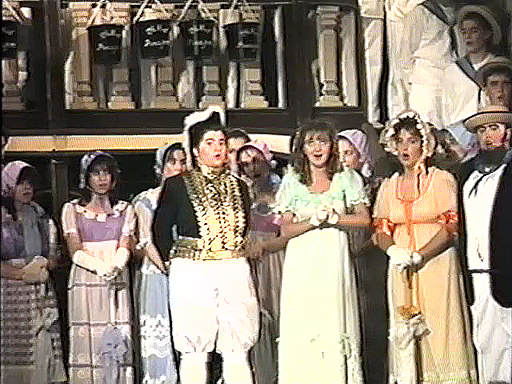
Sir Joseph, Josephine, Hebe
& Boatswain

Slide 27
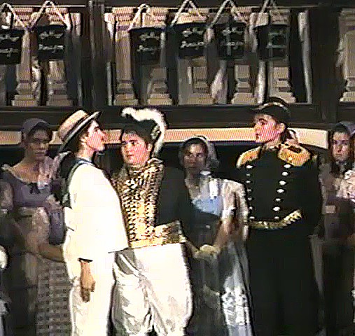
Roles reversed

Slide 28
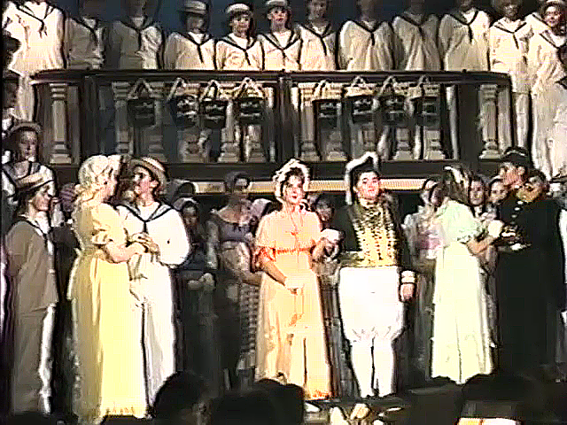
Buttercup
&
Captain
Hebe
&
Sir Joseph
Josephine
&
Ralph

Slide 29
Buttercup
&
Captain united

Slide 30
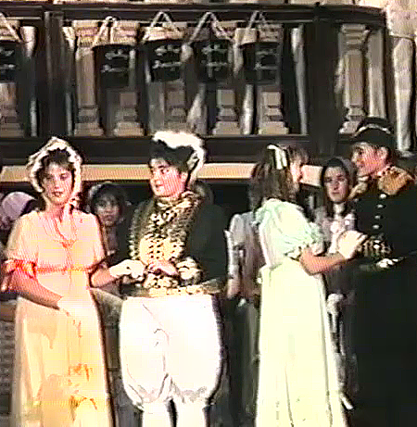
Hebe
&
Sir Joseph
Josephine
&
Ralph

Slide 31
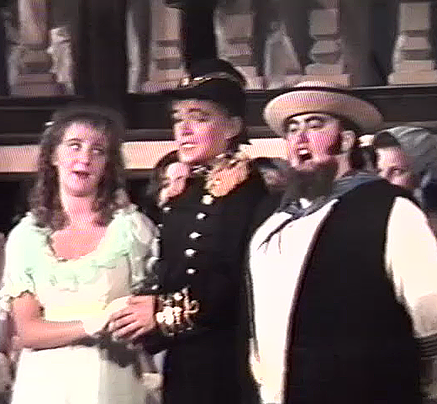
Josephine,
Ralph
&
Boatswain

Slide 32
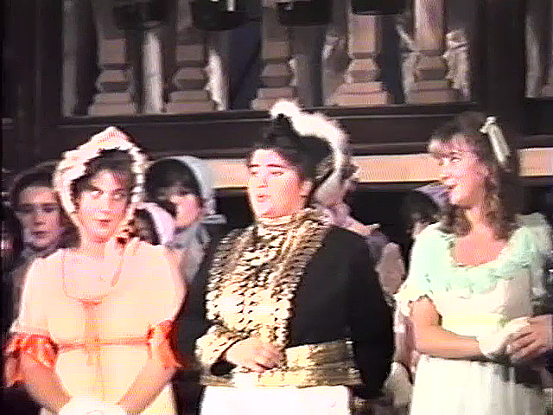
Hebe,
Sir Joseph
&
Josephine

Slide 33


