Slide 1
What are same-sex relationships?
Year 9 PSHCE – Relationships
Learning Objectives:
To be able to explain that there is a spectrum of sexuality and gender in relation to a range of romantic relationships
To be able to identify and understand the legislation relating to a range of relationships
To be able to identify where to find help and support around sexual identity and gender

Slide 2
Starter
Do you know the definition of the following term –
LGBT+
Notes:
Lesbian, Gay, Bisexual, Transgender and then the + could include: asexual, questioning, queer, intersex and androgynous

Slide 3
What is a same-sex relationship?
The term same-sex relationship is usually used to refer to a romantic relationship between two people of the same sex.

Slide 4
Key words to understand
Do you know what the following mean –
Heterosexual
Sexual Orientation
Gender Identity
Transgender

Slide 5
Key words to understand
Heterosexual – A person who is attracted to the opposite sex
Sexual Orientation – A term used to describe a person based on who they are attracted to
Gender Identity – A person’s internal self-perception or their own gender
Transgender - An umbrella term for anyone whose gender isn’t the same as the one they were assigned at birth

Slide 6
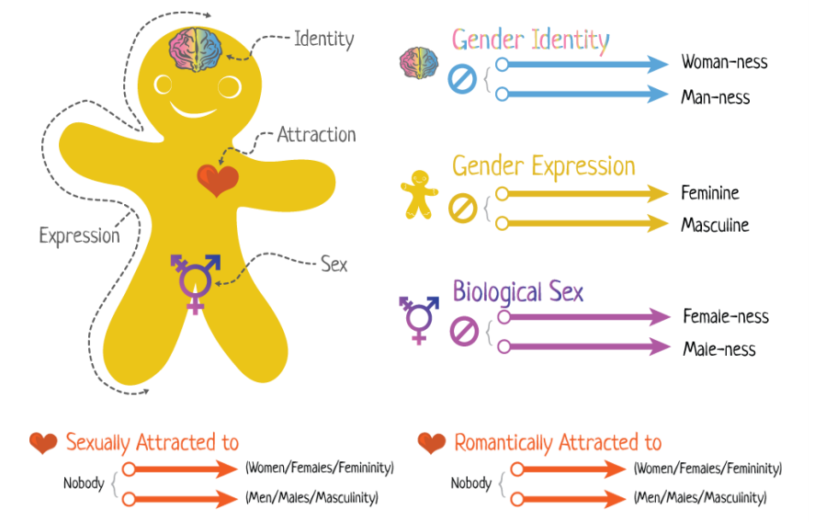
The gender/sexuality spectrum
Gender identity is someone’s personal perception and can be either male, female, both or neither.
Gender expression is how someone communicates their gender based on societal factors. There are ‘stereotypical’ male and female gender expressions but this is something quite fluid.
Biological sex is often used to refer to the sex that was assigned at birth
People can be attracted to the opposite sex or gender, or the same. Or sometimes people are attracted to both or none. This can also be fluid and sometimes might change.

Slide 7
Understanding same-sex relationships
It is a common mistake that all people in a same-sex relationship identify as gay or as a lesbian.
Sometimes, people in same-sex relationships identify as bisexual or pansexual.
Equally, transgender people may not want to use the term ‘same-sex relationships’ because there can sometimes be a difference between a person’s biological sex and their gender identity.
It is important to remember that there are, therefore, different types of relationships which might be deemed ‘same-sex’.
Key words
Bisexual – being attracted to both genders
Pansexual – when someone is not limited in sexual choice with regard to biological sex, gender, or gender identity.

Slide 8
What is the law regarding same-sex relationships?
There have been same-sex relationships throughout history and some historical figures were in same-sex relationships including King Edward II. Historically, they were very common in the Ancient Greek world too.
However, the law regarding same-sex relationships and in particular, around same-sex marriage has only changed in recent years … lets see how much you know about this!

Slide 9
What is the law regarding same-sex relationships?
Do you know when the following were legalised?
Homosexual couples were allowed to adopt? 2002
Gay Marriage was made legal in England and Wales. 2013
Gay Marriage was made legal in Ireland. 2015
Do you think these dates are surprising?
Why might this be?

Slide 10
The first step – civil partnerships
Civil partnerships were legalised in 2004. Nearly 140,000 people entered into civil partnerships between 2005 and 2015.
Across the UK, same-sex couples were granted many of the same rights as married heterosexual couples, albeit with a few differences around issues like private-sector pensions.
It meant that couples could no longer be kept out of hospital rooms when their partner was sick, they would no longer lose their home or business because of tax laws, and they had parental rights over children.

Slide 11
The second step - Same-sex marriages
Same-sex marriage was then legalised a decade later, with the first ceremonies taking place in England, Wales and Scotland in 2014. According to official estimates about 60,000 people were in same-sex marriages in 2016.
Same-sex marriage (typically referred to as ‘Gay Marriage’) is legal in many countries today including the UK, USA, Canada, Argentina, Australia, Belgium, Brazil, Columbia, Denmark, Finland, France, Germany, Iceland, Ireland, Luxumberg, Malta, Mexico, the Netherlands, Norway, Portugal, South Africa, Spain, Sweden and Urugway and is growing in recognition in other countries such as Taiwan, Austria, Isreal and Armenia.
However, this is not the case everywhere and many countries still have large penalties for being homosexual.
In 26 countries, it is also legal for same-sex couples to adopt, including the UK.

Slide 12
Understanding the wider history of legislation -
1967 - Sex between two men over 21 and "in private" is decriminalised (no longer illegal)
1980 - Decriminalisation in Scotland
1982 - Decriminalisation in Northern Ireland
1994 - The age of consent for two male partners is lowered to 18
2000 - The ban on gay and bisexual people serving in the armed forces is lifted; the age of consent is equalised for same- and opposite-sex partners at 16
2002 - Same-sex couples are given equal rights when it comes to adoption
2004 - A law allowing civil partnerships is passed
2007 - Discrimination on the basis of sexual orientation is banned
2010 - Gender reassignment is added as a protected characteristic in equality legislation ( more on this in the next slide!)
2014 - Gay marriage becomes legal in England, Wales and Scotland
Notes:
Source – BBC

Slide 13
The equality act and protected characteristics
In 2010 the Equality Act was passed by the UK government which identified 9 protected characteristics. These include:
- Age
- Disability
-Gender identity
- Marriage and civil partnership
- pregnancy and maternity
- race
- religion or belief
- Sex ( biological)
- Sexual orientation
Treating anyone with prejudice due to one of these characteristics is therefore a criminal offence and can result in a criminal records, fines or prison time depending on the severity of the action against them.

Slide 14
What is the law about same-sex marriages?
Using the previous information, answer the following questions –
When were ‘Civil Partnerships’ legalised in the UK and what did this change?
When was ‘same-sex marriage’ legalised in the UK?
How was ‘same-sex marriage’ a progression from Civil Partnerships?
Is this legal everywhere?

Slide 15
Same-sex relationships – key discussion
In pairs, discuss the following –
What challenges might same-sex couples face that perhaps a heterosexual couple may not? Why?

Slide 16
What challenges might same-sex couples face that perhaps a heterosexual couple may not?
This could include –
Obstacles to getting married, depending on where there were living BUT this is improving, as you saw with the history of legal developments
Difficulty in having a child naturally BUT there are many solutions to this
Other people’s perceptions of their relationship adding complications BUT gradually, this is developing, helped perhaps by the legal changes

Slide 17
Plenary
In thinking back to our lesson on healthy romantic relationships, regardless of what type of relationship you are in, what is the most important thing to remember?
Why is this important regardless of whether the relationship is same-sex or not?

Slide 18
Available help -
At school: Form Tutor, Ms Verrall, Mrs Holman, Ms Kaye, Ms James, Ms Marku or Mrs Carron. We are all here to support you.
Stonewall - For further information about LGBT+ and support, please see - https://www.stonewall.org.uk/
Switchboard (an LGBT+ Helpline) Accessed on - http://switchboard.lgbt/
The Proud Trust – For information about local support groups. Available on - https://www.theproudtrust.org/
The Pride Youth Network is run by Miss Keith on Mondays in SF7, 1:30-2pm

