Slide 1
Why might some people have concerns about Romantic Relationships?
Learning Objectives:
I am able to explain why some people might see romantic relationships as important
I am able to identify some reasons why someone might not want a romantic relationship
I am able to describe some concerns people have about romantic relationships
Year 9 PSHCE – Relationships
Lesson 2

Slide 2
Ground rules reminder
Over the next couple of lessons, there will be a lot of discussion work. During this, it is important to –
Listen to people’s ideas
Respect each other and their views
Remember that there is no such thing as a silly question
Be kind to each other
And remember, if you are at affected by any of the topics covered, then please do speak to your Form Tutor, Ms Keith, Mrs Holman, Ms Kaye, Ms Bird, Ms Marku or Mrs Greenfield. We are all here to support you.

Slide 3
Thinking back to last lesson …
Last week we looked at the differences between healthy and unhealthy relationships. We considered the reasons why someone might stay in an unhealthy relationship. Now lets think about the following –
Why do some people want a ‘romantic relationship’?
Why might they see romantic relationships as important?

Slide 4
Possible reasons why romantic relationships may be seen as important:
‘Fall in love’/ Companionship / friendship can all help to avoid feelings of loneliness
Another person to share experiences and interests with
Lack of love and support from family or friends but desire this
Can provide affection
Sexually fulfilling
Want to be a parent in the future – find the right mother/father to their future child
Boosts confidence (being desired/wanted by another person)
Can be financially beneficial if the couple are together and both work together to share costs of living

Slide 5
“I don’t want a romantic relationship – is there something wrong with me?”
In short, absolutely not.
Not everyone wants to have romantic relationships and that is absolutely fine. What is important to one person, might not apply to all.
Can you think of any other reasons why young people might not want to have a relationship with another person?

Slide 6
Why might someone not want a romantic relationship?
There are many reasons why young people, and adults alike might not want to enter into a romantic relationships, such as:
Not attracted to anyone they know
Not sure of their sexuality
Or may be asexual
Might see this as a distraction from their academic work, sports teams, employment, and social lives
Might not feel ready for a romantic relationship
All of these reasons are absolutely understandable.

Slide 7
What might scare someone about romantic relationships?
Some people may not want a romantic relationship as they are worried or scared potential problems:
Might be worried about being hurt
Might worry about what will happen if the relationship ends
might worry what their friends or family will think of their partner
might not feel ready for an affectionate, or intimate romantic relationships

Slide 8
Potential fears 1
- am I ready?
TASK FEAR 1 –
Use our discussion to think about what advice you would give to a student who has shared the following with their friends –
‘I want a relationship because all my friends have partners but I don’t think I am ready …’
Some people may not want a romantic relationship as they are worried about perhaps not being ready to have a partner, or to be affectionate or intimate with someone else.
Remember - there is not a set time by which you are ‘meant’ to have a romantic relationship.
And whilst, there is no legal age at which you are allowed to have a boyfriend/girlfriend, there is a legal age to engage with sexual activity. In the UK this is 16. There is also the need for consent before engaging in sexual activity – we will look more closely at consent in a future lesson.

Slide 9
Potential fears 2
- will I get hurt?
TASK FEAR 2 –
Use our discussion to think about what advice you would give to a student who has shared the following with their friends –
‘I am scared about feeling sad or being hurt at the end of the relationship’
Some people may not want a romantic relationship as they are scared of being hurt and the end of a relationship.
Unfortunately, there can be some negative consequences of relationships ending too, such as being abandoned by shared friends, feeling rejected/hurt.
Sometimes, ex-partners may try to seek revenge by sharing intimate messages or text or being threatening or aggressive.

Slide 10
Potential fears 3
- what if they like someone else?
TASK FEAR 3 –
Use our discussion to think about what advice you would give to a student who has shared the following with their friends –
‘I am worried that my partner will start to like someone else and not me’
What is unrequited love?
For many, the idea of romantic relationships may be scary if they are worried about the person they like, not liking them or even liking someone else.
Sometimes, people can be in a romantic relationship but form feelings for someone else which can lead to them being unfaithful.
This is why trust and building respect is an important part of healthy romantic relationships.

Slide 11
Key things to remember
For some people it is natural to see a romantic relationship as important. However, not all people will feel this way and that is natural too.
There is no ‘age’ by which people should start to see romantic relationships as important – this may happen later for some people, or not at all.
The legal age for sexual activity in the UK is 16.
Some relationships can be unhealthy, remember the signs of unhealthy romantic relationships that we looked at last lesson.
Some relationships can end badly, leaving people hurt and upset. It is important to look out for signs of unhealthy relationships to try and avoid this.

Slide 12
Reflections
Which of the following statements do you agree with?
Romantic relationships are the most important thing – it doesn’t matter if you’re ready.
You shouldn’t have a romantic relationship until you are 16.
You must be in a romantic relationship by the time you are 16.
Romantic relationships can be important for some people, if they are ready.

Slide 13


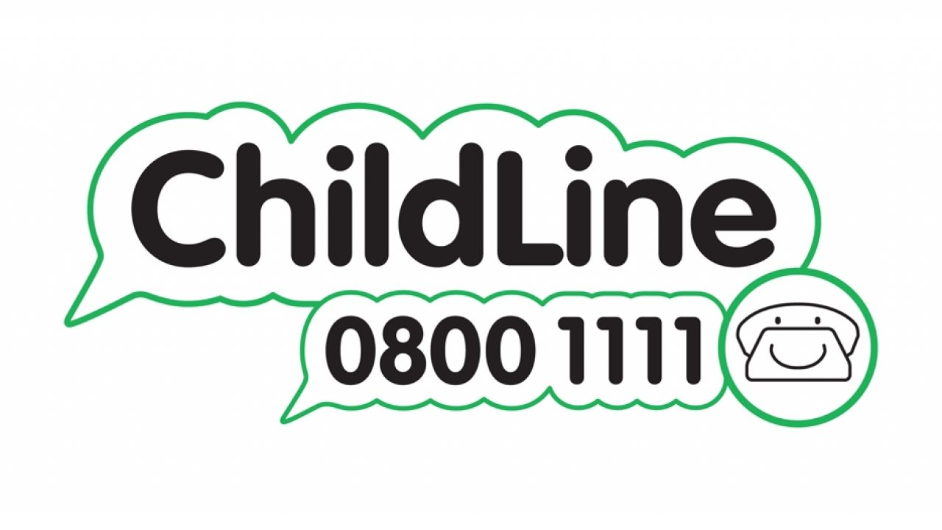
Reminders of where to go if you want someone to talk to:
At school: Form Tutor, Head of Year: Ms Keith, Mrs Holman, Ms Menon, Ms Marku Mrs Greenfield, Ms Kaye, Ms Bird, any teacher you trust
Childline 0800 1111 or childline.org.uk
Thinkuknow.co.uk
Relate.org.uk

