Slide 1
What is consent and why is this important?
Trigger Warning.
A reminder … We are going to be discussing some sensitive topics today.
If there is anything you would like to talk about remember you can see your Tutor, Mr Mills or Ms Marku.
Learning Objectives:
I am able to define what consent is and what the law is about consent and sexual relations
I am able to explain why physical intimacy can be considered important in a relationship but that everyone has a choice about this
Year 9 PSHCE – Relationships Lesson 4

Slide 2
Ground rules
Remember, it is important to –
Listen to people’s ideas
Respect each other and their views
Remember that there is no such thing as a silly question
Be kind to each other

Slide 3
What problems might young people experience in a romantic relationship?
In the lesson before last, we discussed some of the big fears someone might have about a romantic relationship.
According to Relate, a charity for young people, these are five of the most common problems that young people seek help with.
Can you guess what each one is?
1. Trying to e_ _ a relationship
2. Con_ _ _ _ _ _ _ _ partner
3. Friends and/or f_ _ _ _ _ not l_ _ _ _ _ a boyfriend/girlfriend
4. J_ _ _ _ _ _ _ and fears of being c_ _ _ _ _ _on
5. Being p_ _ _ _ _ into in_ _ _ _ _ _

Slide 4
What problems might young people experience in a romantic relationship?
1. Trying to end a relationship
2. Controlling partner
3. Friends and/or family not liking a boyfriend/girlfriend
4. Jealousy and fear of being cheated on
5. Being pressured into intimacy
Today we are going to be looking at the final problem today, being pressured into making a relationship intimate.

Slide 5
What is physical intimacy in a romantic relationship?
Often in a romantic relationship, intimacy is very important. This is the feeling of being close, emotionally connected and supported.
Romantic relationships can also be physically intimate – this may start with small physical intimacy such as hugging, or holding hands but also includes kissing and having sexual relations.
There are laws regarding sexual intimacy, which we are going to look at now. Before we do, do you know any of the following?
What is the legal age for having sex?
What might the consequence be of someone having sexual relations with someone underage?

Slide 6
What is consent?
Watch the following video created by Childline.
What can you learn from this about what ‘consent’ means?
‘Consent is agreement which is given willingly and freely without exploitation, threat or fear, and by a person who has the capacity to give their agreement.’
• What do the words ‘willingly’ and ‘freely’ mean in this definition?
• How can we know if consent is willingly and freely given?
• What does it mean for someone ‘to have capacity’ to give their agreement? Why is someone unable to give consent if they are threatened or afraid?

Slide 7
What is the law of consent?
The Sexual Offences Act 2003 states that a person has consented ‘if she or he agrees by choice, and has the freedom and capacity to make that choice’.
There are three important parts to this …
  Firstly, there is the emphasis on choice – a deliberate, active decision;
  Secondly, there is the question of capacity to give consent: is the person old enough, are they capable of understanding what is happening, are they intoxicated by alcohol or affected by drugs, do they have a mental health problem or learning difficulties, and are they conscious?
  Finally the law asks whether a person makes their choice freely, that is to say without manipulation, exploitation or duress. This may include the use or threat of force, or may be more subtle, to do with whether the person seeking consent is in a position of power or authority, or is significantly older than the other person.

Slide 8
What is the law of consent?
Consent is not only about sex but any sexual contact with another person without that person’s explicit consent is considered sexual assault or rape, which are serious crimes.
This can include unwanted sexual touching or forcing someone to perform sexual acts.
It can also include pressuring someone to the point where they say yes, or assuming someone would say yes in a situation where they otherwise can’t.

Slide 9
are the following examples of someone giving consent?
‘They said no at first but after I asked a couple of times, they were fine with it.’
‘She was wearing a short skirt and flirting with me. She was asking for my attention!’
No.
In none of these situations has consent been given.
Consent is not about the absence of a ‘no’.
‘They were happy to kiss me all night but then they fell asleep. They would have said yes if they were awake …’

Slide 10
What else does the law say?
The age of consent is 16. This is the minimum age at which a young person is allowed to engage in sexual activity, either with someone under or over the age of 16.
It is both a gross violation and a very serious offence to take or share sexual images of another, without their consent. The sharing of images of another, or sending sexual images (‘sexting’) of yourself up to the age of 18 is illegal.
It is illegal for an adult in a position of authority to have a sexual relationship with a person aged 16-18 (such as a social worker, teacher, university lecturer).

Slide 11
A closer look at sexting
Sexting involves sending photographs and/or videos of yourself to others, and others sharing that without your consent.
Watch this video.
Afterwards identify two mistakes that Katie and her boyfriend made.
Where has consent not been given?
What is the danger of ‘sexting’?

Slide 12
Sexual harassment and assault
The law of consent also related to sexual assault and harassment.
Do you know the difference between these?
Sexual harassment is a broad term, including many types of unwelcome verbal and physical sexual attention.
Whereas, sexual assault refers to sexual contact or behaviour, often physical, that occurs without the consent of the victim.

Slide 13
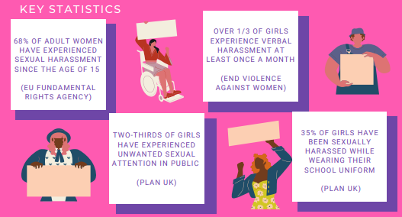
Understanding definitions
Unfortunately, quite a common type of sexual harassment is Public sexual harassment. This comprises unwelcomed and unwanted attention, sexual advances and intimidating behaviour by strangers occurring in public spaces. This can be committed on multiple, and often interlocking, grounds, but all forms of PSH are inherently linked by power and control. It is usually directed towards women and often groups within society who may already face some oppressions. However, it can be experienced by all.
These statistics from various Charities reveal just how common this is …

Slide 14
But why is consent important?
Consent is about more than a yes or no – it is about listening to and respecting your partner. Every person deserves to be respected, especially by their partner.
Having conversations about consent and what you are comfortable with is a normal part of a healthy relationship.
Ignoring consent breaks trust and hurts people. Someone who chooses not to respect their partner’s consent can be breaking the law.
Consent is part of the law but it plays a bigger role than this. Why is consent important?

Slide 15
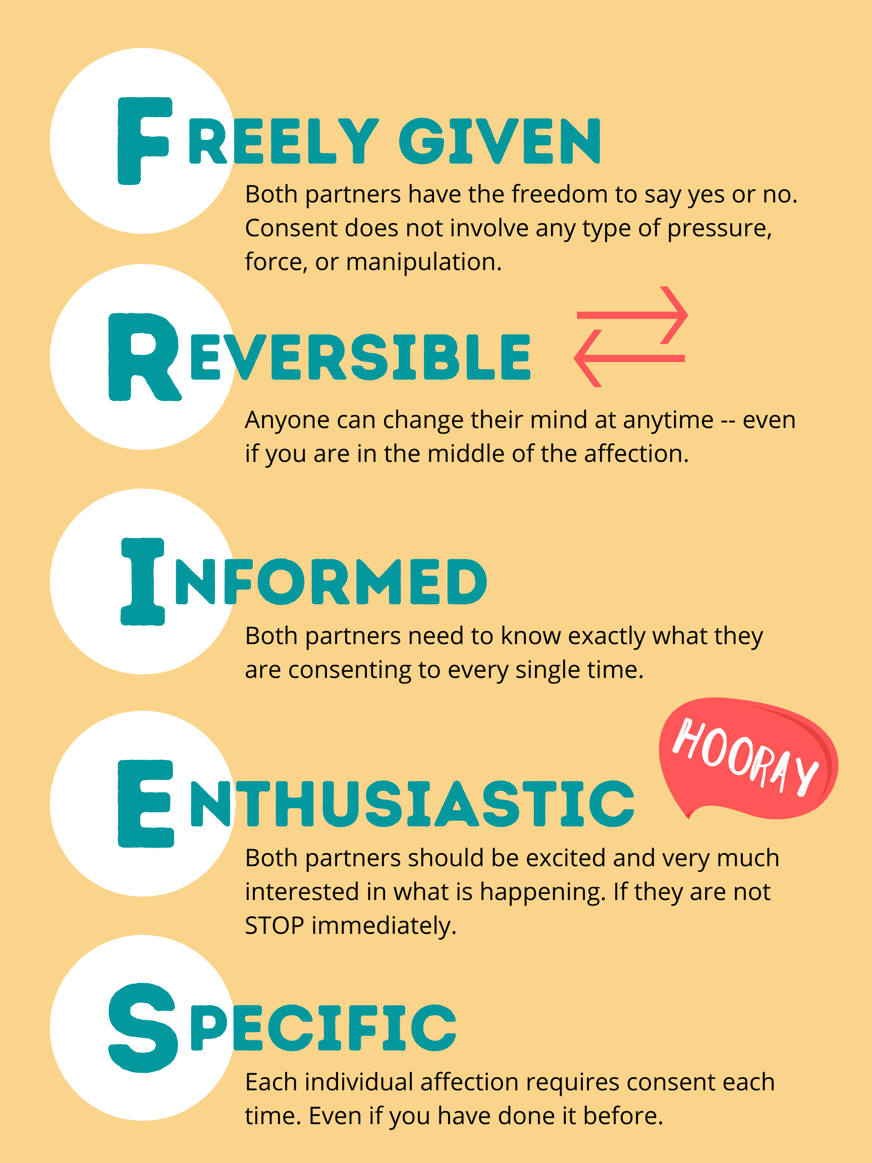
Plenary
Using all of the information from the past few lessons, create an acronym for the word ‘consent’ with an important warning/reminder for each letter that young people should be aware of before getting into an intimate relationship to ensure they are in a safe, healthy relationship.

Slide 16



Available help to those in an unhealthy romantic relationship
At school: Form Tutor, Ms Wilson, Ms Kaye, Ms Marku or Mrs Carron. We are all here to support you.
Childline 0800 1111 or childline.org.uk
Thinkuknow.co.uk
Relate.org.uk

