Slide 1

A LEVELS
Making sensible choices

Slide 2
How many A Level subjects are there?
15 25 45?

Slide 3
In fact…
There are about 60 A Level subjects available in England.

Slide 4
At Woodford we offer 19 A Level courses
They are very much traditional
A level courses

Slide 5
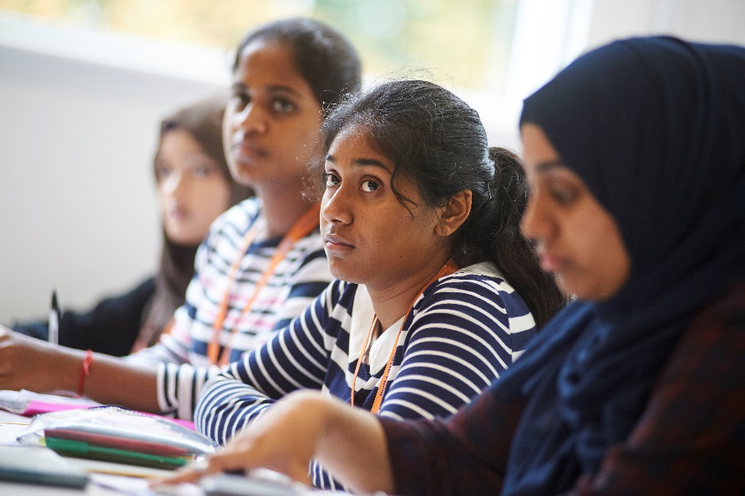
What to study in the Sixth Form?
Consider your options for 2020

Slide 6
There are lots of reasons for choosing a particular A level…
Which of these is not a good reason?

Slide 7
You love the subject.
You need to take it for the course you want to do later.
You’re good at it.
You like the teacher.

Slide 8
You love the subject.
This is arguably the most important reason.

Slide 9
You’re good at it.
We generally enjoy the things we are good at and achieving high grades at A Level is increasingly important.

Slide 10
You need to take it for the course you want to do later.
Entry requirements at university are very strict for some subjects. Do your research. However, there are lots of misconceptions about which degree courses and A Levels you need for a chosen career.

Slide 11
Common Misconceptions
“I wish to become an Accountant or Actuary or work in the City so I must study Economics and Mathematics at university.”
In fact these professions are open to any graduate: 5% of Engineering and History students typically take up these jobs on graduation.
“I must do a degree (and therefore A Levels) linked to a vocation to be sure of getting a job.”
In fact fewer than 5% of jobs in the commercial and business sector require specific degrees.
“I must not do ‘non-facilitating subjects’ if I want to get into a good university.”
In fact even the top universities (Oxbridge) are happy for students to be studying one ‘non-facilitating subject’ at A Level.

Slide 12
You like the teacher
?

Slide 13
Please note: Entry requirements
If you are thinking about applying to a competitive university and for a very competitive course then it is important that you are aware of all the entry requirements for that course, including GCSEs.

Slide 14
Entry requirements: GCSE
The following statement is taken from the
‘Russell Group guide to making decisions about
post-16 education 2011’:
‘Universities may ask for a specific number of
GCSEs…For example, a number of medical
courses ask for five (sometimes more) A*
grades’
In fact experience shows that you are unlikely to be considered for the most competitive courses or by the most competitive universities if you do not have good GCSE results.

Slide 15
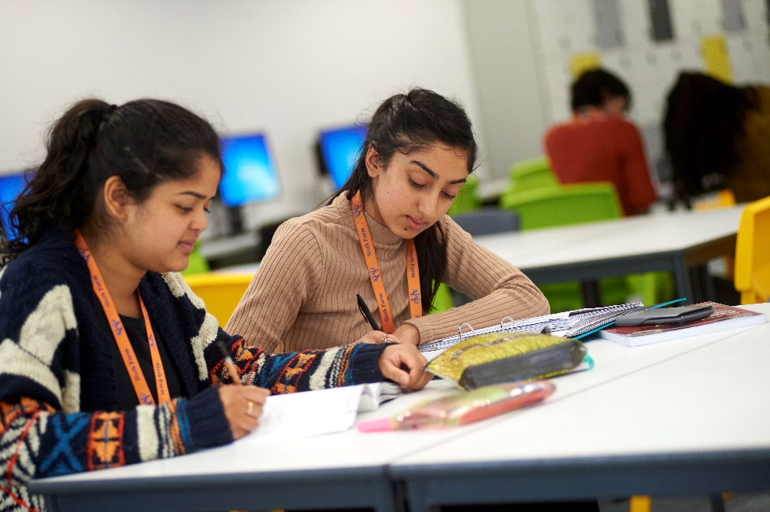
Finally…taking a combination of ‘traditional’ A level courses does not restrict your choice later on
Our students are able to apply for a range of subjects at university

Slide 16
Popular Degrees And Required A Levels
DEGREE | ESSENTIAL A LEVELS | DESIRABLE A LEVELS
Accounting & Finance | None | Mathematics
Architecture | Art (some courses) | Art, Mathematics, Physics
Biosciences | Chemistry | Biology or Mathematics or Physics
Business & Management | None | None
Dentistry | Biology, Chemistry | Mathematics or Physics
Engineering | Mathematics, Physics | Further Maths at some universities
Law | English (some courses) | None
Medicine | Chemistry & Biology (usually) or Mathematics or Physics (some courses) | Mathematics or Physics or contrasting subject
Pharmacy | Biology & Chemistry or Mathematics or Physics (some courses) | Mathematics or Physics

Slide 17
Facilitating Subjects
Most traditional A Levels are so-called “Facilitating Subjects”. These enable you to study for a degree in a linked subject.
For example, if you wish to study History at university you must have A Level History, for Chemistry A Level Chemistry etc. For sciences it is usually advisable to have Maths as well.
You will also need the right facilitating subjects for certain fields of study. For the sciences this is at least one science and maths; for social sciences (eg Politics, Economics, Sociology) at least one Arts or Humanities subject.
However, as long as you have at least two facilitating subjects that is usually sufficient.

Slide 18
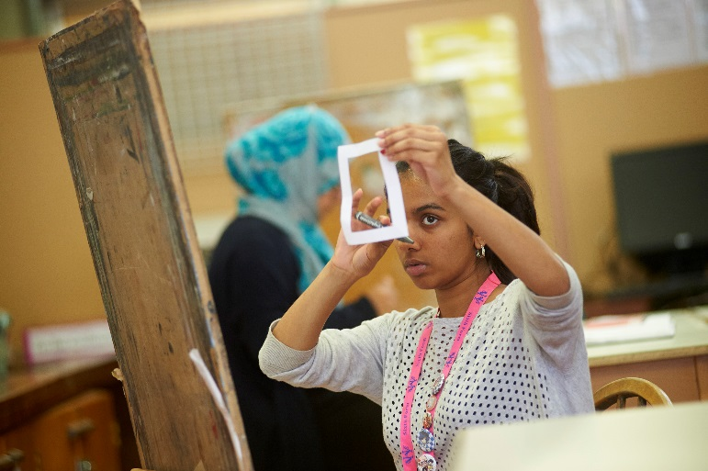
Don’t narrow the field too much now.
You could go on to study courses you have never thought of:
Speech and Language therapy
Nutrition and dietetics
Actuarial sciences
Games and animation design
Advertising and communication
Zoology
Acting
A breadth of choices will keep your options open.

Slide 19
Thinking About Oxbridge?
For many of you this will be a realistic ambition.
To be a competitive candidate you will need:
Very good GCSE grades
A*AA at A Level
To be genuinely enthusiastic about your subject and be aware of developments related to it in the news.
To read a lot.
This starts now (if it hasn’t already).
These attributes are also sought by other highly competitive universities such as LSE, Imperial, Durham, Edinburgh etc

Slide 20
What About Further Maths?
Definitely Consider if:
Do Not Consider Unless:
You wish to do a degree in Maths.
You would like to study Engineering, especially if at a highly competitive university.
You would like to study Economics at LSE and one or two other institutions
You absolutely love maths – this will be half your timetable.
You are really good at maths – GCSE ought to come easily to you.
You need a contrasting subject if studying sciences.

Slide 21
As you can see…our A level programme provides a platform
for a lot of different opportunities

Slide 22

The important thing is for you to do your research
Consult: University websites, parents, teachers, older siblings etc

Slide 23
Important choices: useful websites
A level subjects: what universities want (The Uni Guide)
https://www.theuniguide.co.uk/advice/a-level-choices/six-things-you-need-to-know-before-making-your-a-level-choices
Russell Group guide to making decisions about post-16 education (Informed Choices) https://www.informedchoices.ac.uk/
Subject matters: advice from Cambridge University
https://www.undergraduate.study.cam.ac.uk/files/publications/the_subject_matters.pdf

Slide 24
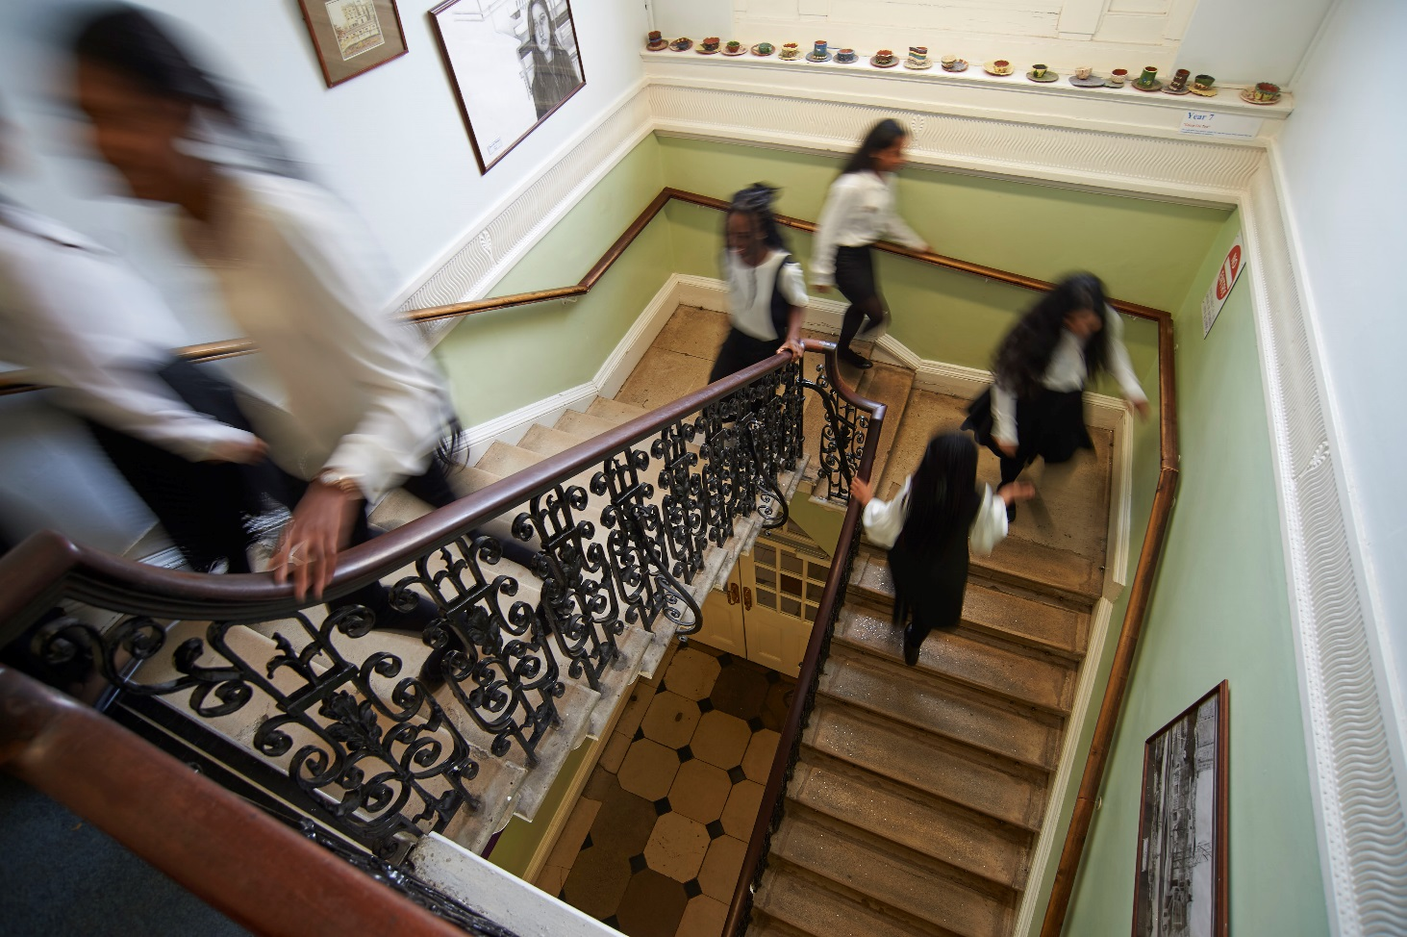
The Options Process

Slide 25
Option Blocks
We will compile these based on the choices you made in the preliminary survey before half-term. These blocks accommodate all those choices.
You will choose THREE full A Level subjects from FOUR blocks.
If you wish to study Further Mathematics you must choose FOUR full A Levels.
If you wish to study a fourth A Level which is not Further Mathematics indicate this on the form.

Slide 26
Three of Four A Levels?
Four A Levels | Three A Levels
You must do 4 if you choose Further Maths. | The standard A Level diet.
If academically strong and well-organised gives added breadth. | Universities make offers on three A Levels
Some courses at some universities have a high points score entry tariff | Manageable workload
 | Better to achieve well on 3 rather than less well on four – A*AA would get you into Oxford, A*ABB would not.
 | Allows you to do the Extended Project

Slide 27
Option Blocks
BLOCK A | BLOCK B | BLOCK C | BLOCK D
Biology | Biology | Biology | Art
Chemistry | Chemistry | Chemistry | Biology
English Literature | Economics | Computer Science | Chemistry
German | English Literature | Mathematics | Classical Civ.
History | French | Music | Economics
Latin | Further Maths | Physics | Mathematics
Mathematics | Geography | Politics | Religious Studies
Physics | Mathematics | Psychology
 | Psychology

Slide 28
The Extended Project
"We welcome the introduction of the Extended Project and would encourage you to undertake one as it will help you develop independent study and research skills and ease the transition from school/college to higher education.“ (Cambridge)
“UCL welcomes the introduction of the Extended Project into the curriculum, recognising that it will develop many of the skills necessary for successful study at university.”

Slide 29
Apply Via The Website
Options go live Tuesday 3rd November.
The deadline is Sunday 3rd January.
Read the information on the Course Guides on the website before making your choice.
https://www.woodford.redbridge.sch.uk/page/?title=Courses+We+Offer&pid=124
If you choose the Extended Project Qualification you will have to fill in a short topic proposal form.

Slide 30
Before Making Your Final Choice
Discuss your options with your teachers in lessons and alongside your parents on Parents Evening on 1st December.
Talk to any Sixth Formers you know who are already studying the subjects in which you are interested.
Make sure that you are happy that these choices are right for YOU.

Slide 31
What Happens Once Choices Are Made?
We will place you in teaching groups ready for next year.
If any subject has insufficient numbers to run we will let you know. You will then have to choose a different subject.
Do as well as you can in your mocks. If it looks like you have chosen the wrong subject we can look again at your choices. We may contact you about this.
We will definitely let you know if we think you may not meet the Sixth Form entry criteria or the criterion for studying four A Levels.

Slide 32
What If I Change My Mind?
We will try to accommodate changes if we think they are reasonable.
We may not be able to do so if:
(a) the subject you wish to take is no longer running in 2021 because of insufficient interest when options were submitted
(b) the subject is full.
(c) there is an option block clash that cannot be resolved.
We try to ensure that no group is larger than 25, except for subjects with a large practical component (eg the sciences) for which a maximum of 20 is our target.

Slide 33
What Are The Entry Criteria?
An average of grade 6 (6 points) across your best 8 subjects.
A Grade 6 in English Language or Literature and Mathematics.
A Grade 6 in the subject you wish to study if you are studying it at GCSE, except:
A Grade 7 for A Level Mathematics and the individual sciences.
A Grade 8 or 9 grade for A Level Further Mathematics
A Grade 7 in Mathematics for Computer Science & Physics
An average GCSE capped points score of 8 or above should you wish to study FOUR A Levels

Slide 34
What If I Don’t Meet General The Entry Criteria?
Unless there are strong extenuating circumstances you will not be able to join the Sixth Form.
If you think that there is a real possibility that you will not meet these criteria at present you need to:
(a) act to improve your academic attainment
(b) apply to another Sixth Form as well as WCHS
If there is a strong extenuating circumstance of which we are unaware, you should let Dr Ashraff know ASAP. Informing us on results day will be too late.
For the vast majority of you none of this should apply! In 2020 only 2 girls did not meet the entry criteria.

Slide 35
What Happens In The Summer?
GCSE Results Day is Friday 27th August.
It is strongly recommended you collect your results in person.
If you achieve the results you need, you confirm your choices and are free to leave.
If you do not achieve the results for your chosen subjects you will need to discuss other options with Mr Jenkins. We will tell you if this is the case.
If you do not achieve the results to return to the Sixth Form you should enrol at once at another institution. We will tell you if this is the case.

Slide 36

Why Woodford?
Strong academic results.
Excellent Higher Education links.
Subject specialists in every subject.
One-to-one tutorial system.
First rate Sixth Form facilities and attractive grounds.
Good range of enrichment activities.
Excellent programme guest speakers and visits to higher education institutions.
Leadership opportunities.
Work experience opportunities.

Slide 37

Any questions?

