Slide 1
AIMS:
This scheme of work is designed to teach students about important legal, social, and cultural aspects of relationships in the UK.
It is not aimed at promoting or encouraging any type of relationship; neither is designed to disparage or discourage any type of realtionship.
The work that has gone into these schme of work attempts to be completely politically neutral and it has not been designed to support any political or activist group's opinions on the issues contained herein.
Lesson 1

Slide 2

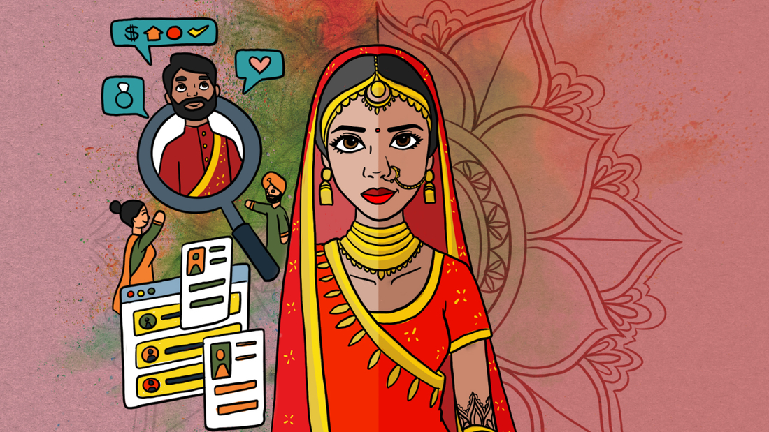
Relationships
Year 8 PSHCE
Lesson 1 – Types of Relationships

Slide 3
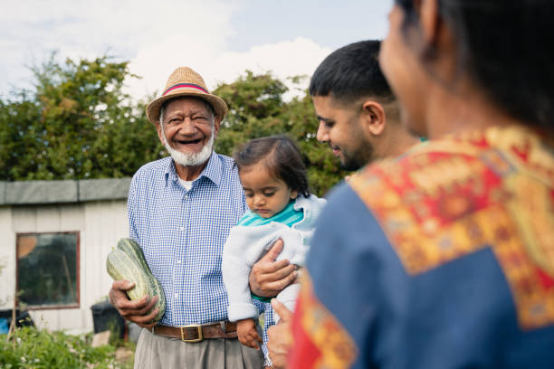
Learning Objectives
To learn about the family and how understand how it contributes to a person's happiness.
To learn about the legal status of marriage and other types of long term relationship.
To consider the role of parents within a family.

Slide 4
The Family

Slide 5
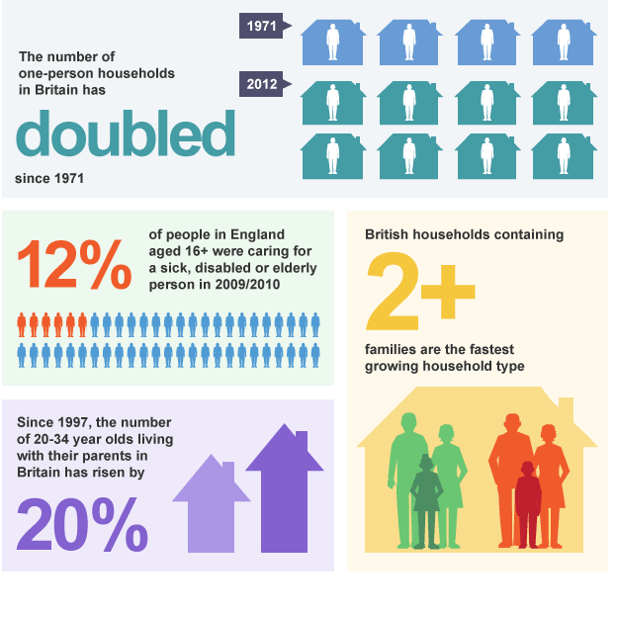
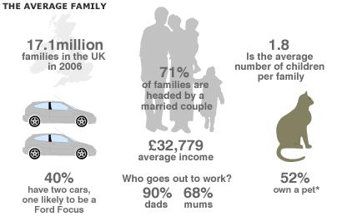
Some Facts on Family in the UK.
1) Do any surprise you? Why?
2) Both images are of previous years' data – what changes would you guess have taken place in subsequent years? Why?
^^^^^^^ BBC Bitesize 2018
BBC News – 2008. >>>>>>>>

Slide 6

Task 1: Guess how many…
Office For National Statistics - UK Families
Guess the missing number in pairs. 5 minutes
Out of 60 million people in the UK, there were [YOUR GUESS] households (homes) in 2014.
B) [YOUR GUESS]% of these contained only one person.
C) Unmarried, 'cohabiting' couples with children grew by a third between 2004 and 2014. This group account for [INSERT OUR GUESS]% of all families in the UK.
D) In 2014 there were [Insert your guess] lone parents with dependent children in the UK.
E) Single homes containing two or more families increased by 56% to [YOUR GUESS] households

Slide 7

How close did you get?
A) Out of 60 million people in the UK, there were 27 million households (homes) in 2014.
B) 28% of these contained only one person
C) Unmarried, 'cohabiting' couples with children grew by a third between 2004 and 2014. This group account for 16% of all families in the UK.
D) In 2014 there were 2 million lone parents with dependent children in the UK.
E) Single homes containing two or more families increased by 56% to 313,000 households

Slide 8
What is a 'family'?
DEFINITION: At least two people living together in the same household who are either in a long term relationship or biologically related; can include biological, step or adoptive children, or relatives from one's extended family.
Types:
- Nuclear families. Two adults with at least one child living together.
- Single-parent families. One parent with one or more children.
- Blended families (Step families). Often two adults with children from previous relationships, who move in to the same home.
- Grandparent families. Grandparents caring for their grandchildren in the absence of the child’s mother and father.
- Childless families. A couple without children; may have pets they consider part of their family.
- Extended families. Multi-generational family units. Can be living in the same home.

Slide 9


Task 2: Family Life is Important
Being part of a family can be rewarding and challenging. Try to identify what benefits come from being part of a family unit. 5 minutes to shortlist as many ideas as you can.
Possible Advanatges | Possible Difficulties
1. ? | 1. ?
2. ? | 2. ?
3. ? | 3. ?
4. ? | 4. ?
5. ? | 5. ?

Slide 10



Possible Advanatges | Possible Difficulties
1. Emotional support and unconditional love during ALL periods of your life. | 1. Overbearing, unreasonable, discouraging, uncaring parenting
2. Companionship, shared interests and entertainment with parents and siblings | 2. Sibling rivalry (not getting on with brothers and sisters)
3. Moral, academic and social guidance - helps you succeed in the outside world | 3. Responsibility for sick or elderly parents and grandparents
4. Financial support growing up (clothes, gifts, university fees, buying a home) and in later life (inheritances) | 4. Bereavement (losing a love one who passes away)
5. Less likely to experience loneliness. | 5. Having to share limited space and resources (larger families)

Slide 11
Marriage

Slide 12

What is marriage?
DEFINITION:
The legally and socially sanctioned union, usually between a man and a woman, that is regulated by laws, rules, customs, beliefs, and attitudes that prescribe the rights and duties of the partners and accords status to their offspring (if any).
Culturally it has been seen as providing the structure for the raising of children, division of labour, economic production, and emotional needs such as affection, companionship and sex (Encyclopaedia Britannica)
Task 3: What does the law say about marriage?
What do you know about marriage in the UK?
In pairs, try to think of two or more facts about this important ceremony. 2 minutes

Slide 13

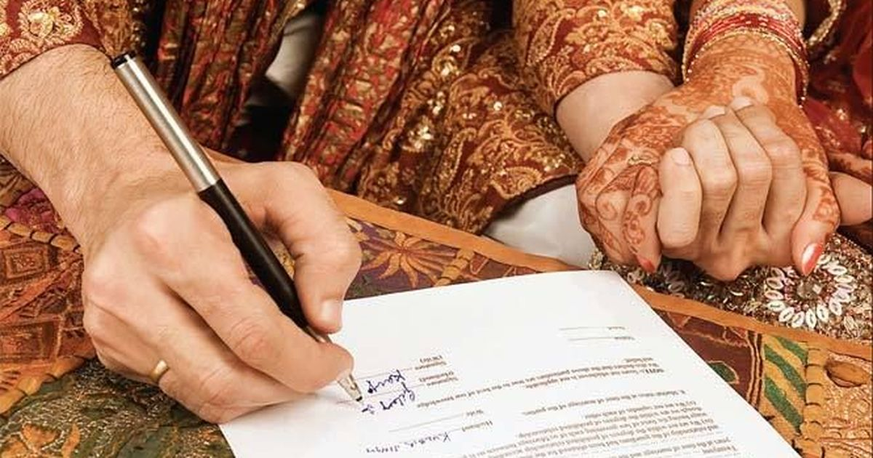
Some answers: How many things did you know?
Only between a man and a woman, both entering voluntarily (forced marriage is illegal).
Many marriages in the UK are influenced by religious belief, but majority of marriages in the UK are non-religious ceremonies, called ‘civil ceremonies’.
A ‘registrar’ (government official) observes the wedding and makes sure it is legally binding.
You can marry at 16 years of age.
You can only be married to one person at a time. Marrying more than one person at a time is called ‘bigamy’ and is illegal.
You must give 28 days notice, provide evidence of your identity and nationality
Overseas travellers can marry in the UK

Slide 14

Task 4: WHY GET MARRIED IN 2021?
Can you think of two or more reasons to get married?
2 minutes to discuss.

Slide 15

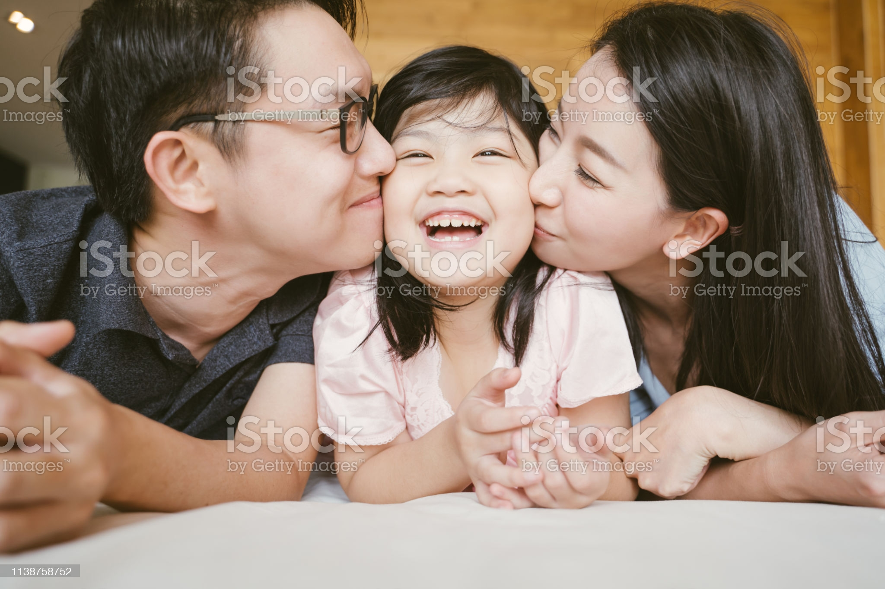

Some answers:
Proof of your love for your partner. Shows your family and friends how you feel about each other.
‘Marriage Allowance’, avoid capital gains tax and inheritance tax, savings protected.
Companionship, share worries, receive emotional support. Some research suggests happily married couples live longer than the average person, and maker swifter recoveries from serious illnesses.
Safe, secure environment for having and raising children.
Excuse for a big family gathering/get together, which is fun!
Make new friends.
In most faiths it is obligatory to be married before sexual intimacy.

Slide 16

How does Marriage differ from other types of long-term relationship?
Introduced in 2005, Civil Partnerships are an alternative to marriage. These afford the same legal protection and recognition to same sex couples as married couples.
However, civil partnerships are also taken up by heterosexual couples who may be wary of marriage (they are divorcees, they do not like the religious associations).
Common law spouses refer to couples who live together but who have not formally registered their relationship. If a couple separate, there is no right to share assets, or provide ongoing financial assistance to one another. Less commitment than marriage or civil partnerships.
- In your opinion, what advantages might marriage have over simply living with your partner as a common law spouse?

Slide 17
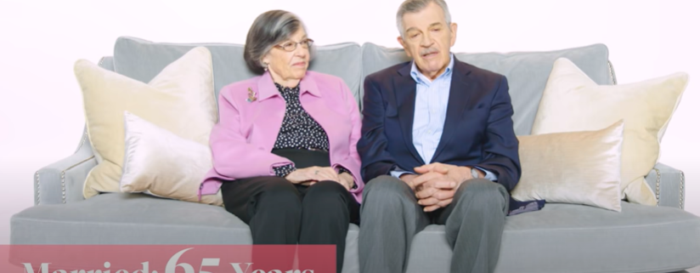
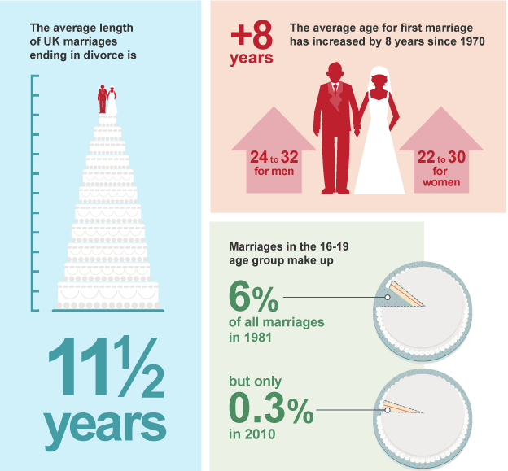
Video Interviews - What is it like to be married?
Watch the following two videos:
1) Older married couples - https://www.youtube.com/watch?v=mj0O_6oVhts
2) Variety of couples discuss their ideas about a happy marriage:
https://www.youtube.com/watch?v=kHL4k9yd8Co
- What do you think about marriage? Class discussion

Slide 18
Parenting

Slide 19


Task 5: What is the role of a good parent?
At different ages, young people require different things from their parents. Try to list as many age-specific duties that good parents undertake in each age category. 10 minutes to discuss and make notes on
0-10 Years | 11-18 Years | 19-30 Years
? | ? | ?

Slide 20
0-10 Years | 11-18 Years | 19-30 Years
Changing nappies feeding with healthy food comforting reading to their child throwing birthday parties finding them a good school pick off and drop off at school not being absent through work if possible raising them in their religious faith not being engrossed in their mobile phone Playing games with their child Character building | Help with homework giving pocket money being welcoming of their child’s friends discouraging their child from falling into wrong peer group and committing crime taxiing their child to sports clubs and friends’ houses encourage academic success and hard effort limiting their child’s time on computer games and smartphones | Encourage their child to get a job and financially assist themselves Financial assistance with university fees and buying first home giving their child space and freedom making effort to see their child encouraging their career choices and aspirations What did you get?

Slide 21
Review of learning:
To learn about the family and how understand how it contributes to a person's happiness.
To learn about the legal status of marriage and other types of long term relationship.
To consider the role of parents within a family.

