Slide 1
Gender
Stereotypes and
Sexual identity
Year 10 PSHCE
[ Relationships]
Lesson 10

Slide 2
Lesson Objectives
I can discuss gender and stereotypes in relation to a range of romantic relationships
I can identify and understand the legislation relating to a range of relationships
I understand the risks associated with exploring sexual identity

Slide 3
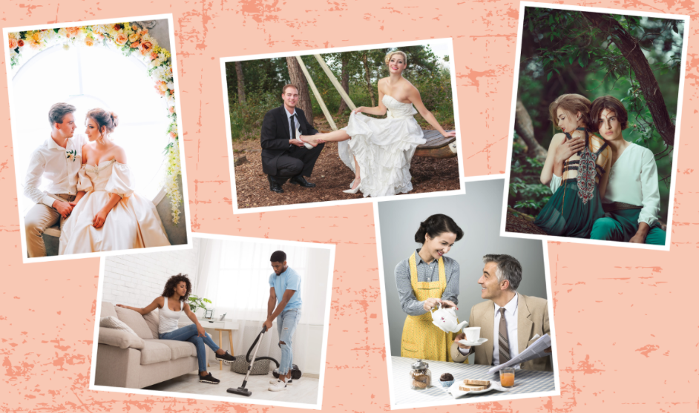
Gender uniqueness or gender stereotype?
Notes:
Ask the class to take a look at the pictures. They should think about whether the images depict gender uniqueness or gender stereotype in a relationship. They can note down what comes to their minds on lined paper.
Students do not have to share their view yet. Please move on to slide 4.

Slide 4
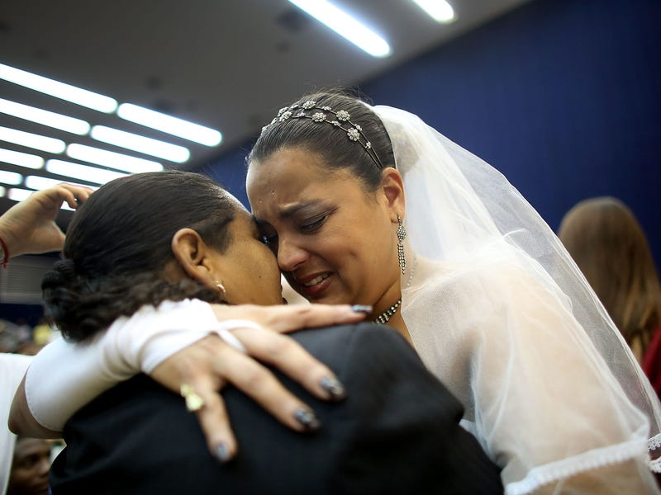
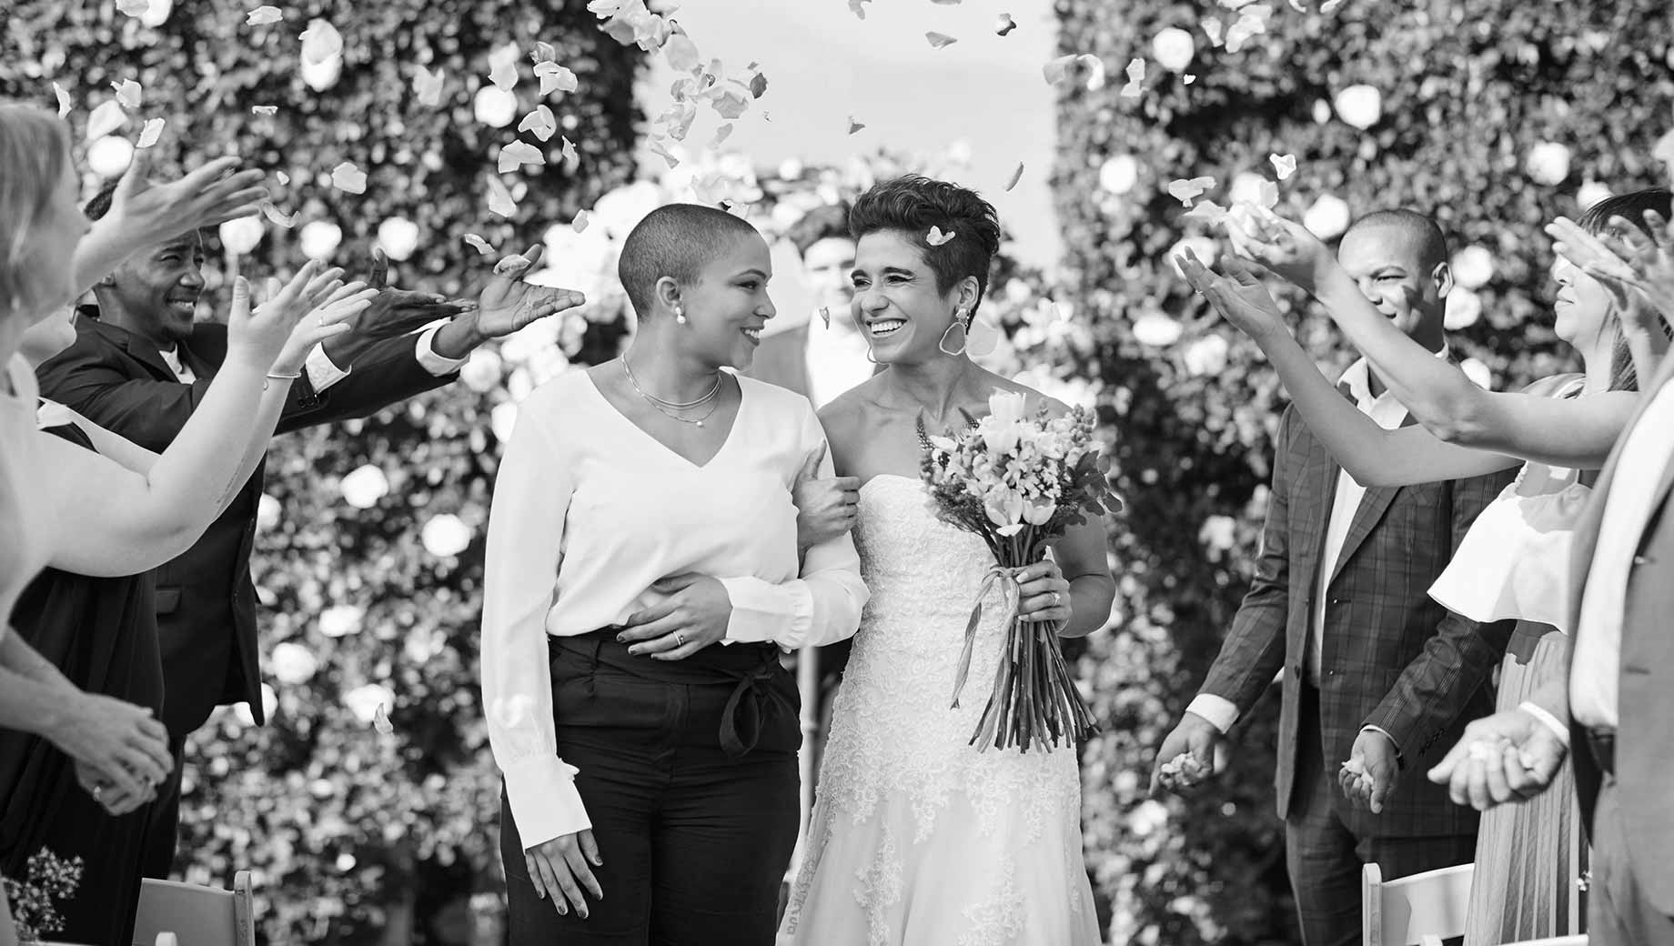
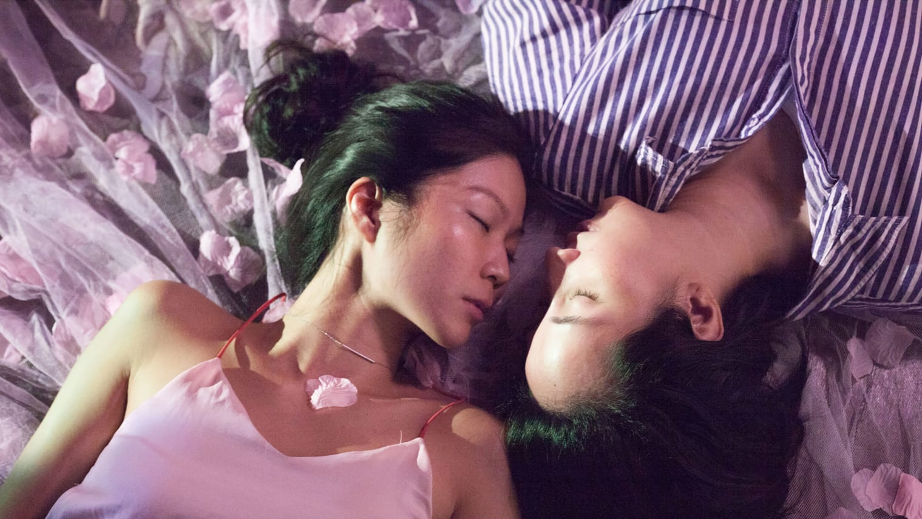
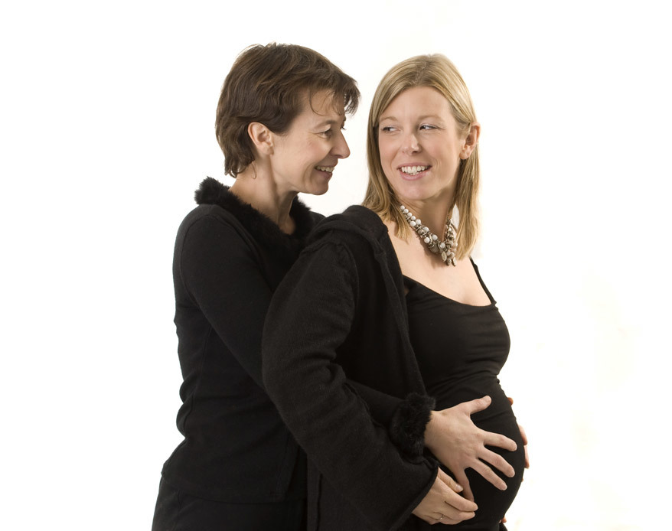
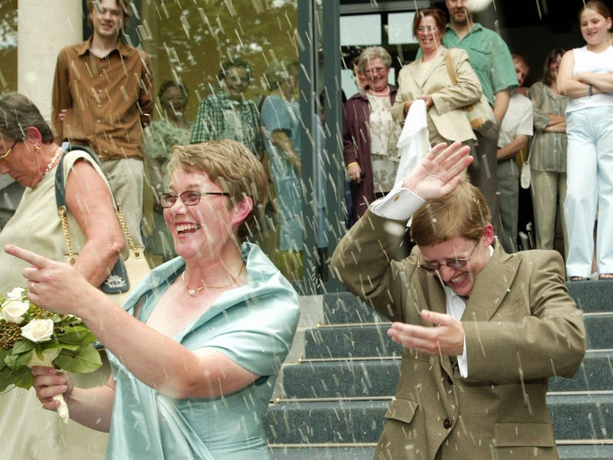
Are there gender stereotypes in same sex couples?
Notes:
Students should be asked to now look at these image. They should note down their thoughts to the question: “ are there gender stereotypes in same sex couples?”
They do not need to share their views at this stage. They should hold on to their notes and can use them as part of the tasks to reflect on throughout the lesson. Please move on to slide 5.

Slide 5
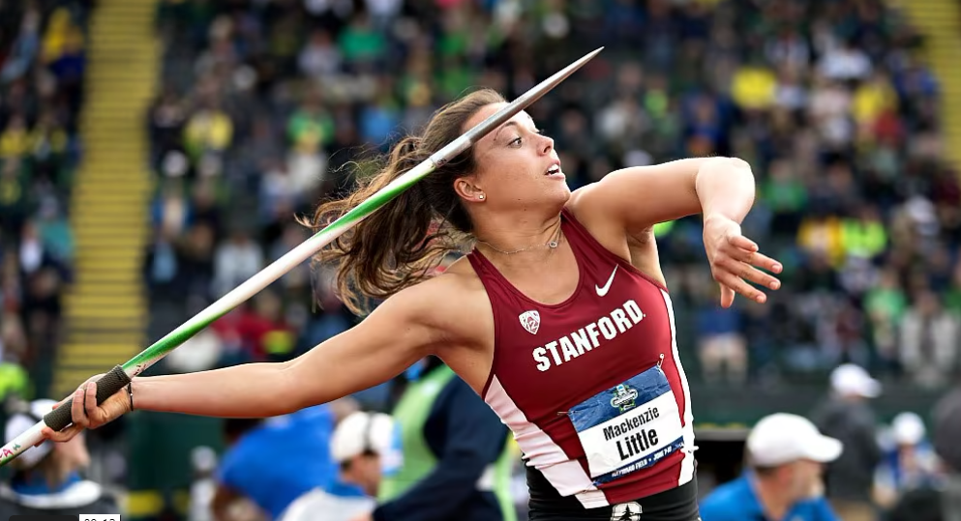
Isabelle
Isabelle has just won a scholarship to a US university to study sports science. She has got the scholarship because she’s a talented javelin thrower and shot –putter.
She trains every day and is very fit and strong. She is in a great mood and wants to celebrate.
Isabelle has been asked out on a date by Brad. She’s liked him for a while but is wondering whether how attractive he finds her.
She’s feeling nervous about the date and wondering if she should try to cover up her muscles and play down the fact that she’s won the scholarship.
his perception or Her assumption?
Notes:
Has Isabelle assumed that Brad will see her as less feminine because she may appear more muscular?
How can Isabelle help herself confident in her body?
Ask the class to read through the short scenario and come up with some advice for Isabelle.

Slide 6
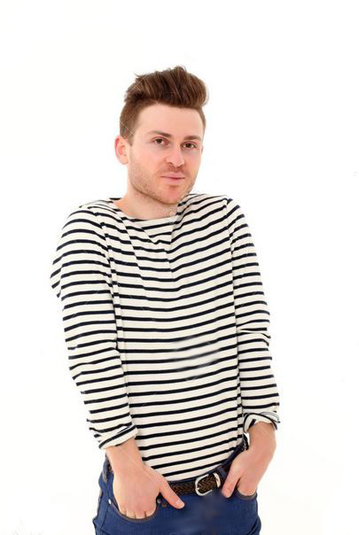
Joel
Joel has often been described as ‘sensitive’. He’s not that keen on sport, likes music, art and literature. He’s tall but fairly slim and wouldn’t be posting his gym body on social media!
He’s just got a summer job as an assistant at a children’s holiday club where he’ll be helping to organise activities like craft projects, games and performances.
Some of his friends have been laughing at this and calling him super-nanny. He’s been chatting a lot to Chloe who is one of the confident, popular girls in his year. He’s quite surprised by this, but they actually get on well and she’s asked him out.
Joel isn’t sure what to do. He’s worried that he will just get dumped, or that she’s asked him out for a dare.
Sensitive
or
introvert?
Notes:
Ask the class to read through the short scenarios and come up with some advice for Joel.
Ask: What other gender stereotypes are there? What about same-sex couples? Are there gender stereotypes around them too?
Introversion is a personality trait characterized by a focus on internal feelings rather than on external sources of stimulation. Introverts and extroverts are often viewed in terms of two extreme opposites, but the truth is that most people lie somewhere in the middle.
While introverts make up an estimated 25 to 40 percent of the population, there are still many misconceptions about this personality type. It is also important to note that introversion is not the same thing as social anxiety or shyness. Being an introvert does not mean that you are socially anxious or shy.
https://www.verywellmind.com/signs-you-are-an-introvert-2795427

Slide 7
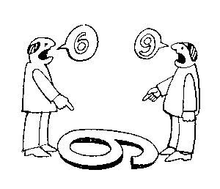
Class activity
Your teacher will split the class into 2 groups – allocate the number 1 and 2 randomly and ask students to move to 1 side of the room according to their number
One side will be the side that “agrees” and the other side will be the side that “disagrees”.
You will need to select a spokesperson for your side
Your teacher will read out statements from the next slide.
You will have a couple of minutes to form your argument to reflect the view of your side ready for your spokesperson to present
Understanding perspectives
Note: It is important to note that this exercise requires you to demonstrate your skills of being tolerant of all views and to be able to explore all opinions and perspectives.
You are not expected nor asked to justify your personal views.
The arguments you provide are for the side you have been placed on to represent.

Slide 8
List of statements:
People should go for the jobs they think they would be good at and are interested in.
Your gender should have no impact on your subject choices.
Males and females are equal
Being the only male/female in a class would put me off choosing that subject.
The best job for you is one that matches your skills, abilities and personal qualities.
Boys are better at technology subjects than girls.

Slide 9
Religious perspectives
In Orthodox Judaism, the role of women is generally seen as separate but of equal value. Women's obligations and responsibilities are different from men's, but no less important. The primary role of a woman is as wife and mother.
Many Catholics believe husbands and wives should respect each other's roles within a marriage and value both equally. These roles include those of care within the home, and that of earning money to provide for the family.
The belief that men and women should have different roles is still common in some Christian communities today. This is because they believe that God made men and women differently.
Muslims also believe that it is the duty of a man to provide for the financial needs of his family, and for a woman to look after the home and family. However women can work and maintain their own wealth.
Reform Jews believe in the equality of men and women. Both husband and wife may work outside the home, take part in domestic work and raise the children.
Muslims believe that Allah views men and women as equal, but they have different roles. It is part of Allah’s design and purpose for men and women to have different physical characteristics.
Other Christians believe that men and women were both made in the image of God and should be treated equally – they should share responsibilities and privileges.
Notes:
Display on board for students to read and consider
Adapted from GCSE Bite size
https://www.bbc.co.uk/bitesize/guides/z2symsg/revision

Slide 10
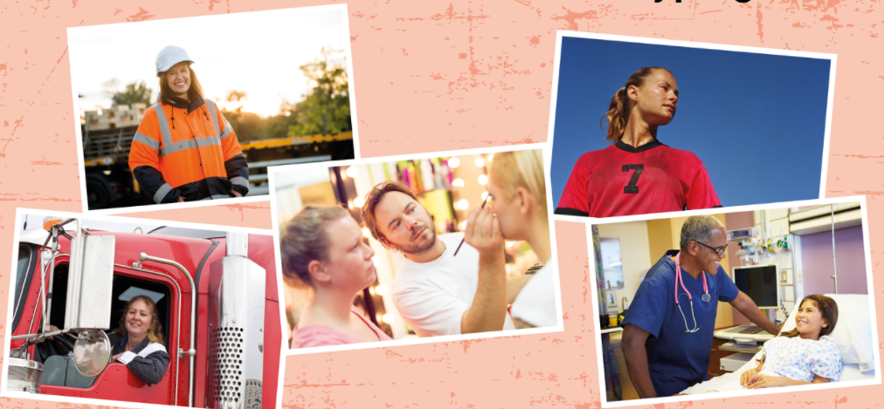
What can we do to reduce stereotyping?
Notes:
Show the slide and ask students to work in pairs come up with a list of suggestions in 3mins.
Share the examples to make a class list.

Slide 11
Exploring sexual identity – what are the risks?
Discuss the scenarios below and identify and dangers/ risks associated with each
 | Situation | What are the risks?
1. | Jude has a miserable home life and is desperate to leave. She has registered with some dating sites. She is 16 but has said that she is 19 on her profiles. She is getting a lot of interest and has 6 dates lined up – all with older men.
2. | Joel is completely confused. He doesn’t feel attracted to girls or boys but, since a young age, lots of people have told him he must be gay because he’s small for his age and not very masculine. He has started spending all his spare time on forums and watching porn to try and find out if anything makes him feel aroused.
Notes:
Ask students to work in small groups or pairs to discuss the scenarios.
If time is short, they could pick one or two to discuss.
Take feedback and make a class list of the potential dangers for the young people in the scenarios.

Slide 12

Reflective thoughts
The difference between gender stereotyping and celebrating gender uniqueness needs to be carefully considered
We need to ensure we are aware of what could potentially be a limiting stereotypical comment in comparison celebrating a gender based quality or ability
For the benefit of our own mental health and self confidence, we should ensure we have considered all perspectives
We should remind ourselves that there is no rush to explore sexuality or to have sexual relationships. Sometimes, time brings clarity.

Slide 13
How can we support?
If you have questions or would like to discuss anything relating to gender stereotyping or sexuality, we are here to support.
You can speak to any of the KS4 pastoral team or a teacher who you feel comfortable with that will inform us
  KS4 Pastoral Team
  Your Form Tutor
  KS4 Assistant Head teacher – Dr Ashraff
  Head of Year - Ms Hossein
  SGO – Mrs Holman
  Assistant SGO – Mrs Menon
You do not have to worry about anything. Information you pass on is dealt with sensitively and the relevant person giving you guidance will only inform whoever it is necessary to inform depending on your situation.

Slide 14
Research task:
How does the following legislation [laws] relate to stereotypes?
Marriage between heterosexual couples
Marriage between same-sex couple
Civil partnership between same sex couples
Civil partnership between heterosexual couples
Notes:
Explain to the class that, until 1937, women had very few rights if they wanted to get divorced. For centuries, men held all the cards, including owning property and money/finance their wives might have had before marriage; they were also able to stop their wives seeing their own children if the marriage dissolved.
Since 1937 legislation changed gradually in favour of women.
As far as same-sex couples are concerned, it is only very recently that civil partnerships and marriage has been a possibility.
Since January 2020, civil partnerships have also been an option for heterosexual couples.
Task: Research the legislations using the internet. Do you think that same-sex couples also find themselves in stereotypical roles within their legal partnerships?

