Slide 1
Pregnancy and Choices
Year 11 - PSHCE

Slide 2
Lesson summary
Teacher
slide
Activity | Description | Timing
Introduction | Introduce learning objectives and outcomes and reinforce ground rules. | 5 MINS
2. Pregnancy Choices in UK | Class discuss and identify pregnancy contraception | 10 MINS
3. Laws | Laws on abortion, adoption and surrogacy | 15 MINS
4. Decision Making | Task 1: In pairs, come up with ten different factors that might influence the decisions someone makes about wanting to have a child. [5mins] Task 2: Students knowing Pregnancy, the myths and reality [5mins] Task 3: Bringing up a baby [5mins] | 20 MINS
5. Reflection and endpoint assessment | Task 4: Students return to their Scenario to give advice and add key learning from the lesson. | 5 MINS
6. Signpost support | Signpost students to relevant support. | 5 MINS

Slide 3
Lesson Objectives
I understand the choices available in relation to contraception and pregnancy
I know key facts about pregnancy
I understand UK law on Abortion and adoption

Slide 4
Social and Emotional Skills Learning Intentions
I have an understanding of my own feelings and beliefs about pregnancy and choice
I understand that there are a range of views and beliefs about contraception and pregnancy and respect that views may differ from my own

Slide 5

Ground Rules
Everyone has the right to…
Participate or pass
Listen and speak
Privacy
An opinion
Learn
Respect each other
Everyone has the responsibility to…
Allows others to participate or pass
Listen and allow others to speak
Maintain privacy
Respect difference of opinion
Allows others to learn
Shows respect to each other
Notes:
Teacher Notes
Negotiate or revisit ground rules for the lesson. Use this slide to display your class agreement / ground rules lessons.

Slide 6
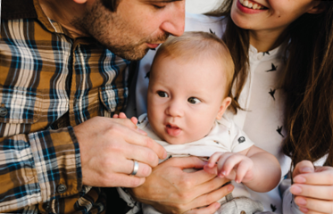
Is having a baby always your choice? [5mins class discussion]
Notes:
Teacher Notes
Is having a baby always your choice
When would you consider having a baby?
Get students to discuss and show their understanding whether they understand if it is a choice

Slide 7
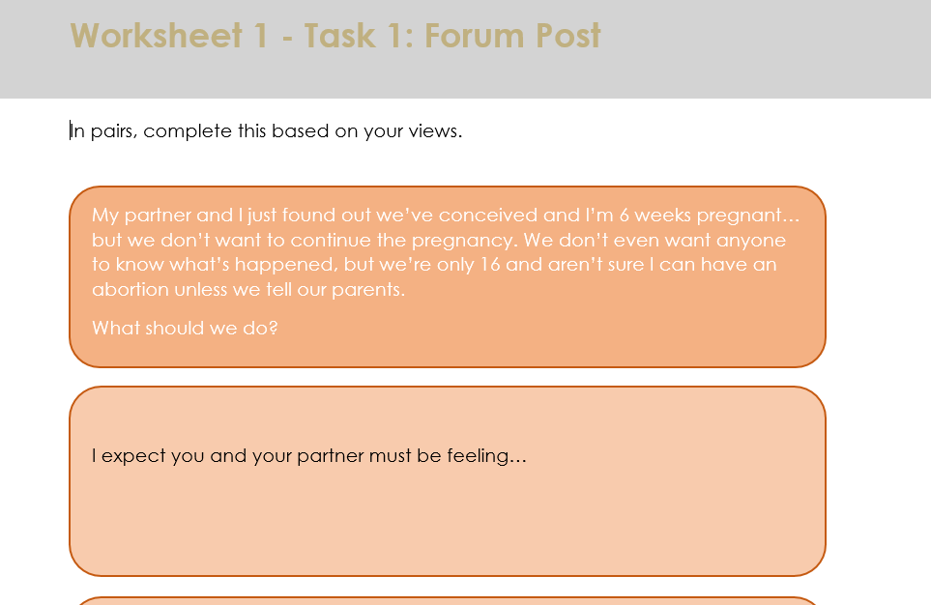
Forum Post [5mins]
In pairs, complete the form post. What advise would you give under the following headings:
I expect you and your partner must be feeling…
The first thing you should do is…
The laws around abortion say that…
To get some more advice, help or support you could…

Slide 8

Pregnancy choice in the UK
Emergency contraception (this is a preventative method that can be used if there is a chance that contraception has failed or has not been used and there is a risk of pregnancy)
Medical abortion (abortion pill)
Surgical abortion (minor medical procedure under local or general anesthetic)
Both methods can be used up to 24 weeks of pregnancy other than in exceptional circumstances.

Slide 9
UK Law on Abortion
The Abortion Act 1967 (as amended by the Human Fertilisation and Embryology Act 1990) states that an abortion is legal if it is performed by a registered medical practitioner (a doctor), and that it is authorised by two doctors, acting in good faith, on one (or more) of the following grounds (with each needing to agree that at least one and the same ground is met):
a) that the pregnancy has not exceeded its twenty-fourth week and that the continuance of the pregnancy would involve risk, greater than if the pregnancy were terminated, of injury to the physical or mental health of the pregnant woman or any existing children of her family; or
(b) that the termination is necessary to prevent grave permanent injury to the physical or mental health of the pregnant woman; or
(c) that the continuance of the pregnancy would involve risk to the life of the pregnant woman, greater than if the pregnancy were terminated; or
(d) that there is a substantial risk that if the child were born it would suffer from such physical or mental abnormalities as to be seriously handicapped.
https://www.bpas.org/get-involved/campaigns/briefings/abortion-law/
Notes:
Teacher Notes
Abortions can only take place in licensed clinics or hospitals.
A number of appointments are necessary and counselling is given as part of the service offered.
It is illegal to carry out your own abortion and abortion pills available online can be harmful.
Abortion is allowed up to 24 weeks
The British Advisory Pregnancy Service (BAPS) is a free confidential service that offers advice on finding appropriate care.

Slide 10

One Word Count on Abortion – what is yours?
Notes:
https://www.youtube.com/watch?v=beRWmz_7kOc

Slide 11

Abortion – Different opinions & Feedback [10mins]
Abortion is a topic which divides people
Some people think that life begins at conception (when the sperm fertilizers the egg) – for them, life is a gift and therefore abortion is wrong.
Others think that the life of the mother is more important as the fetus is not independent – they think the woman should chose what happens to her body. Abortion for them is the mother’s right.
Two women's stories of abortion - BBC Newsnight
Click on the image to watch the clip
Notes:
https://www.youtube.com/watch?v=thXev9aP2p8
Shows that either side is not without complication
Abortion influences
Ask students to list what they think might influence someone’s views about abortion and take some feedback.
Opinions on abortion might be influenced by: someone’s family, friends, or peers; their personal values; their culture; their religion; the strength and/or nature of their relationship with their partner; their plans for the future; the legal status of abortion; the media.

Slide 12
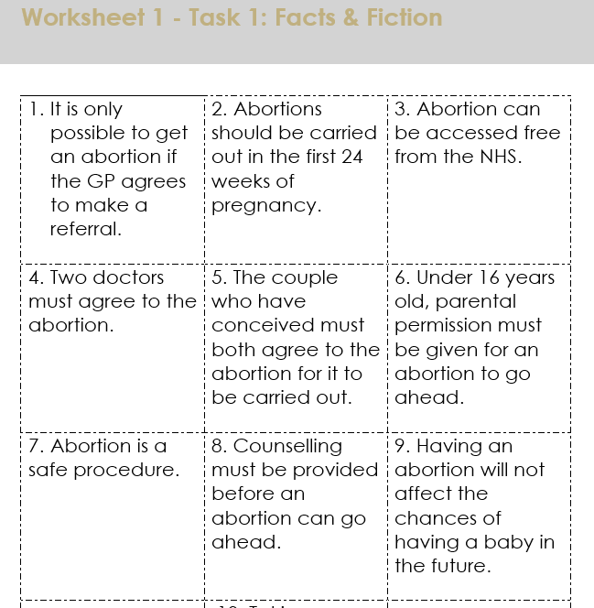
Abortion Fact or Fiction [5mins]
In pairs, assess whether a variety of statements about abortion are true or false.

Slide 13

What about adoption?
What is adoption: Adoption is a way of providing the security, permanency and the love of a new family when it is not possible for a child to be raised by his/her birth parents or within the birth family.
After adoption, all rights and responsibilities are transferred from the original parents to the adoptive parents

Slide 14
Adoption Rules
You are able to adopt:
  Single or married
  Regardless of your sexual orientation
  If you are from any ethnic or religious background
  If you have your own children or not
  If you are a homeowner or if you are rent
  If you have already adopted
  If you are disabled
You will not be eligible to adopt if you are under the age of 21, have a criminal record for offences against children or for a serious sexual offences.
https://www.gov.uk/child-adoption

Slide 15

What is surrogacy?
Surrogacy is when a woman carries and gives birth to a baby for another person or couple. Find out more about what surrogacy involves and if it might be right for you. Please note we don’t regulate most aspects of surrogacy.
Who might have surrogacy?
Surrogacy may be appropriate for women with a medical condition that makes it impossible or dangerous for them to get pregnant and give birth. These include:
absence or malformation of the womb
recurrent pregnancy loss
repeated in vitro fertilisation (IVF) implantation failures.

Slide 16


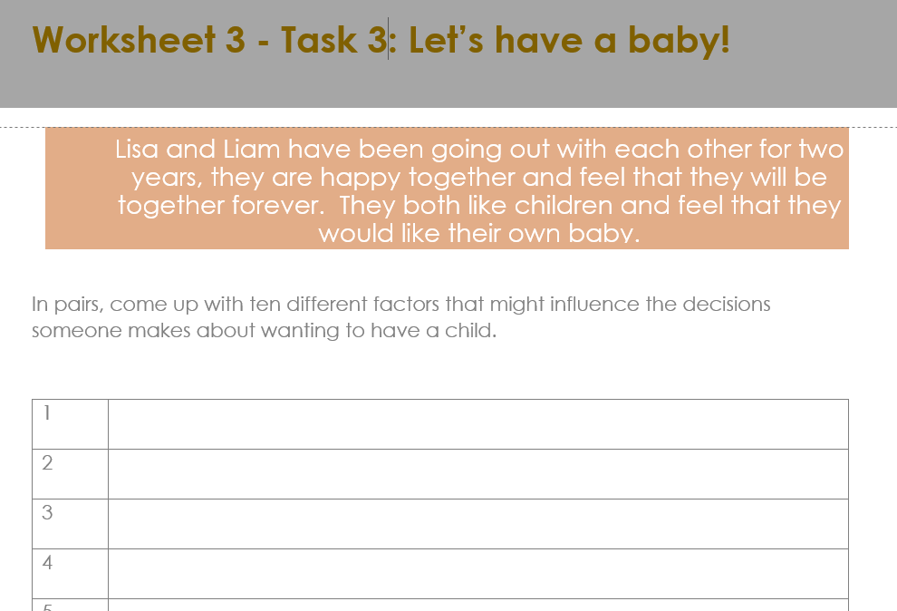
Lets have a baby! [5mins]
Lisa and Liam have been going out with each other for two years, they are happy together and feel that they will be together forever. They both like children and feel that they would like their own baby.
Task 3: Worksheet 3 - In pairs, come up with ten different factors that might influence the decisions someone makes about
wanting to have a child.

Slide 17
Did you think of..?
attitudes toward/feelings about having a baby (own and partner’s)
relationship status, e.g. wedlock
opinions of their family and friends
community attitudes
financial considerations
religion or culture
plans for the future, career goals, aspirations
personal goals or aspirations
education or employment
physical or mental health

Slide 18
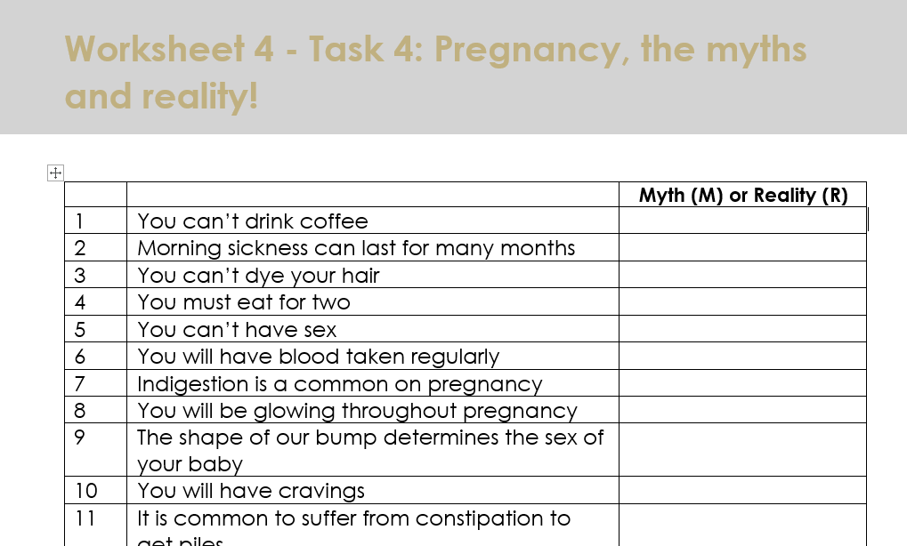
Pregnancy, the myths and reality [5mins]
Task 4: On the worksheet 4, read through the following statements about pregnancy and decide if they are myth or reality

Slide 19


Giving advice [5mins]
Return to Lisa and Liam’s scenario. At the bottom of the Task 1 Worksheet, Task 4: write a paragraph of advice to Lisa and Liam explaining what they could do next and where they could go to access further help and support.
Now, share your ideas in small groups, and together decide what you think is the single most important piece of advice you could give someone in Lisa and Liam’s position — write this on a post-it and stick it on the board.

Slide 20
Summary Points: Pregnancy Choices: Raising the Baby, Abortion and Adoption
Having a baby is huge decision whatever the age of the parents, but it can be even more challenging for young people. We often assume that pregnancy is a choice that everyone has but its not quite straight forward as we think.
Infertility is a problem for many people. Some people might chose to IVF methods and adoption instead.
Whatever the choice, the effect on physical and mental health can be long term and sometime is something that may not be forgotten.
Being aware of effect methods of contraception, what to do if there is any problem with contraception and who to speak to for help and advise is information that all young people need to be aware.

Slide 21
Further support
Speak to a tutor, head of year, school nurse or other trusted member of staff in the school
Contact GP surgery or local sexual health clinic
Contact Childline www.childline.org.uk 0800 1111
Visit www.nhs.uk/SERVICE-SEARCH/sexual-health
Notes:
Teacher Notes – Signposting support (5mins)
Ensure that students know where they can seek help and further advice both now and in the future, in relation to planned/unplanned pregnancy.

Slide 22

More activities
Research and create a short fact-file about the service you have been given, ensuring the following are included:
Name of service and location
Contact details and opening times
Services they provide
Notes:
Teacher Notes – Extension activities
Select some local support services and provide students with links to them. Ask students to research and create a short fact-file about one of the services, ensuring the following are included:
Name of service and location
Contact details and opening times
Services they provide
These could form part of a ‘support services’ display.

