Slide 1
Sexual Pressure
Year 11 - PSHCE

Slide 2
Lesson summary
Teacher
slide
Activity | Description | Timing
Introduction | Introduce learning objectives and outcomes and reinforce ground rules. | 5 MINS
2. Faith View | Discussing views on why do people have sex? Looking at the faith perspective When do you know if you are ready or not to have sex? | 10 MINS
3. Scenarios – What advice? | Working in small groups of 3, read through the scenarios and complete the question. Students feedback to the class and teacher engages in class discussion Students in pair, work on putting some phrases together to fending off unwanted sexual advances | 15 MINS
4. Consent? | Watch the short video clip and consent Working in small groups of 3, read through the scenarios and complete the question. Class discussion on each scenario | 10 MINS
5. Reflection and endpoint assessment | Students reflect on the lesson add key learning from the lesson. | 5 MINS
6. Signpost support | Signpost students to relevant support. | 5 MINS

Slide 3
Lesson Objectives
I understand the influences that inform decision making with regard to sexual relationships.
I know some strategies to help manage sexual pressure
I understand what consent is in relation to sexual relationships

Slide 4
Social and Emotional Skills Learning Intentions
I recognise that there are different views about sexual relationships and my own may be different from others

Slide 5

Ground Rules
Everyone has the right to…
Participate or pass
Listen and speak
Privacy
An opinion
Learn
Respect each other
Everyone has the responsibility to…
Allows others to participate or pass
Listen and allow others to speak
Maintain privacy
Respect difference of opinion
Allows others to learn
Shows respect to each other
Notes:
Teacher Notes
Negotiate or revisit ground rules for the lesson. Use this slide to display your class agreement / ground rules lessons.

Slide 6

Everybody is doing it – are they really?
Notes:
Teacher Notes
Class discuss on students views

Slide 7

Why do people have sex?
Notes:
Teacher notes
Class discussion: To think about the reason why people have sex. [5mins]

Slide 8
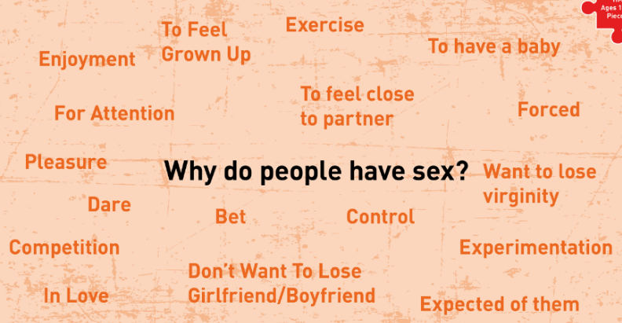
Marriage
Religion

Slide 9

Faith View on Sex
Many religious views teach that sexual relationships are important, and that sex is a gift from God and not something to be taken lightly.
Therefore, many believe that sex should only take place within marriage, as it is a safe and stable environment in which a couple can share the whole of themselves with each other.
Marriage is also regarded as the best environment to raise a family than having a casual sexual relationships.
Purpose of sex – it is important as it is a way to continue the human race and express love.
Christianity, Islam, Judaism.

Slide 10

Are you ready for sex?
The questions to ask yourself about sex. If you think you might have sex, ask yourself the following questions:
Does it feel right?
Do I love my partner?
Does he/she love me just as much?
Have we talk about using contraception's? To protect against pregnancy?
Do I feel able to say “no” at any point if I change my mind and will we both be OK with that?
If you have taken into your religious, culture views, personal, family views and answered yes to the above, and are above the age of consent then you may be ready.

Slide 11

Are you ready for sex?
The questions to ask yourself about sex. If you think you might have sex, ask yourself the following questions:
Do I feel under pressure from anyone, such as my partner or friends?
Could I have any regrets afterwards?
Am I thinking about having sex just to impress my friends or keep up with them?
Am I thinking about having sex just to keep my partner?
If you have answered yes to the above, then you may not be ready.
Remember, being in a relationship doesn’t mean you have to have sex. Even if you have done it once or twice, you still need to make sure it’s the right time.

Slide 12
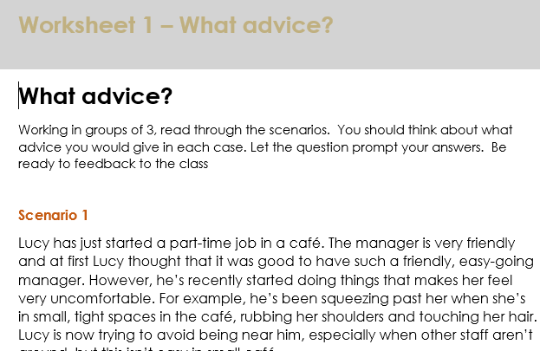
Scenarios – what advice?
Working in groups of 3, read through the scenarios.
You should think about what advice you would give in each case. Let the question prompt your answers.
Be ready to feedback to the class

Slide 13
Scenario 1 – what advice?
Lucy has just started a part-time job in a café. The manager is very friendly and at first Lucy thought that it was good to have a such a friendly, easy-going manager. However, he’s recently started doing things that makes her feel very uncomfortable. For example, he’s been squeezing past her when she’s in small, tight spaces in the café, rubbing her shoulders and touching her hair. Lucy is now trying to avoid being near him, especially when other staff aren’t around, but this isn’t easy in small café.
Why is Lucy feeling awkward?
Is the behaviour of her manager appropriate?
What would you advise Lucy to do?
Notes:
Teachers Note
Class discussion

Slide 14
Scenario 2 – what advice?
Elijah and Amelia have been together for two years and are very happy together. They have a respectful relationship and up until this point there has been no pressure around taking their relationship to the next stage. Amelia now feels that she would like to have sex, however, Elijah is worried about this as he and his family are very religious and don’t believe in sex before marriage. Elijah loves Amelia but is worried that his family would somehow find out if he had sex and be upset with him. This has put pressure on their relationship.
What advice would you give Amelia and Elijah?
Do you think the relationship is likely to continue?
Notes:
Teachers Note
Class discussion

Slide 15
Scenario 3 – what advice?
All of Jamal’s friends have been boasting that they’ve had sex and are now joking about him being a virgin. There’s a girl who really likes Jamal and although he thinks she’s a nice person he doesn’t fancy her. However, he thinks that if he pays her a bit of attention, she will have sex with him and then his friends will stop taunting him about being a virgin.
What's influencing Jamal to feel this way?
What do you think Jamal using the girl who likes him for sex?
What would you advise him to do?
Notes:
Teachers Note
Class discussion

Slide 16
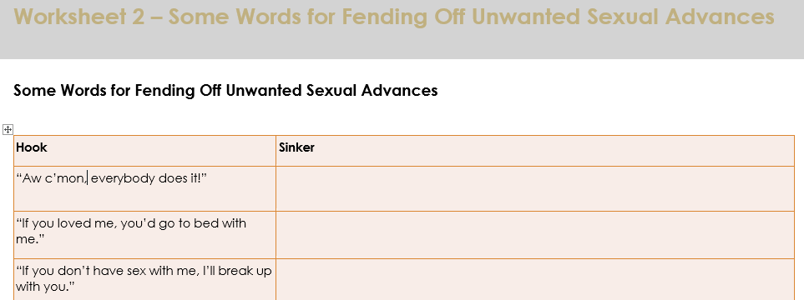
Some Words for Fending Off Unwanted Sexual Advances [5mins]
In pairs, come up with some replies (sinkers) that you use to prevent unwanted sexual advances
Hook | Sinker
“Aw c’mon, everybody does it!”
“If you loved me, you’d go to bed with me.”
“If you don’t have sex with me, I’ll break up with you.”
“Why won’t you have sex with me?”
“We had sex before; why are you turning me down now?”
“Yo, let’s do it. You know you want to!”
“Your parents are out all night; let’s go back to your house.”

Slide 17
Some Words for Fending Off Unwanted Sexual Advances
Hook | Sinker
“Aw c’mon, everybody does it!” | “I don’t care, I’m not everybody. And besides, not everybody ‘does it,’ including some of the kids who say they do.”
“If you loved me, you’d go to bed with me.” | “If you loved me, you wouldn’t pressure me into doing something that I’m not ready to do.”
“If you don’t have sex with me, I’ll break up with you.” | “If being your girlfriend means that I have to sleep with you, then I guess I don’t want to be your girlfriend.”
“Why won’t you have sex with me?” | “Because I don’t want to.” No further explanation needed.
“We had sex before; why are you turning me down now?” | “I’m entitled to change my mind. It’s my body and my life, and I want to wait until I’m older before I have sex again.”
“Yo, let’s do it. You know you want to!” | “No. No. No! What part of ‘no’ don’t you understand?”
“Your parents are out all night; let’s go back to your house.” | Use your ace in the hole: blame your folks. “Go back to my house? We can’t. My parents won’t let me have boys over when they’re not home.”
https://www.healthychildren.org/English/ages-stages/teen/dating-sex/Pages/Helping-Teens-Resist-Sexual-Pressure.aspx

Slide 18
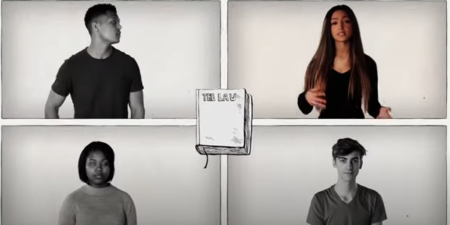
Consent – what is it?
Click on the image to watch the video
Notes:
https://www.youtube.com/watch?v=V5DecVLCJwY

Slide 19
Definition of consent:
“Someone consents to sex only if he or she agrees by choice, and has the freedom and capability to make that choice. Consent to sexual activity may be given to one sort of sexual activity but not to another, or to sex with conditions, such as wearing a condom. Consent can be withdrawn at any time during sexual activity and each time activity occurs.”
Notes:
Teacher Notes
Ask a few students to explain what each clause (section of the sentence) means in their own words.
Explain that sex without consent is rape, even if a couple are in a relationship or married.
Also point out that the legal age of consent in the UK is 16 which means that - by law - someone under the age of 16 cannot give their consent to sex, even if they want to.

Slide 20
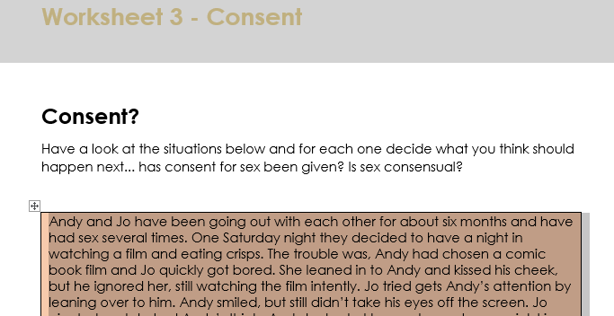
Consent? [5mins]
Working in groups of 3, read through the scenarios.
You should decide whether consent has been given in each case.
Be ready to feedback to the class
Notes:
Teacher Notes
Hand out the Consent Sheets (Worksheet 1) and give your students a few minutes to read through the scenarios.
They should decide whether consent has been given in each case. They can either do this in pairs or small groups. 10mins
When the class has finished reading through the scenarios, spend some time discussing each one, and make sure that they understand that consent is only clear in the scenario starring Andy & Jo.
The fact that Andy says, “Gerroff!” to Jo, even though he is clearly only messing about, could lead to further discussion: people have tried to excuse rape by saying, “No doesn’t really mean no” – that the other person wanted to have sex and was just “playing hard to get”. How would someone tell the difference between “Gerroff” and a real “No”?
Point the class to Lucas and Kim – where “yes doesn’t mean yes” and her body language is a clear indicator of how someone is actually feeling.

Slide 21
Summary Points
Everyone needs to decide when sexual relationship is right for them?
It is important that you should not ever feel under pressure to do anything you are uncomfortable with.
Support is available if you are worried about anything.
Remember its your body and your choice.

Slide 22
Further Support
Speak to a tutor, head of year, school nurse or other trusted member of staff in the school
Contact GP surgery or local sexual health clinic
Thinkuknow - www.thinkuknow.co.uk
NSPCC - www.nspcc.org.uk
Notes:
Teacher Notes – Signposting support (5mins)
Ensure that students know where they can seek help and further advice both now and in the future, in relation to planned/unplanned pregnancy.
Tell the class that if they have any personal problems they would like to talk about, you have a list of useful websites of, and phone numbers for, organisations who offer confidential advice.

