Slide 1
Conflicts in friendship -
Bullying or Banter

Slide 2
Objectives
Know that in school and in wider society everyone should be treated with respect and show respect to others
Explain the difference between joking and banter and respect the boundaries friends and peers may have
Understand the different types of bullying including cyber bullying, the impact it may have and know the responsibility as a bystander or recipient

Slide 4
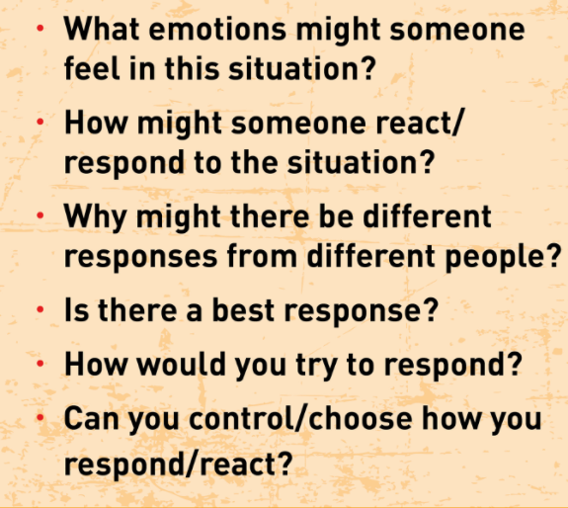
Scenarios

Slide 5
You and your friend are caught doing something wrong. You tell the truth, your friend lies and now your parents want to know what is going on.

Slide 6
Your best friend has found a new friend to hang out with.

Slide 7
You lend a favourite top to a friend and she doesn’t return it for ages. When she does it is dirty.

Slide 8
You and your friend want to go to a club together at lunch but can’t agree on which to go to as they clash.

Slide 9
Your friend likes to come over to your house after school – you appreciate the friendship but you want more freedom

Slide 10
One of your best friends invites you to sleep over, and then five minutes later cancels the arrangement. You later find out that she’s invited someone else.

Slide 11
Your friend ‘jokes’ about things such as your appearance, but you find it hurtful.

Slide 12
Your friend swears sometimes and you don’t or do you like it.

Slide 13
How to resolve….
Effective communication
Effective communication involves two parts: presenting information and active listening. Without both, resolving conflict is impossible, as is maintaining your friendships. Practice these skills:
•Think before speaking. Know exactly what message you want to convey.
•Make sure your friend has your full attention and understands your meaning.
•Stay focused on the matter at hand.
•Be clear and precise.
•Listen to yourself speak.
•Be aware of your body movement, voice inflection, facial expressions and other nonverbal cues.
When listening:
•Pay attention to what your friend is saying and acknowledge your interest and understanding in what your friend is saying.
•Listen for what is behind the words—like feelings and ideas.
•Do not interrupt, get angry or judge.

Slide 14
….
When resolving conflict, keep these additional communication tips in mind:
•Remain calm. Recognize when you are becoming defensive or too emotional.
•Do not blame or accuse each other.
•Focus on the issue at hand, not the way you are feeling toward each other.
•Explore underlying issues.
•Accept that each other’s perspective is different, but not wrong.
•Be willing to apologize and forgive.

Slide 15
Remember
As you grow older your interest and passions change, not only do you develop but so do some of your friends. It is perfectly normal to outgrow some of your friends. Sometimes when this happens when we are on the receiving end of this we feel upset or hurt.
How should we reconcile with this issue?

Slide 16
Banter is…

Slide 17
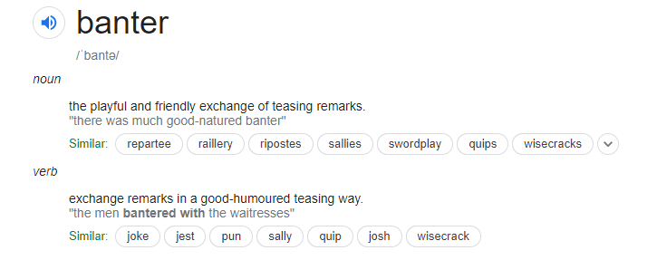
Banter is…

Slide 18
Bullying is…

Slide 19
Bullying is…
There is no legal definition of bullying. It is usually defined as repeated behaviour which is intended to hurt someone either emotionally or physically, and is often aimed at certain people because of their race, religion, gender or sexual orientation or any other aspect such as appearance or disability

Slide 20
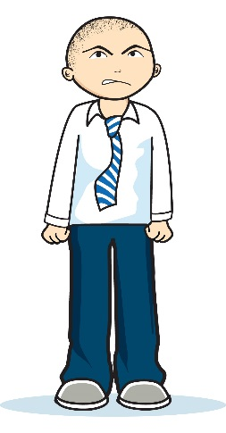
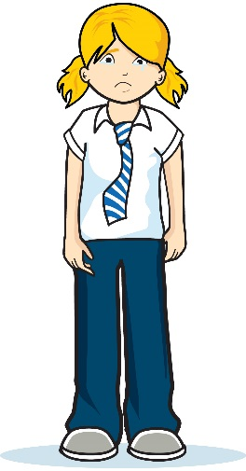
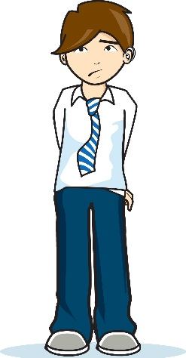
Aw Stephen, you’re such a nerd! I can’t believe you got full marks in that Chemistry test! Is studying your new hobby!?!?

Slide 21
OMG- did you see Jenna at parents evening? With her TWO MUMS!!!!! WEIRD!!!!!

Slide 22
Why was Aine upset after class today?!?! They only called her Ginge! We call you that all the time and you don’t mind. What’s her problem?

Slide 23
That was so funny earlier today. When Andrew’s voice broke in class. I got it on cam- will upload it later!

Slide 24
Did you see what Henryk was eating at lunch today? It looked disgusting. Polish food stinks.

Slide 25
Someone’s made a video of us all limping about around the playground. The same way Sarah walks. It’s so funny!

Slide 26
Why do you never wear make-up? And why is your hair so short? You look like a boy! Lol

Slide 27
Remember
Things to always remember:
Your actions and words have consequences, think about how they might impact someone
Something may not be a big deal to you, but may do to someone else, and that’s okay respect and validate their feelings
We are all entitled to our different opinions and feelings, we need to be careful that they do not impact or affect someone negatively

