Slide 1
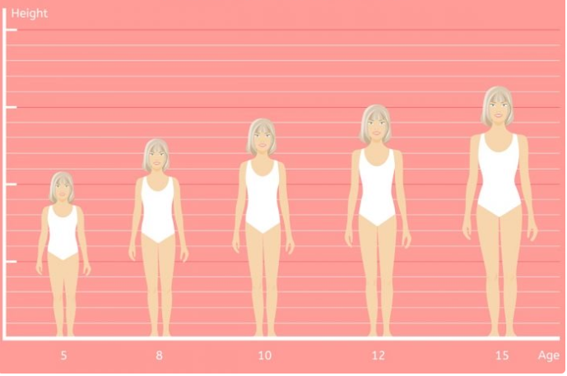
Lesson 4: Puberty and Personal Hygiene?
Year 7 PSHCE - Health

Slide 2
Learning Objective:
To learn

Slide 3

What is ‘puberty’?
Definition:
The process by which a child moves into adulthood caused by chemical messages within the body. The changes make the individual reach sexual maturity so that they are able to reproduce.

Slide 4
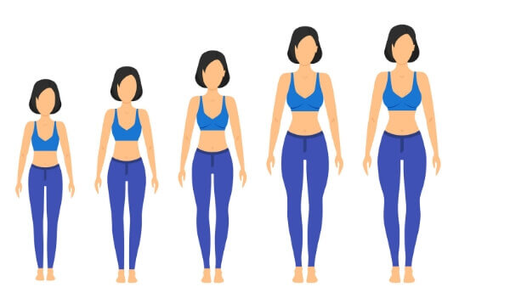
What is ‘puberty’?
Key facts:
Average age of puberty to begin in girls is 11, average for boys is 12. People go through puberty at different ages.
Accelerated growth and change in body shape.
What is ‘normal’? https://www.youtube.com/watch?v=FKHHjIVpuB8

Slide 5
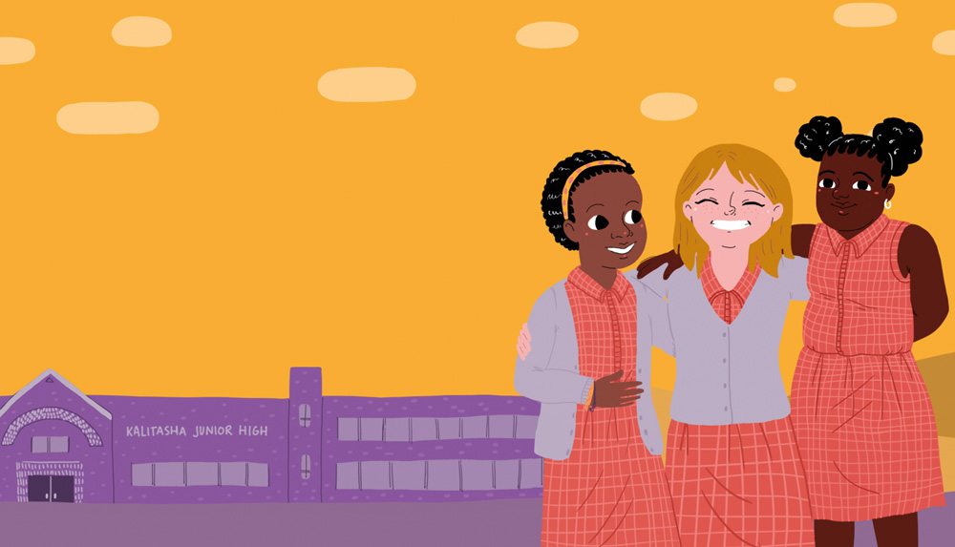
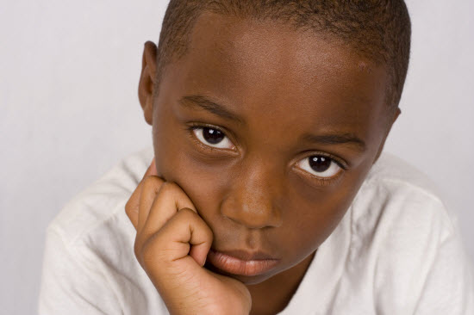
What happens to a young person’s body as they go through puberty?
(Source NHS)
Girls
Can you list TWO or more ways in which a girl’s body changes during puberty?
Boys
Can you list two ways in which a boy’s body changes during puberty? 5 minutes

Slide 6
What happens to a young person’s body as they go through puberty?
(Source NHS)
Girls
Menstruation / ‘Periods’
Growth of pubic hair
Breasts begin to develop
Start to sweat more
Get taller
Acne, oilier skin
Hips, buttocks widen, waist gets smaller
Boys
Enlarging of testicles and penis
Pubic hair growth
More sweating, acne
Voice ‘breaks’ - deeper voice pronounced ‘Adam’s Apple’ in neck
More muscular and increased growth in height

Slide 7
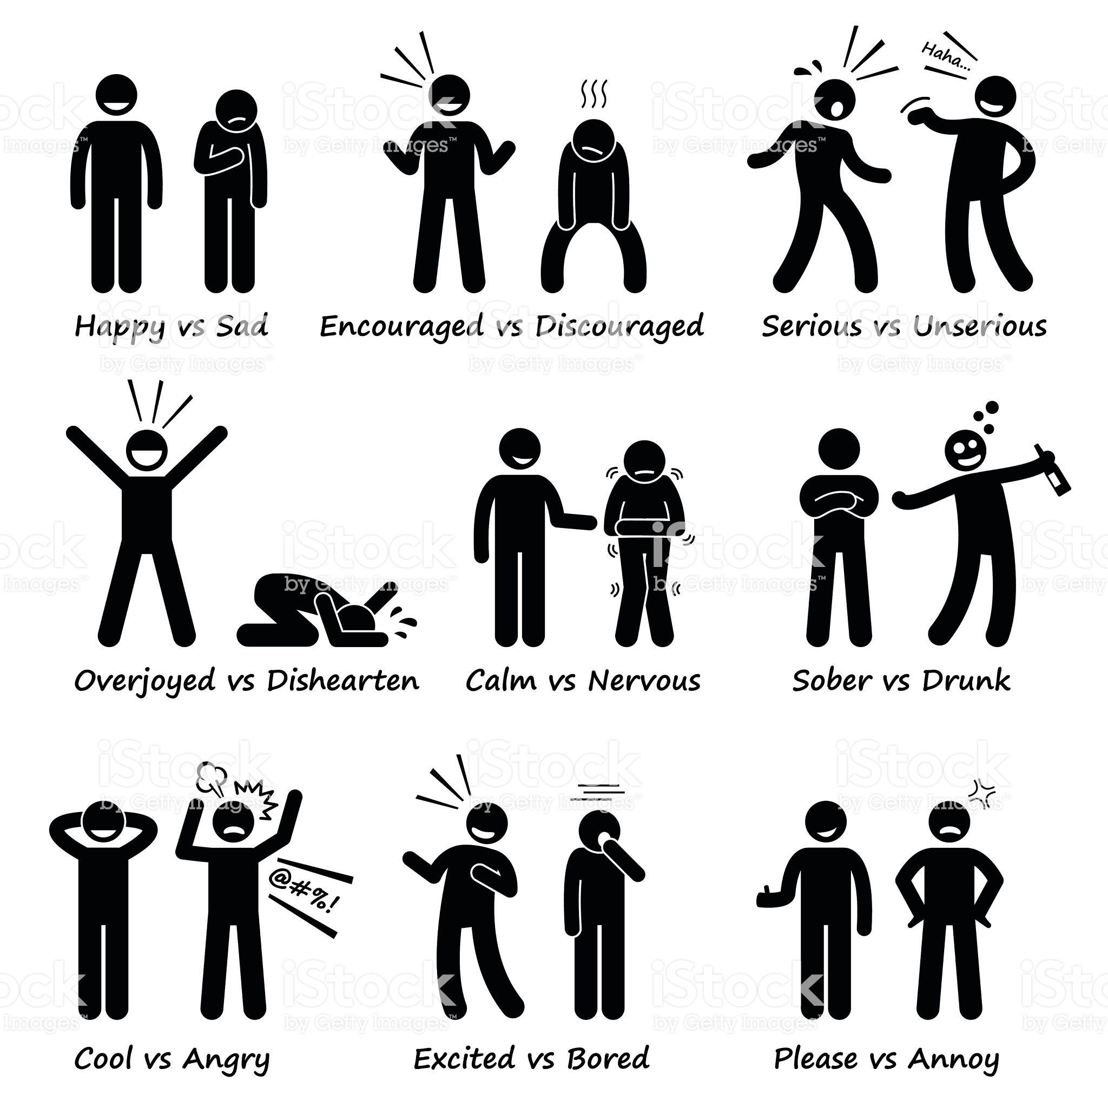
The Brain
…What about changes in the brain?
Can you list TWO ways in which people’s personality sometimes change as a result of puberty?
5 minutes

Slide 8

Some changes in character due to puberty:
Uncontrollable mood swings
Greater self-awareness
Low self-esteem
More aggressive
More frustrated
Depression
These do not effect all people and the intensity of these emotions vary widely.

Slide 9
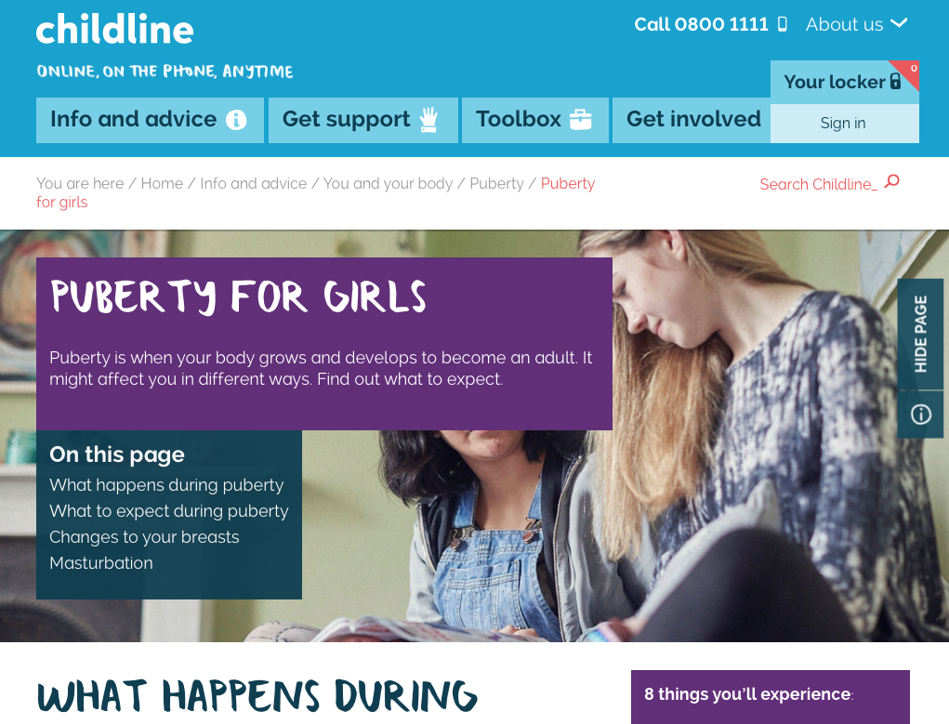
Can I get help if I find ‘puberty’ difficult?
Childline website and phone line
‘4You’ leaflet.
‘Periods: what you need to know’ – Family Planning Association.
NHS website
Kidshealth.org.uk

Slide 10
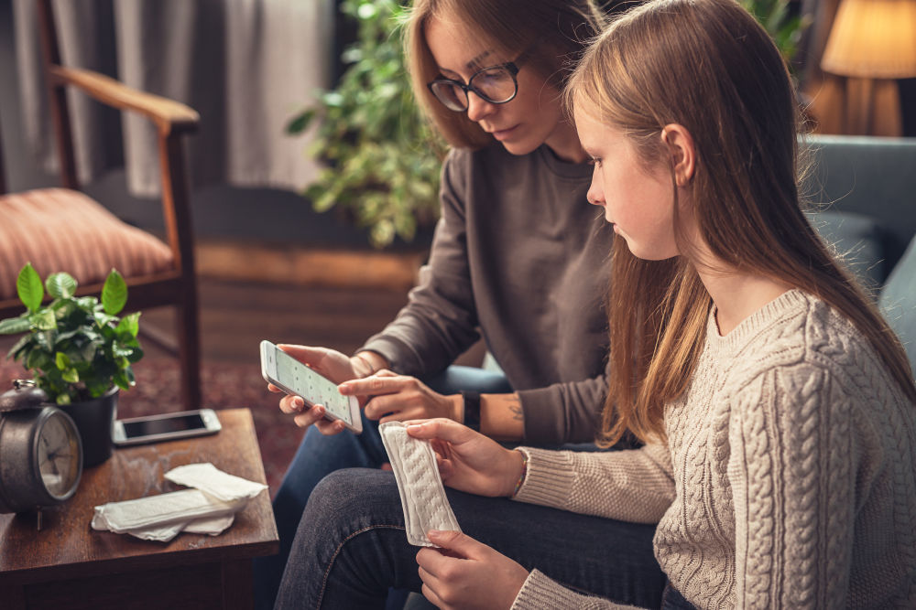
…Why should I NOT worry about puberty?
You’re not alone – everyone goes through it eventually
Exercise can help – research suggests regular exercise helps massively with the emotional side effects of puberty
Athletic advantage – rapidly gaining height, strength can give you a big advantage in individual and team sports
Self-awareness – many people develop greater self-awareness making them develop better relationships with others
Look older – treated with more respect?
Clothes look better?
Family: Important for later in life if you want to start a family.

Slide 11
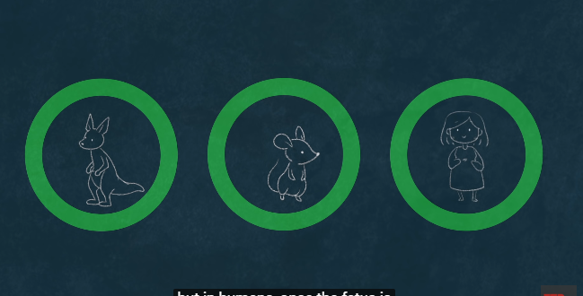
Subheading: Why do women have periods?
https://www.youtube.com/watch?v=cjbgZwgdY7Q
Watch and take notes: 5 minutes
AND: ‘What is Puberty’
https://www.youtube.com/watch?v=j_mFJ2d0qxQ
10 minutes

Slide 12

What is ‘personal hygiene’?
Definition:
Maintaining one’s own bodily cleanliness to prevent the spread of disease and illness

Slide 13

Task
List three ways in which girls should maintain bodily cleanliness…
5 minutes

Slide 14
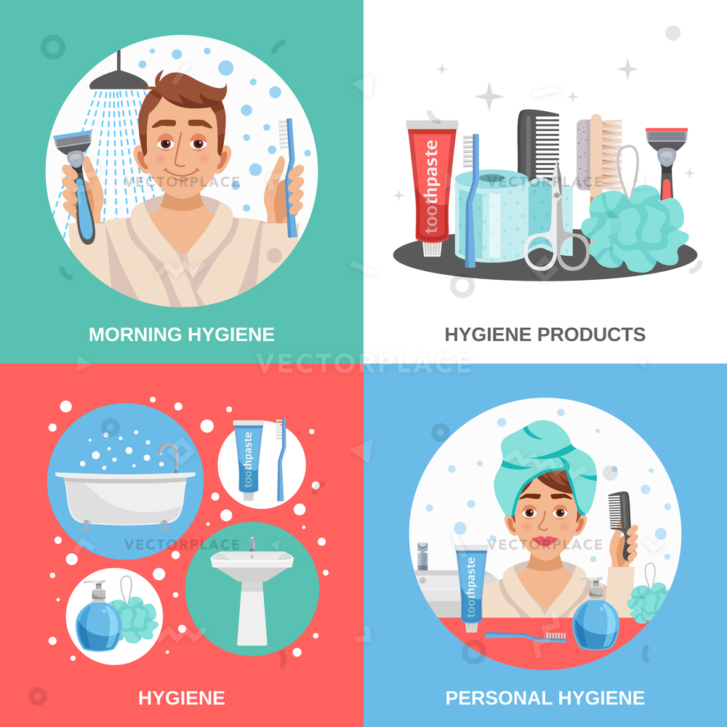
1. Brush teeth/floss
2. Bath/shower
3. Wear antiperspirant
4. Cut nails on hands and feet
5. Wash hair regularly
6. Wash hands after using the toilet/before eating
7. Change tampon regularly (every 4-6 hours) if you are menstruating
8. Wash your clothes
9. Drink plenty of water (fights bad breath and body odour)
10. Safe hair removal (i.e: eyebrows/shaving legs)

Slide 15
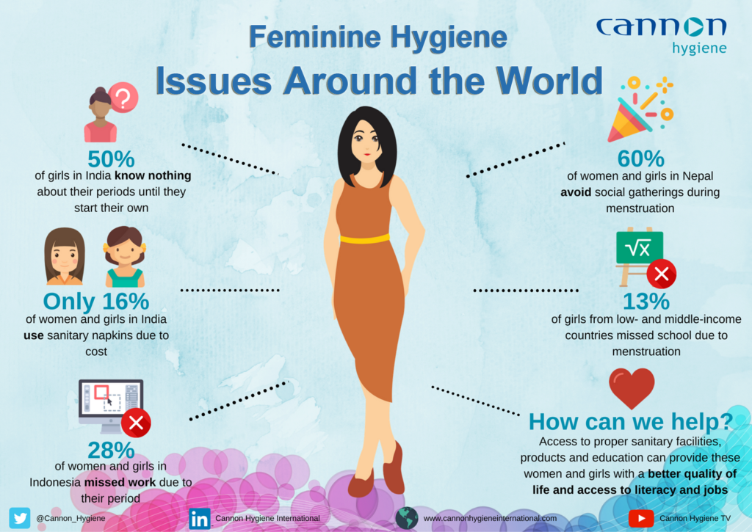
Body Odour & Bad Breath
Watch this video which explains why everyone develops body odour.
https://www.youtube.com/watch?v=g96z1P3z5yU
And this video that explains bad breath: 5 minutes
https://www.youtube.com/watch?v=oZ13QfP2os8
5 minutes
Q. How can you prevent smelling bad?

