Slide 1
Year 7 Curriculum Evening

Slide 2
Aims
To explain the structure of the Curriculum at Woodford and the philosophy that lies behind it.
To explain how we assess your daughter in Year 7.
To explain what that means for assessment, reporting and progress in Year 8 and thereafter.

Slide 3
Curriculum Overview 1
Key Stage 3 (Years 7-9)
~Girls follow the National Curriculum.
~There is no external assessment.
~Girls begin studying for GCSE Mathematics and Science in Year 9.
~Girls are assessed internally by a variety of means, including end of year examinations.
The aim is to give girls a broad and balanced education, with the focus on rich learning.
Assessment supports learning – not the other way around!

Slide 4
Curriculum Overview 2
Key Stage 4 (Years 10-11)
~Girls study for 10 GCSEs.
~English, Mathematics and Triple Science are compulsory, as is a Humanities and Modern Language.
~Girls are assessed externally, although some work may be marked internally before verification by the exam boards.
~The vast majority of marks are awarded through external examinations sat at the end of Year 11.
~We do not enter girls early for any subjects.

Slide 5
Curriculum Overview 3
Key Stage 5 (The Sixth Form - Years 12-13)
~Girls study either 4 A Levels or 3 A Levels plus the Extended Project
~Girls are assessed externally, although some work may be marked internally before verification by the exam boards.
~The vast majority of marks are awarded through external examinations sat at the end of Year 13.
~We do not enter girls early for any subjects.
~We expect virtually all girls to apply to university in Year 13.

Slide 6
The Year 7 Curriculum
Art | French |  | Music
 |  | History |  | Science
Computing |  |  | Personal, Social, Health & Careers Ed
English | Geography | Mathematics | Physical Education
 | German or Latin |  |  | Technology (Design, Electronics, Food)
 |  |  | Religious Studies

Slide 7
Benefits Of The National Curriculum Assessment System
We can determine what is important for students to know and understand within the framework of the National Curriculum.
We can focus on embedding real mastery and understanding.
We will no longer have to use sometimes inconsistent methods to determine NC Levels.
We can focus discussions with girls and their parents on the knowledge, skills and understanding they need to develop to progress.

Slide 8
Our Approach So Far
To develop a system which is appropriate for each subject.
To ensure consistency both within and across subject disciplines.
Using consistent benchmark data which everyone understands.
A system which monitors both progress and raw attainment.
A system which allows parents to understand easily the progress their child is making.

Slide 9
Year 7: Step 1
Girls sat CATs to set a common benchmark.
CATs assess Verbal, Quantitative, Non-Verbal and Spatial skills.
They are a good (but not infallible) measure of academic ability and potential.

Slide 10
Year 7: Step 2
During the autumn term each subject teacher evaluates the accuracy of the CATs score for each girl.
In December their feedback is collated and is used to adjust the CATs baseline prediction.
Separate predictors are set for Art, Music and PE.

Slide 11
Year 7: Step 3
After Christmas you will be informed of our initial baseline judgment.
Teachers continue to assess their students.
Reports home comment on how far girls are making the expected progress based upon their revised baseline score.
Because we are reporting progress girls with the same grade might receive different comments if their baseline scores are very different.
In July the baseline scores are reviewed again.

Slide 12
The Baseline Score
What does it mean?

Slide 13
THE CATs TESTS
QUANTITATIVE – The ability to reason via the use of numbers.
VERBAL – The ability to reason via the use of language.
NON-VERBAL – The ability to reason via the use of images.
SPATIAL - The ability to reason by visualising shapes and patterns and thinking in three dimensions.
Girls receive an age-adjusted score for each, plus a mean score.
A combination of these produces a GCSE prediction.

Slide 14
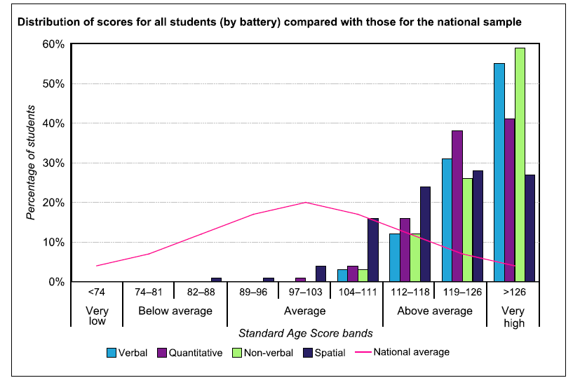
Year 7 CATS Results

Slide 15
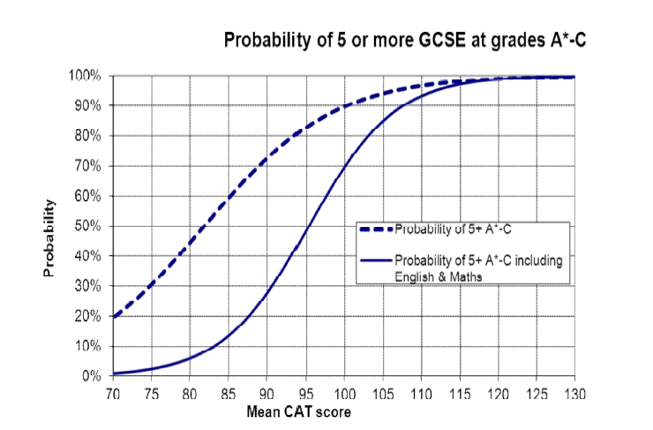
The GCSE Prediction

Slide 16
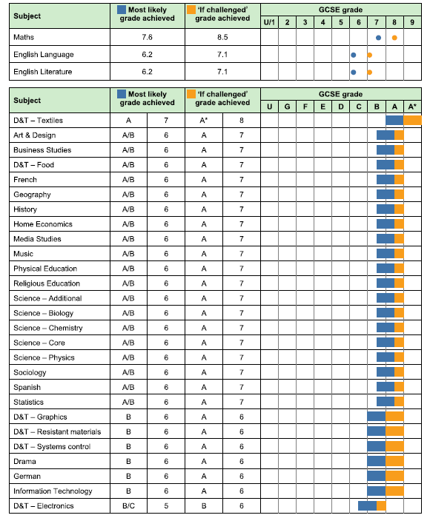
Individual Predictions
For a Pupil scoring 125

Slide 17
The Spread Of Grades
CATS Score | Expected Grade Spread
105 | Mainly grades 5 & 6; some grade 7.
110 | A mixture of grades 7, 6 and 5
115 | Roughly an equal mixture of grades 6 & 7
120 | Mainly grades 6 & 7; some grade 8
125 | Mainly grades 7 & 8; some grade 6
130 | Mainly grades 7-9
135 | Mainly grades 8 & 9

Slide 18
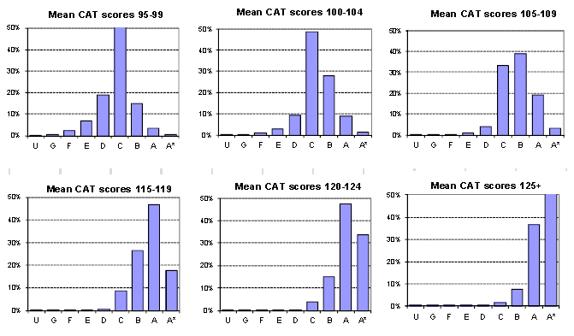
Accuracy of Expected Grades

Slide 19
Please Bear In Mind…
These are statistical predictions, not prophesies.
Motivation and effort have a huge impact on success.
Other factors may affect whether the statistical prediction proves accurate – health, luck, unexpected events, personal circumstances.

Slide 20
Reports: Why Girls With The Same Grade Might Have Different Progress Grades
Name | CAT | Expected Result | Actual Result | Difference | Progress
Belinda | 105 | 65% | 75% | +10 | Exceeding Expectations
Ria | 130 | 75% | 77% | +2 | Meeting Expectations

Slide 21
Year 8 And Beyond
Your daughter will be given a school-adjusted baseline. Not the same as a CATS score.
She may have a different baseline for Art, Music or PE.
Progress will be measured against this baseline during Year 8.
Teacher assessment, feedback and reporting will take this into account.
Its accuracy will be reassessed at the end of Year 8 and further adjustments made.

Slide 22
Starting GCSEs
We will set target grades at the start of Year 10 using this data and FFT.
It will also play a part (along with internal assessment data) in setting in Science and Mathematics.
It will not be used to determine GCSE entry decisions such as tiering. This is based on performance during Years 10 and 11.
It is expected that all girls will be entered for 10 GCSEs.

Slide 23
Your Daughter’s Baseline
You will receive notification of this in January.
It will look like this:
NAME: Imaginary Person
Based on our assessment of your daughter’s academic achievement during the autumn term of Year 7 we would expect her to achieve mainly grades XYZ at GCSE.

