Slide 1
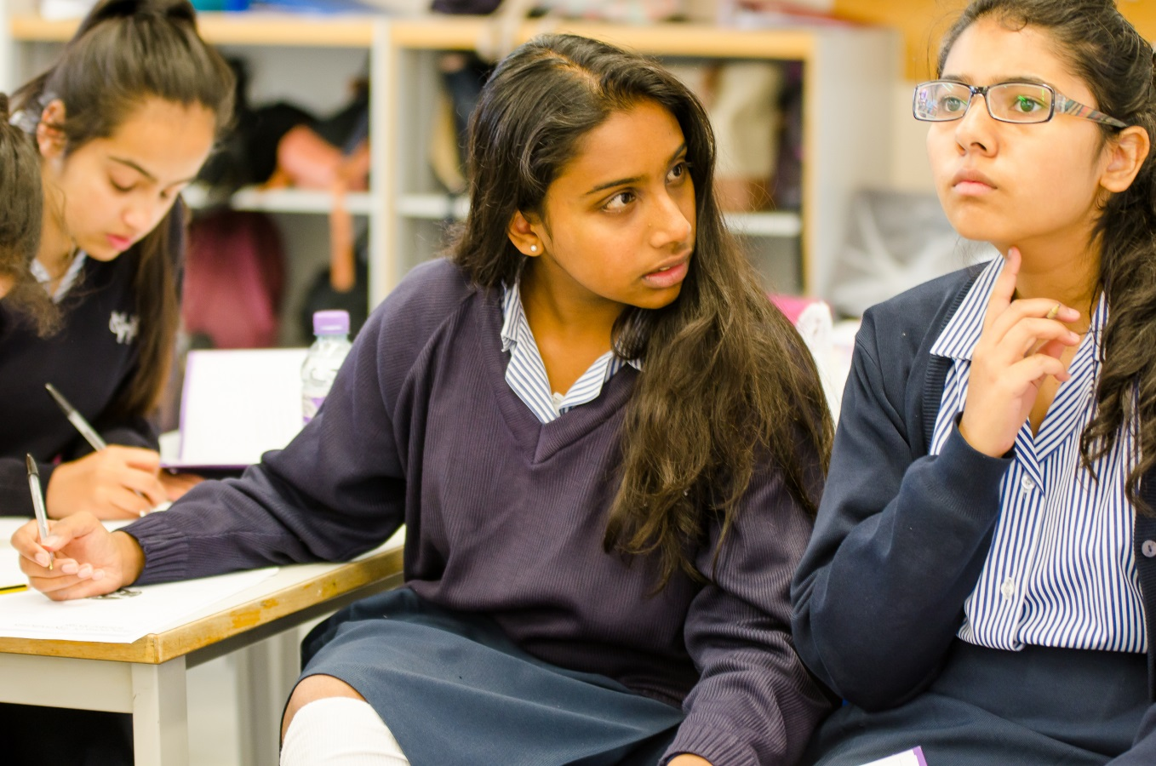
Decision Time is approaching!

Slide 2
OUTLINE OF PROCESS
DATE EVENT
Thu 19 Dec Options Talk In PSHCE
20-24 Jan Review Week
Mon 10 Feb Option Talk To Parents
Wed 12 Feb Parents’ Evening
Thu 13 Feb Options form goes live
Fri 21 Feb Options form submitted

Slide 3
ENGLISH BACCALAUREATE
(The Department for Education)
Students attaining GCSE grades 9 to 5 in a specified group of subjects will be awarded the English Baccalaureate Certificate.
The specified subjects are as follows:
English
Mathematics
A language (classical or modern)
Sciences (at least 2)
A humanity (either History or Geography)

Slide 4
THE CORE
All students will study the following subjects to GCSE:
ENGLISH (LANGUAGE & LITERATURE)
MATHEMATICS
SCIENCE (TRIPLE)
A LANGUAGE (FRENCH, GERMAN OR LATIN)
A HUMANITY (GEOGRAPHY OR HISTORY)
8 GCSE SUBJECTS IN THE CORE
PLUS CORE P.E. AND CORE R.S.

Slide 5
TWO FURTHER OPTION SUBJECTS to be chosen from:
Art | German
Classical Civilisation | History
Computing | Latin
Design Technology* | Music
Food Prep & Nutrition* | Physical Education
French | Religious Studies
Geography
*Girls cannot choose both of these subjects.

Slide 6
GCSE OPTIONS INFORMATION
Information on website.
Introduction giving general guidance
Subject Pages giving more detailed information on the subject and the GCSE course.
https://www.woodford.redbridge.sch.uk/page/?title=GCSE+Courses&pid=314
Year 9 Options form will be sent via a Notice on SatchelOne (Show My Homework).

Slide 7
HOW TO CHOOSE
Language Section: Choose French OR German OR Latin
Humanities Section: Choose Geography OR History
Other Options Section: Rank the top four choices – 1 for top choice, 2 for second most preferred etc.
We will do our best to ensure ALL Girls get their top choice.
The vast majority should get their second.
In the event of an impasse the final decision will be reached by lot.

Slide 8
EXAMPLE OF OPTION BLOCKS
Constructed AFTER the option form is filled in.
Here is an example of what it could look like:
OPTION BLOCK 1 | OPTION BLOCK 2 | OPTION BLOCK 3 | OPTION BLOCK 4
ART | CLASSICAL CIV | ART | CLASSICAL CIV
DESIGN TECH | COMPUTER SCI | CLASSICAL CIV | COMPUTER SCI
FOOD & NUTR | FRENCH | DESIGN TECH | GEOGRAPHY
FRENCH | GEOGRAPHY | FOOD | GERMAN
GEOGRAPHY | HISTORY | GEOGRAPHY | HISTORY
HISTORY | LATIN | GERMAN | GEOGRAPHY
LATIN | RELIGIOUS ST | HISTORY | LATIN
RELIGIOUS ST |  | MUSIC | PHYSICAL ED

Slide 9
MAKING THE DECISION
Good Criteria
What am I good at?
What do I enjoy?
What do I need?
Poor Criteria
Do I like the teacher?
Are my friends doing it?
Does somebody else think it’s a good idea?
What To Do
Read the information on the website.
Girls should talk to their subject teachers and form tutor.
Discuss it as a family.
Ask other experts on the staff – eg Ms Hasler, Mr Mills, myself…

Slide 10
DEADLINE FOR SUBMISSION OF OPTION CHOICES IS FRIDAY 21st FEBRUARY 2025

Slide 11
ANY QUESTIONS?

